Slide 1
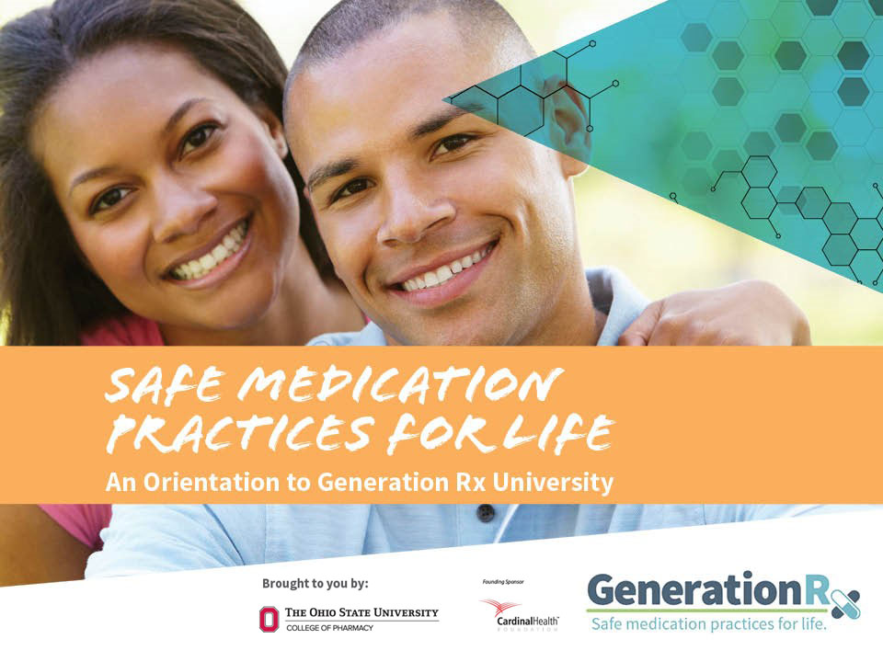

Presenter Name
Presenter Organization
An Orientation to Generation Rx University
Notes:
Presentation Talking Points
Welcome to today’s program: “Safe Medication Practices for Life: An Orientation to Generation Rx University”.
This is a resource from “Generation Rx University”—an initiative which encourages your members to incorporate the Generation Rx key messages into their individual, everyday lives. This presentation provides an overview of Generation Rx University messages designed to educate all college students toward “safe medication practices for life.” We will focus on specific issues relating to opioid, stimulant, and sedative medications, and review some key general guidelines for safe medication-taking practices.

Slide 2
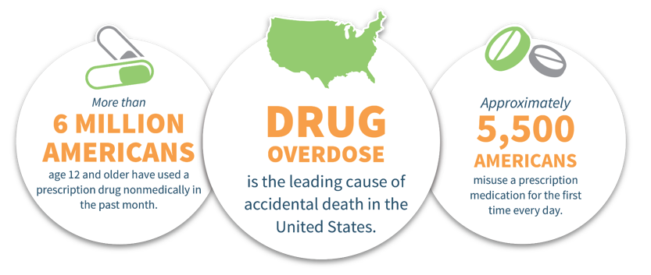

Prescription drug misuse is a national epidemic
^{©2020} ^{The Ohio State University}
Notes:
Presentation Talking Points
Prescription drug misuse is a national epidemic. Prescriptions medications can help us live longer and healthier lives when used as directed by a health professional, but there are real risks associated with misusing medication.
More than 6 million Americans age 12 and older have used a prescription drug nonmedically (i.e., they’ve misused this product) in the past month¹.
More than 5,500 Americans misuse a prescription medication for the first time every day¹.
Any medication can produce adverse health effects, and drug overdose is now our leading cause of accidental death.
Among all age groups, the most commonly misused prescription drugs are opioid pain medications (e.g., Vicodin®, OxyContin®), prescription stimulants (e.g., Adderall®, Ritalin®), and prescription sedatives (e.g., Xanax®, Valium®).

Slide 3
Misusing medication is:
Taking more than prescribed
Taking medication for a reason different than prescribed
Sharing or taking someone else’s medication
Regardless of intentions…
^{©2020} ^{The Ohio State University}
Notes:
Presentation Talking Points
What is meant by “prescription drug misuse”? We define misuse as engaging in primarily three behaviors.
Taking more of a prescription medication than prescribed.
Taking a prescription medication for a reason (or in a way) different than that intended by the prescriber.
Sharing or taking someone else’s prescription medication.
And regardless of our intentions, engaging in any of these behaviors is misuse.

Slide 4

What do you think?
Does the national epidemic of prescription drug misuse impact college students or possibly peers in your social group?
Yes…
OR
No…
^{©2020} ^{The Ohio State University}
Notes:
Presentation Talking Points
What do you think? Does the national epidemic of prescription drug misuse impact you or peers in your social group? Meaning, the previous slide reported national data that consisted of all Americans ages 12 and older. So, does this national epidemic actually involve college students or possibly peers in your social group?
The 2018 College Prescription Drug Study reported that most college students do not misuse medication (i.e. 77% of college students have never misused medication in their lifetime)⁵.
As we move throughout the program, we’ll discuss how the misuse of medication does present various risks and harms that we should be aware of; and, we will also discuss approaches for how you can help protect your friends and peers from engaging in this risky behavior.
Note to Presenters
Encourage participants to think about this question, then discuss the talking points above:
In-person: encourage participants to discuss this question with their nearby peers and then briefly share their ideas with the group.
Virtual: if available, participants could use the “thumbs up/thumbs down” icon, a polling question, or the chat thread to indicate their thoughts.

Slide 5

Let’s consider important issues relating to…
Module 1: Prescription Opioids
Module 2: Prescription Stimulants
Module 3: Prescription Sedatives
Module 4: Safe Medication Practices
Each module consists of watching a short video and engaging in a brief discussion
^{©2020} ^{The Ohio State University}
Notes:
Presentation Talking Points
This program consists of four modules total - each module consists of watching a short video, reviewing a few additional slides relating to the topic, and engaging in a brief discussion around some thought-provoking questions. Module topics include the misuse of prescription opioid pain relievers, prescription stimulants, and prescription sedatives, as well as consideration of a few general safe medication practices.
Note to Presenters
If you are not presenting all four modules in a single session, consider sharing with your audience the specific modules they will be working through in your program.

Slide 6

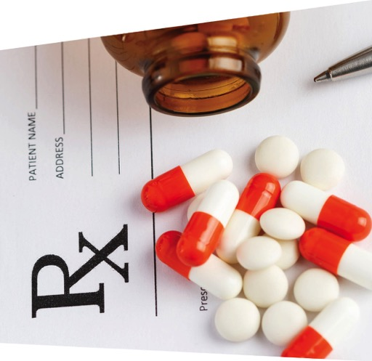
Module 1:
Prescription
Opioids
^{©2020} ^{The Ohio State University}
Notes:
Presentation Talking Points
We have an opioid epidemic in America - the misuse of opioid pain medications (e.g., OxyContin®, Vicodin®, Percocet®) has increased, along with the use of illegal drugs like heroin and illicitly manufactured fentanyl.
As we think about college students specifically, the 2018 College Prescription Drug Study reported around 9% of college students had misused a prescription opioid in their lifetime⁵.
While most students report having never misused a prescription opioid medication, many are impacted by the opioid epidemic. Thus, understanding the risks associated with prescription opioid misuse and knowing how to help others is important. Let’s discuss these topics further in Module 1.

Slide 7

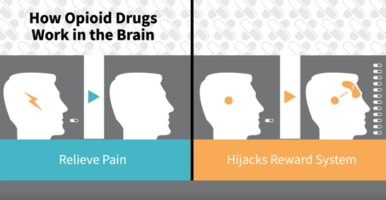
Video:
The Impact of Misusing Prescription Opioids
^{©2020} ^{The Ohio State University}
Notes:
Presentation Talking Points
Let’s begin by watching a short video that addresses risks inherent to the misuse of prescription opioids.
Note to Presenters
The video is posted online at: https://generationrx.org/toolkits/university/. When you are ready to play the video, minimize this presentation. Once the video is complete, resume the presentation.

Slide 8

Module 1:
Discuss in small groups:
Am I putting myself at risk if I take prescription opioids and drink alcohol at the same time?
Is a transition to using heroin common for those who misuse prescription opioids?
What other problems may arise from misusing prescription opioids?
^{©2020} ^{The Ohio State University}
Notes:
Presentation Talking Points
Let’s engage in a brief discussion about some of the points addressed in this video. Here are three discussion questions – based on the video and your own understanding of this issue, try developing a response to these questions.

Slide 9
Module 1:
Discuss in small groups:
Am I putting myself at risk if I take prescription opioids and drink alcohol at the same time?
^{©2020} ^{The Ohio State University}
Notes:
Note to Presenters
You can utilize this slide as a placeholder for 1-2 group leaders to share a summary of their small group conversation. Advance the slide to provide additional content and talking points that can help reinforce or elaborate upon the ideas shared.

Slide 10
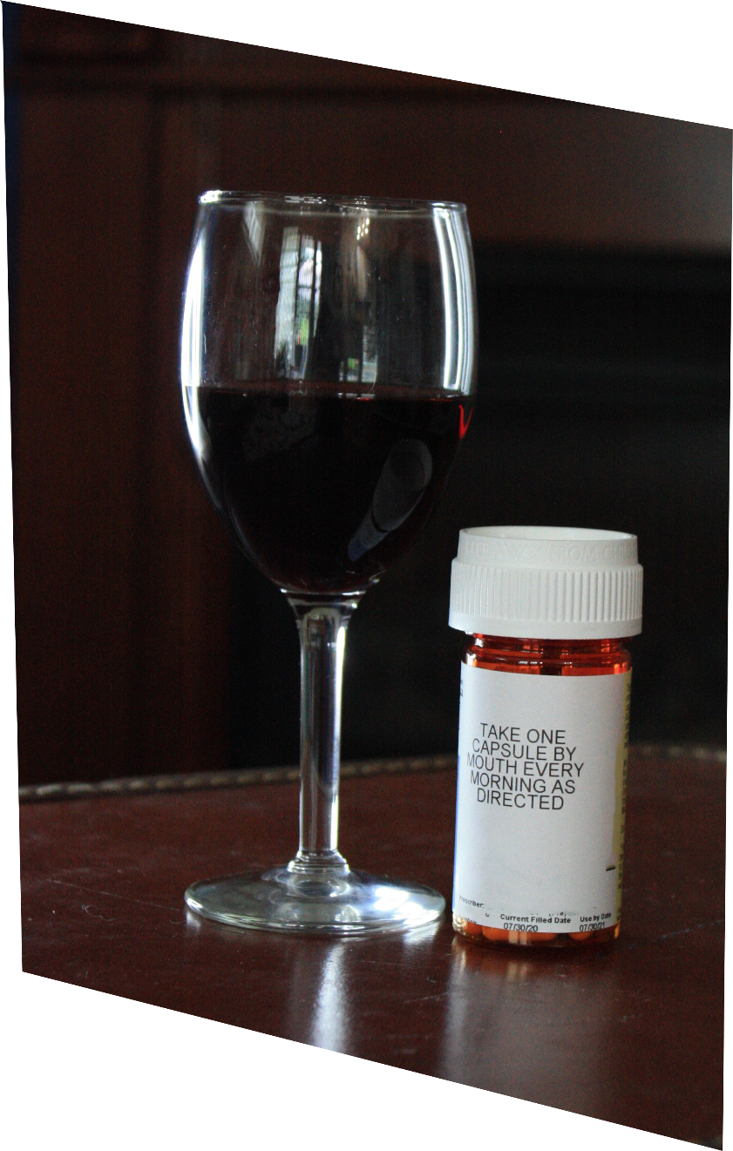
Mixing Rx opioids with alcohol or with Rx sedatives can cause dangerously slow breathing
^{©2020} ^{The Ohio State University}
Notes:
Presentation Talking Points
All medications have side effects—and mixing alcohol with prescription drugs can sometimes enhance these negative effects.
For example, adverse side effects for prescription opioid pain medications include drowsiness, confusion, sedation, and slowed breathing. Drinking alcohol at the same time can actually worsen these potentially harmful effects.
In fact, many drug overdoses result from mixing prescription opioids with alcohol, prescription sedatives, or other drugs – which results in dangerously slow breathing and can cause death.

Slide 11
Module 1:
Discuss in small groups:
Am I putting myself at risk if I take prescription opioids and drink alcohol at the same time?
Is a transition to using heroin common for those who misuse prescription opioids?
^{©2020} ^{The Ohio State University}
Notes:
Note to Presenters
You can utilize this slide as a placeholder for 1-2 group leaders to share a summary of their small group conversation. Advance the slide to provide additional content and talking points that can help reinforce or elaborate upon the ideas shared.

Slide 12
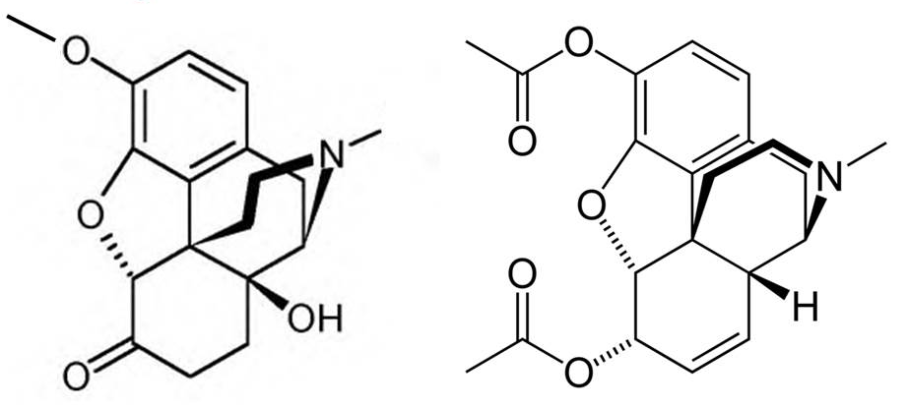
Some individuals who misuse prescription opioids may transition to using heroin…
Drugs with similar chemistry may produce similar effects in the body…
Oxycodone
Heroin
^{©2020} ^{The Ohio State University}
Notes:
Presentation Talking Points
Some individuals who misuse prescription opioids may transition to using heroin.
Recall from the video that because prescription opioids and heroin share similar chemistry, they can also produce similar effects in the body. Because these effects are nearly identical, individuals who misuse and become dependent upon prescription opioids sometimes transition to using heroin in order to experience the same (or stronger) effect. In many cases, heroin may also be easier (and cheaper) to obtain. In fact, there has been a substantial increase in the use of heroin, with approximately 75% of users reporting misusing prescription opioids first².
Your brain doesn’t care if society labels a drug as an illicit street drug or a prescription drug. If the two drugs share similar chemistry, they may produce similar effects in the body, including increased risk for drug dependence and addiction. This relationship between prescription opioids and heroin is certainly troubling and serves as another reason to avoid misusing prescription opioids.

Slide 13
Module 1:
Discuss in small groups:
Am I putting myself at risk if I take prescription opioids and drink alcohol at the same time?
Is a transition to using heroin common for those who misuse prescription opioids?
What other problems may arise from misusing prescription opioids?
^{©2020} ^{The Ohio State University}
Notes:
Note to Presenters
You can utilize this slide as a placeholder for 1-2 group leaders to share a summary of their small group conversation. Advance the slide to provide additional content and talking points that can help reinforce or elaborate upon the ideas shared.

Slide 14
drug rehab
expulsion from school
drug overdose
legal fines
drowsiness
addiction
shallow breathing
felony offense
nausea
decline in grades
confusion
jail
dependency
damaged relationships with family members or friends
loss of job
Emergency department visits
^{©2020} ^{The Ohio State University}
Notes:
Presentation Talking Points
Those who misuse prescription opioids sometimes spiral into drug dependency or addiction and experience the harmful health, legal and social consequences that can follow.
Health-related consequences: as noted in the video, the most tragic consequences of prescription drug misuse affect our health -- including drug overdose, which is the leading cause of accidental death in the U.S. Emergency department visits and drug addiction treatment admissions relating to medication misuse have also escalated.
Legal consequences: federal law prohibits the possession of the types of medications which are most often misused without a prescription.
Social consequences: the misuse of medications can affect our community members, peers, family, friends, job, education, finances, and much more.
Note to Presenters
If participants have already identified these problems, consider simply summarizing the problems noted in the word cloud.

Slide 15
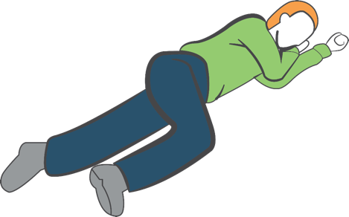
Take action in a drug overdose situation:
Call 9-1-1
If available, administer naloxone
Move individual to recovery position
Stay with the person until help arrives
Hand
supports
head
Knee stops
body from
rolling onto
stomach
^{©2020} ^{The Ohio State University}
Notes:
Presentation Talking Points
If you suspect someone has overdosed on any drug or alcohol, how can you take action?
First, call 9-1-1.
Second, if available, administer naloxone. More information on naloxone will be provided in the next slide.
Third, move the individual to the recovery position (place the individual on their left side—with their arms under their head, bending their right leg to prevent them from rolling onto their stomach). This position is designed to prevent suffocation if the individual vomits.
Lastly, stay with the individual until help arrives.

Slide 16
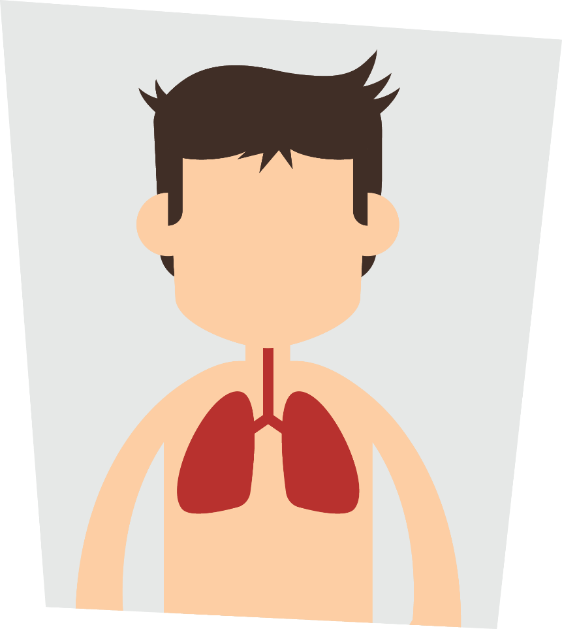
Naloxone reverses opioid drug overdoses
Delivery as an intranasal spray increasingly common
Naloxone access varies from state to state
Naloxone training sessions provide important information
^{©2020} ^{The Ohio State University}
Notes:
Presentation Talking Points
An overdose occurs when too much of any opioid activates its target in the brainstem – this slows and then stops breathing. Naloxone knocks the opioid drug off this target – allowing breathing to resume. Naloxone wears off in 30-90 min; thus, calling 911 first ensures the person receives help before this happens.
Naloxone is available in various forms – the form packaged as a nasal spray (brand name Narcan®) is increasingly common.
You can get naloxone without a prescription, but accessing naloxone by the general public varies from state to state. Ask a local pharmacy about your state laws.
Participate in a naloxone training session if you do decide to carry it on your person. A training session will reinforce how to take action in an overdose situation, discuss how to administer naloxone, and explain important precautions regarding its use. Different campus units or a local community harm reduction organizations often offer free training sessions.
If you are interested in equipping a publicly accessible site with naloxone, work with your local campus community to ensure you are following proper guidelines and protocols.

Slide 17


Module 2:
Prescription
Stimulants
^{©2020} ^{The Ohio State University}
Notes:
Presentation Talking Points
We’ve discussed the impact of misusing prescription opioids. Now, let’s switch our attention to prescription stimulant misuse.
Across the three prescription drug classes most commonly misused, the 2018 College Prescription Drug Study reported the highest percentages of lifetime misuse for prescription stimulants⁵.
Let’s explore how misusing prescription stimulants may impact you and others.

Slide 18
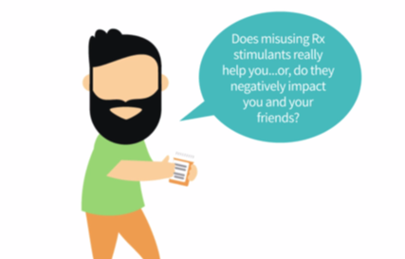
Video:
The Impact of Misusing Prescription Stimulants
^{©2020} ^{The Ohio State University}
Notes:
Presentation Talking Points
Let’s watch a video that addresses risks inherent to the misuse of prescription stimulants. Then, we’ll engage in a brief discussion.
Note to Presenters
The video is posted online at: https://generationrx.org/toolkits/university/. When you are ready to play the video, minimize this presentation. Once the video is complete, resume this presentation.

Slide 19

Module 2:
Discuss in small groups:
Can the misuse of prescription stimulants improve your grades?
When you ask a friend or peer for their medication, how do you think this request makes them feel?
Is mixing alcohol with prescription stimulants a big deal?
^{©2020} ^{The Ohio State University}
Notes:
Presentation Talking Points
Let’s engage in a brief discussion about some of the points addressed in this video. Here are three discussion questions – based on the video and your own understanding of this issue, try developing a response to these questions.

Slide 20
Module 2:
Discuss in small groups:
Can the misuse of prescription stimulants improve your grades?
^{©2020} ^{The Ohio State University}
Notes:
Note to Presenters
You can utilize this slide as a placeholder for 1-2 group leaders to share a summary of their small group conversation. Advance the slide to provide additional content and talking points that can help reinforce or elaborate upon the ideas shared.

Slide 21
Students who misuse prescription stimulants typically have lower grade-point averages, and they…
Have fewer academic achievements
Commit an illegal act that places several people at risk
Violate codes of student conduct
Jeopardize scholarships, internships, and membership standing
^{©2020} ^{The Ohio State University}
Notes:
Presentation Talking Points
Research shows that students who misuse prescription stimulants typically have lower grade-point averages⁴.
Health professionals, administrators, friends, and parents should view this behavior as concerning, as it may indicate that the student is struggling academically, experiencing a mental health condition, or using other legal or illegal drugs⁴.
As the video identified, when we ask another individual for their stimulant medication, we are asking them to commit an illegal act that also places them at risk. This risk includes legal concerns and personal liability for any harm that might come from medications that they provide to others.
Depending on individual state laws, possession of a controlled substance (e.g., Adderall®, Ritalin®) without a prescription may result in a felony charge, with penalties which could include fines and/or imprisonment. How would a drug-related offense impact your future?
If we break a law, we also violate most codes of student conduct.
In addition to violating codes of student conduct, a felony offense appearing on your record could interfere with employment and educational opportunities, such as scholarships, graduate education, summer internships, or employment following graduation. It may also jeopardize your membership standing within your student organizations/clubs.

Slide 22
Module 2:
Discuss in small groups:
Can the misuse of prescription stimulants improve your grades?
When you ask a friend or peer for their medication, how do you think this request makes them feel?
^{©2020} ^{The Ohio State University}
Notes:
Note to Presenters
You can utilize this slide as a placeholder for 1-2 group leaders to share a summary of their small group conversation. Advance the slide to provide additional content and talking points that can help reinforce or elaborate upon the ideas shared.

Slide 23

When we ask someone to share their medication, they may perceive it as you…
Putting me at risk for getting in trouble…
Using our friendship to obtain drugs…
Disrespecting my health needs…
^{©2020} ^{The Ohio State University}
Notes:
Presentation Talking Points
If you ask someone to sell or share their medication, have you ever considered how that friend may perceive your request?
By asking a friend, member, or stranger for some of their medication, we put them in an incredibly vulnerable and uncomfortable position. For example, they often perceive that request as you:
Using your friendship to obtain drugs. Your friend may begin questioning whether your friendship is solely based on you gaining access to their medication.
Disrespecting their health needs. Your friend has a legitimate need for their medication. If they give it to others, they may not be able to take their medication as instructed, and their health could jeopardized.
Putting them at risk for getting in trouble. Even if your friend simply gives (versus sells) you the medication, sharing medication is always illegal. Think about it—would a real friend ask someone to risk their future so that they could misuse a medication?
Be a good friend—if you feel that you need medication for a legitimate reason, talk with your healthcare provider.

Slide 24
Module 2:
Discuss in small groups:
Can the misuse of prescription stimulants improve your grades?
When you ask a friend or peer for their medication, how do you think this request makes them feel?
Is mixing alcohol with prescription stimulants a big deal?
^{©2020} ^{The Ohio State University}
Notes:
Note to Presenters
You can utilize this slide as a placeholder for 1-2 group leaders to share a summary of their small group conversation. Advance the slide to provide additional content and talking points that can help reinforce or elaborate upon the ideas shared.

Slide 25
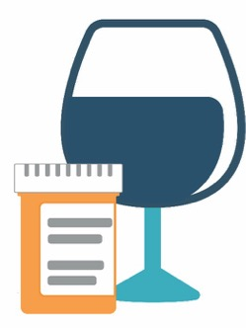
Mixing alcohol and prescription stimulants sends the body mixed messages…
Decreases heart rate
Increases heart rate
Slows messages between body and brain…
Triggers “fight or flight” response…
…and increases your risk for dangerous levels of intoxication
^{©2020} ^{The Ohio State University}
Notes:
Presentation Talking Points
Mixing alcohol with prescription stimulants is a big deal, because it sends the body mixed messages and increases your risk for dangerous levels of intoxication.
The orange text bubbles highlight effects produced by prescription stimulants; the blue text bubbles highlight effects produced by alcohol. Some individuals incorrectly perceive that these mixed messages cancel each other out. However, because alcohol and stimulants produce these effects through different mechanisms, these mixed messages don’t cancel each other out. Rather, the body is receiving all of these messages simultaneously. Thus, these mixed messages simply confuse the body and place it at risk for dangerous consequences.
Note that alcohol reduces heart rate, whereas stimulants increase heart rate. These mixed messages may cause an irregular heart beat.
In addition, alcohol slows messages between the body and brain, yet prescription stimulants activate part of the nervous system to trigger the fight or flight response. These mixed messages confuse the body and increase the risk for dangerous levels of alcohol intoxication, as well as other potential harms resulting from risky drinking.

Slide 26

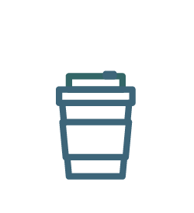
Caffeine can also interact with prescription stimulants
^{©2020} ^{The Ohio State University}
Notes:
Presentation Talking Points
Lastly, drug interactions can also exist with prescription stimulants and caffeine. In this situation, their shared adverse effects intensify when taken together. We recognize that caffeine consumption through beverages (like coffee) is likely an everyday part of many college student and adult lives. Therefore, if you are prescribed a prescription stimulant and consume caffeine, monitor yourself for adverse effects like increased heart rate, blood pressure, and anxiety, as well as insomnia. In addition, risk for these adverse effects are elevated in situations where one misuses prescription stimulants; and, mixing can be especially harmful for those with a pre-existing heart condition or those with anxiety disorders.

Slide 27


Module 3:
Prescription Sedatives
^{©2020} ^{The Ohio State University}
Notes:
Presentation Talking Points
We’ve discussed the impact of misusing prescription opioids and stimulants. Now, let’s switch our attention to prescription sedative misuse. As prescribing rates for prescription sedatives rise, it is important to understand practices for safe use as well as the misuse risks associated with this drug class.
The 2018 College Prescription Drug Study reported around 9% of college students had misused a prescription sedative in their lifetime⁵.
Let’s explore how misusing prescription sedatives may impact you and others.

Slide 28
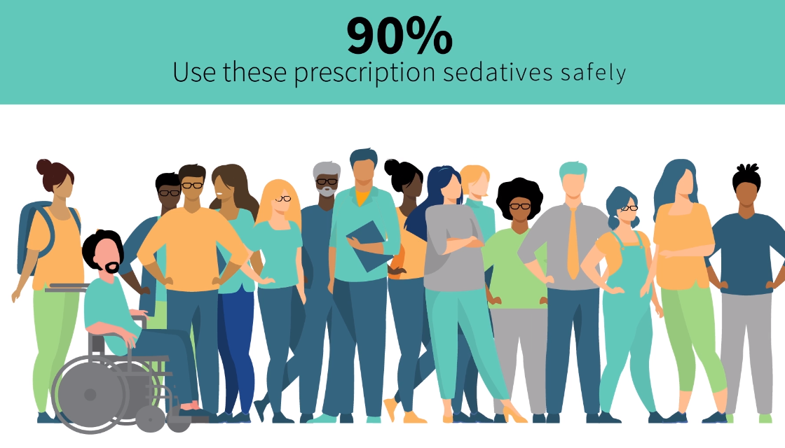
Video:
Prescription Sedatives
^{©2020} ^{The Ohio State University}
Notes:
Presentation Talking Points
Let’s watch a video that discusses the misuse of prescription sedatives. Then, we’ll engage in a brief discussion.
Note to Presenters
The video is posted online at: https://generationrx.org/toolkits/university/. When you are ready to play the video, minimize this presentation. Once the video is complete, resume this presentation.

Slide 29

Module 3:
Discuss in small groups:
Some students misuse prescription sedatives for social purposes (think pregaming, partying, etc.). What is concerning with this behavior?
How may self-medicating with prescription sedatives impact you both now and long-term?
What are some sustainable methods to manage stress that support your well-being?
^{©2020} ^{The Ohio State University}
Notes:
Presentation Talking Points
Let’s engage in a brief discussion about some of the points addressed in this video. Here are three discussion questions – based on the video and your own understanding of this issue, try developing a response to these questions.

Slide 30
Module 3:
Discuss in small groups:
Some students misuse prescription sedatives for social purposes (think pregaming, partying, etc.). What is concerning with this behavior?
^{©2020} ^{The Ohio State University}
Notes:
Note to Presenters
You can utilize this slide as a placeholder for 1-2 group leaders to share a summary of their small group conversation. Advance the slide to provide additional content and talking points that can help reinforce or elaborate upon the ideas shared.

Slide 31
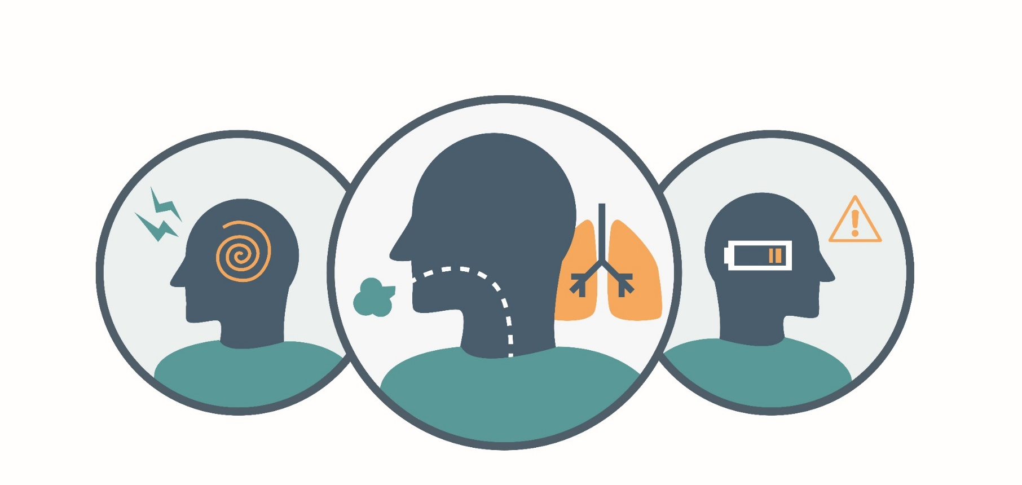
Mixing alcohol with prescription sedatives intensifies their harmful adverse effects
Notes:
Presentation Talking Points
Pregaming or partying with prescription sedatives, including in situations where the medication is mixed with alcohol, is dangerous. Even when taken as instructed, prescription sedatives can slow breathing and cause sedation. Alcohol works in the body through a similar mechanism – it also acts to inhibit central nervous system function. Thus, mixing alcohol with prescription sedatives intensifies their harmful adverse effects, leading to dangerously slow messaging between the brain and body.
This can lead to confusion (left image), dangerously slowed breathing (middle image), or passing out (right image).
The Food and Drug Administration (FDA) requires a “black box” warning in the package insert materials for all benzodiazepines. This warning informs patients that breathing may be slowed or it may stop altogether if they take prescription sedatives with other drugs that depress the nervous system (like alcohol or prescription opioids).
As we discussed earlier, many drug overdoses result from mixing prescription opioids, alcohol, prescription sedatives, or other drugs.

Slide 32
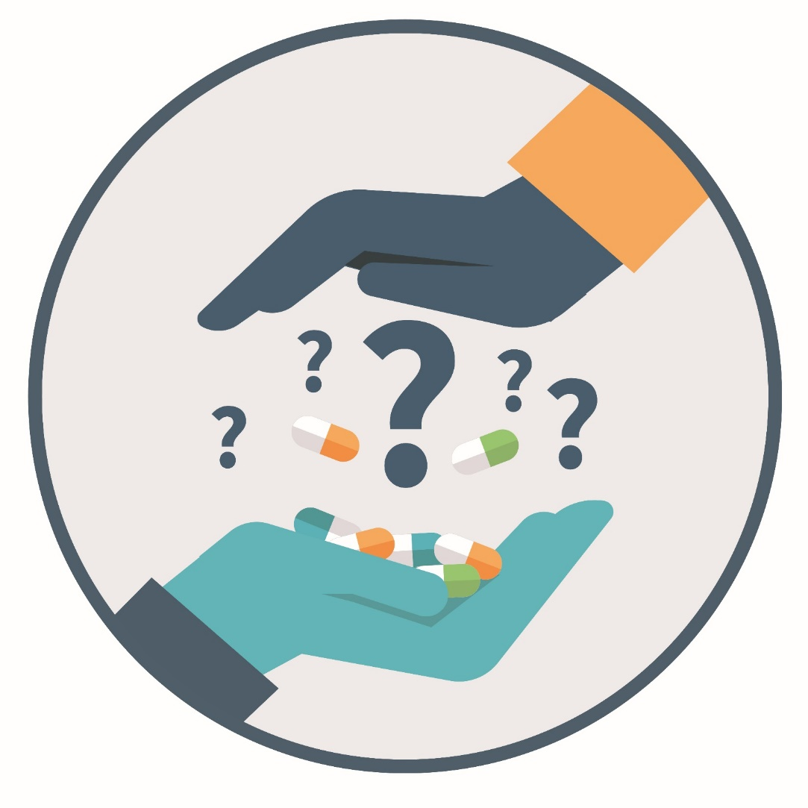
Be aware of illegally manufactured fentanyl
Notes:
Presentation Talking Points
In addition, be aware of illegally manufactured fentanyl. Fentanyl is also a synthetic opioid pain reliever, typically prescribed for severe pain (like cancer-related pain) as a lozenge or transdermal patch. Fentanyl is a prescription opioid pain reliever that is now being illegally manufactured and used to contaminate the illicit drug supply.
Because of its strong potency (50-100X more potent than morphine), only a small amount is needed to cause an overdose.
Thus, if an individual purchases counterfeit sedative pills or other illicit substances (like cocaine, heroin, or methamphetamine), they could be contaminated with lethal doses of illegally manufactured fentanyl. As a result, the individual may become exposed to fentanyl without their knowledge and thereby also at-risk for opioid-related overdoses.
If comfortable, consider sharing this information with other friends, peers, or family members.

Slide 33
Module 3:
Discuss in small groups:
Some students misuse prescription sedatives for social purposes (think pregaming, partying, etc.). What is concerning with this behavior?
How may self-medicating with prescription sedatives impact you both now and long-term?
^{©2020} ^{The Ohio State University}
Notes:
Note to Presenters
You can utilize this slide as a placeholder for 1-2 group leaders to share a summary of their small group conversation. Advance the slide to provide additional content and talking points that can help reinforce or elaborate upon the ideas shared.
Consider if you need to define “self-medicating” prior to groups discussing the second question. If so, we define self-medicating as selecting and using medication to treat a self-diagnosed symptom or illness. Thus, it often includes two behaviors – self-diagnosing and self-prescribing. Individuals may self-medicate with a medication prescribed to them (e.g. taking more medicine if their condition isn’t improving) or with someone else’s prescribed medication (e.g. diagnosing yourself with an anxiety disorder and taking a friend’s medication to manage it).

Slide 34

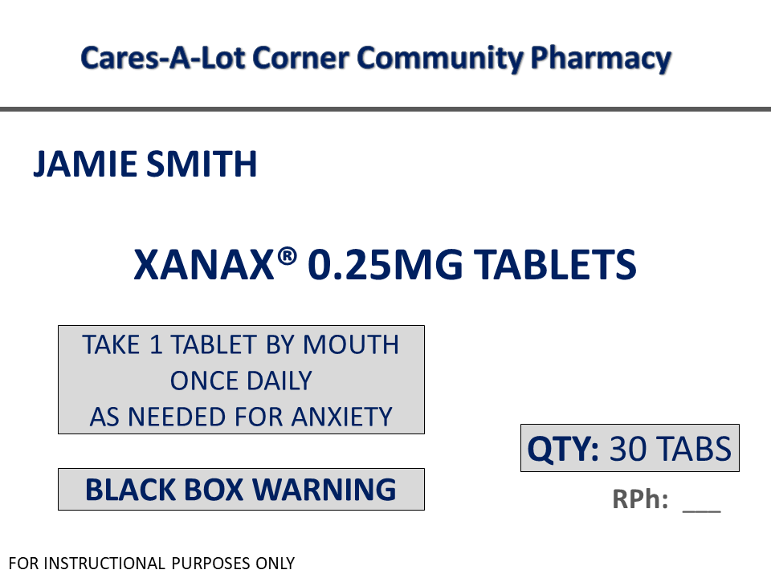
Avoid self-medicating—talk with your healthcare provider
1
Individual prescribed the medication
2
How much and how often
3
Warnings
^{©2020} ^{The Ohio State University}
Notes:
Presentation Talking Points
If needed, first review the definition of “self-medicating” from a previous slide.
Let’s consider how self-medicating with prescription sedatives may impact you. There is a prescription for a reason – because medicine affects everyone differently, the medication is deemed safe and effective for only the individual prescribed (reference #1 in image), and only when taken as instructed under supervision by a healthcare provider (reference #2 in image). All medication produces a range of effects. Because prescription sedatives inhibit nervous system function, self-medicating increases risk for experiencing adverse effects (often identified as ‘Warnings’, reference #3 in image) such as:
Decreased mental alertness or confusion
Impaired coordination and judgement
Decreased heart rate and blood pressure
Slowed breathing
Risk for drug dependence and addiction
As noted earlier, the FDA requires a “black box” warning for all benzodiazepine drugs related to these adverse effects. A “black box” warning constitutes FDA’s strongest cautionary information for patients. And your body can begin experiencing these adverse effects right away – it doesn’t require misusing the medication over a long period of time.

Slide 35
Module 3:
Discuss in small groups:
Some students misuse prescription sedatives for social purposes (think pregaming, partying, etc.). What is concerning with this behavior?
How may self-medicating with prescription sedatives impact you both now and long-term?
What are some sustainable methods to manage stress that support your well-being?
^{©2020} ^{The Ohio State University}
Notes:
Note to Presenters
You can utilize this slide as a placeholder for 1-2 group leaders to share a summary of their small group conversation. Advance the slide to provide additional content and talking points that can help reinforce or elaborate upon the ideas shared.

Slide 36
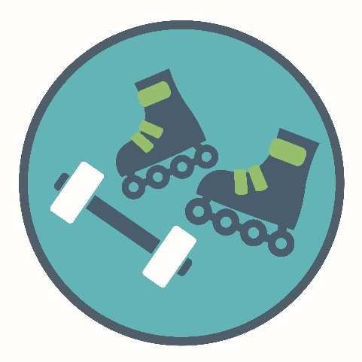
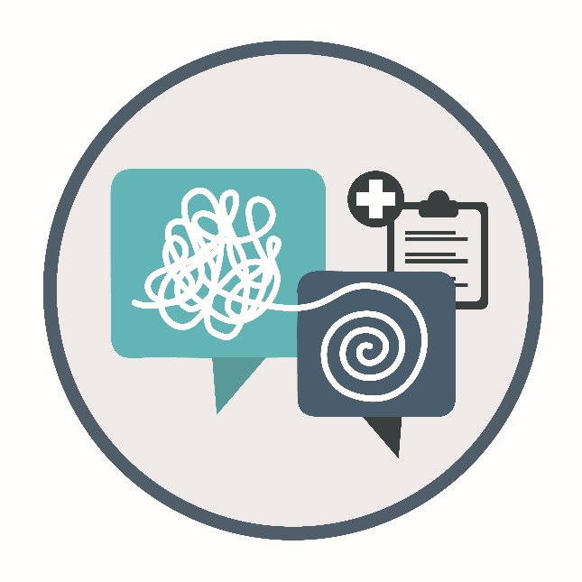


Consider methods to manage stress that support your well-being
Physical Activity
Professional Care
Trusted Friends or Adults
Notes:
Presentation Talking Points
Stress and anxiety are a natural part of life. If you experience intense and uncontrollable anxiety or stress that impacts your daily life, consider methods to manage it that support your well-being.
We can try some methods on our own, like engaging in physical activity or talking it out with a trusted friend (refer to imagery on the left). Campus wellness centers often provide a range of services for helping you develop skills to safely manage stress long-term – consider contacting them for more information.
Other methods may require talking with a professional, like discussing with a healthcare provider the appropriateness of medication or talk therapy (refer to imagery on the right). Prescribed medication is a viable option that can effectively treat anxiety and sleep disorders. However, taking the medication safely helps you get the best outcomes from your medication while lowering risk of harm (safe use implies only using medication intended for you, taking medication as instructed by a healthcare professional for the right dose and right amount of time, and taking medication for the reason it is prescribed).
Utilizing these methods now helps establish healthy habits related to managing stress and anxiety that will pay-off long-term.
Note to Presenters
Encourage participants to share additional ideas to safely manage stress or anxiety. In addition, consider identifying relevant campus resources before the presentation and share this information during the program.

Slide 37

Module 4:
Safe Medication Practices
^{©2020} ^{The Ohio State University}
Notes:
Presentation Talking Points
We’ve discussed the impact of misusing prescription opioids, stimulants, and sedatives.
Let’s conclude the program by discussing some safe medication practices for life, including practices for safe storage and disposal.

Slide 38
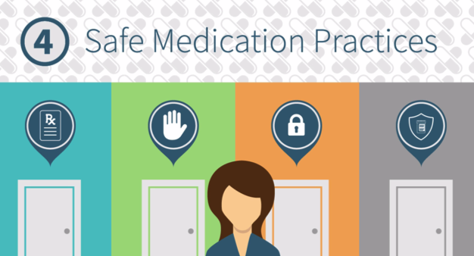
Video:
Safe Medication Practices
^{©2020} ^{The Ohio State University}
Notes:
Presentation Talking Points
Let’s watch a video that outlines safe medication practices. Then, we’ll engage in a brief discussion.
Note to Presenters
The video is posted online at: https://generationrx.org/toolkits/university/. When you are ready to play the video, minimize this presentation. Once the video is complete, resume this presentation.

Slide 39

Module 4:
Discuss in small groups:
How can we safely store and dispose of medication to limit social access?
How do you say “no” if a friend or peer invites you to misuse medication; or, if someone asks for your medication?
What are positive alternatives to misusing medications?
What are some safe medication practices for life?
^{©2020} ^{The Ohio State University}
Notes:
Presentation Talking Points
Let’s engage in a brief discussion about some of the points addressed in this video. Here are four discussion questions – based on the video and your own understanding of this issue, try developing a response to these questions.

Slide 40
Module 4:
Discuss in small groups:
How can we safely store and dispose of medication to limit social access?
^{©2020} ^{The Ohio State University}
Notes:
Note to Presenters
You can utilize this slide as a placeholder for 1-2 group leaders to share a summary of their small group conversation. Advance the slide to provide additional content and talking points that can help reinforce or elaborate upon the ideas shared.

Slide 41

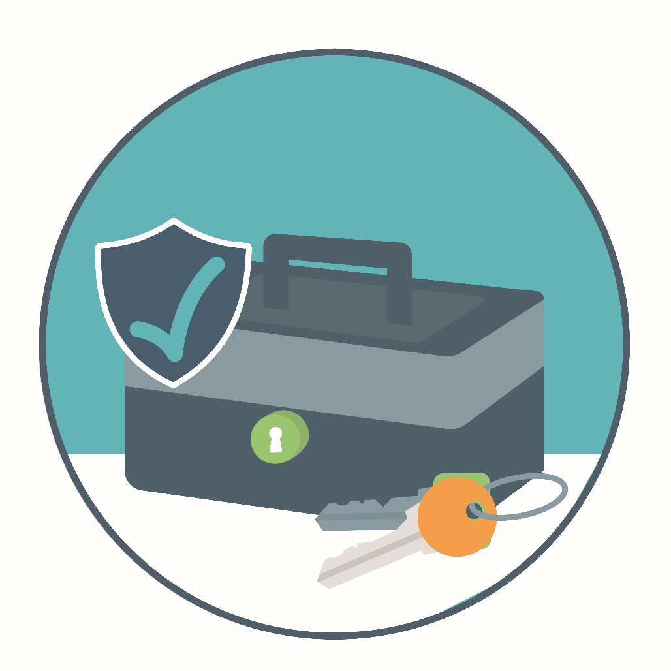
Store
medication in lockable spaces
^{©2020} ^{The Ohio State University}
Notes:
Presentation Talking Points
Remember that most people who misuse prescription drugs get them from family members or friends. Help keep those around you safe by storing your medications in lockable spaces.
Store prescription drugs in secure locations such as lock-boxes, medication safes, or other lockable spaces. Keep this lockbox in a private space that is out of sight from others.
Avoid storage places which visitors and other members can easily access, such as purses, backpacks, un-locked drawers, nightstands, or counters.

Slide 42
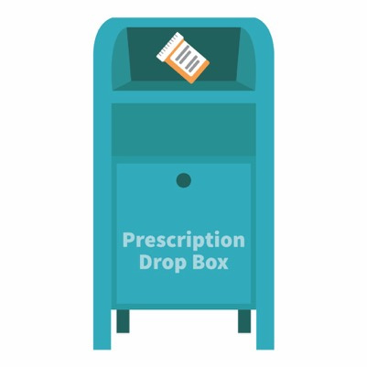
The best option for safe disposal?
Place the medication in a drug drop box or take advantage of a drug take-back event
Visit: rxdrugdropbox.org
^{©2020} ^{The Ohio State University}
Notes:
Presentation Talking Points
Similarly, it is important to safely dispose of your medications when they are no longer needed. The best options for safe disposal include:
Option #1: place the medication in a drug drop box. To find a drop box in your area, visit: rxdrugdropbox.org
Option #2: take advantage of community drug take-back programs that allow the public to bring unused drugs to a central location for proper disposal. Call your local law enforcement agency or ask your pharmacist to see if a take-back program is available in your community.
Note to Presenters
Prior to the presentation, we encourage you to visit rxdrugdropbox.org and identify a local drug drop box in your area. Consider sharing your findings during the program.

Slide 43


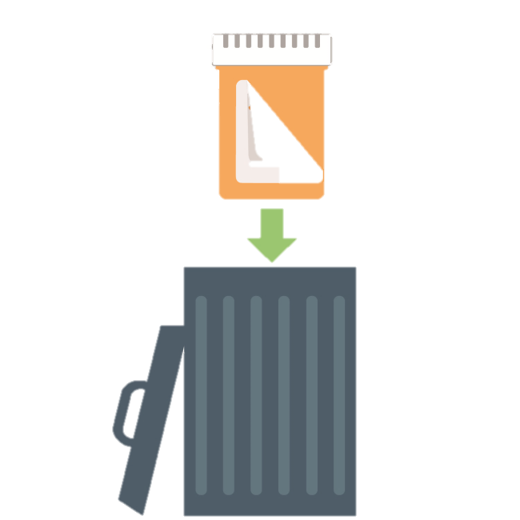

If needed, safely dispose of medications at home:
STEP
STEP
STEP
^{©2020} ^{The Ohio State University}
Notes:
Presentation Talking Points
If a drug drop box or a drug take-back event is not available, you can dispose of the medication at home. In general, you should not flush medications down a toilet or drain; however, the FDA still recommends that certain drugs should be disposed by flushing (for a list, visit: www.fda.gov).
Option #3: dispose of the medication at home (steps illustrated on this slide). Before completing these steps, we encourage you to follow any disposal instructions on the prescription label or provided patient information sheets.
If disposal instructions are not given, complete these three steps:
Step 1: Remove the pills from the original container and mix them with an undesirable substance such as used coffee grounds or kitty litter.
Step 2: Throw away the sealed mixture into the trash.
Step 3: Remove the prescription label and dispose of the empty bottle.

Slide 44
Module 4:
Discuss in small groups:
How can we safely store and dispose of medication to limit social access?
How do you say “no” if a friend or peer invites you to misuse medication; or, if someone asks for your medication?
^{©2020} ^{The Ohio State University}
Notes:
Note to Presenters
You can utilize this slide as a placeholder for 1-2 group leaders to share a summary of their small group conversation. Advance the slide to provide additional content and talking points that can help reinforce or elaborate upon the ideas shared.

Slide 45

Need help saying “no”?
Want to pregame with some meds?
I’m so stressed – can I have some of your Xanax®?
Give a Reason:
I’d rather not – I have a really big test tomorrow and I’m not sure how that medicine affects me.
Suggest an alternative:
I actually need all of my medication to manage my daily symptoms. Have you considered talking with a healthcare provider?
Reinforce your values:
As your friend, I don’t want to see either of us supporting something that could jeopardize our membership standing…
^{©2020} ^{The Ohio State University}
Notes:
Presentation Talking Points
If you are invited to misuse any prescription medication, how do you turn down this invitation? Alternatively, if someone requests that you share or sell your prescription medication, how can you say no? Three examples are listed on this slide. General approaches including giving a reason, reinforcing your values, leaving the situation, and suggesting an alternative. In addition, you can simply say “no” – by doing so, you become one of the majority of college students who use medications safely.
Note to Presenters
Some strategies are provided on this slide – encourage participants to share other ideas. You can also reference other social implications mentioned in the video, including disrespecting the health needs of others as well as jeopardizing scholarships, membership standings, and post-graduation plans.

Slide 46
Module 4:
Discuss in small groups:
How can we safely store and dispose of medication to limit social access?
How do you say “no” if a friend or peer invites you to misuse medication; or, if someone asks for your medication?
What are positive alternatives to misusing medications?
^{©2020} ^{The Ohio State University}
Notes:
Note to Presenters
You can utilize this slide as a placeholder for 1-2 group leaders to share a summary of their small group conversation. Advance the slide to provide additional content and talking points that can help reinforce or elaborate upon the ideas shared.

Slide 47
Try these positive alternatives to misusing medications…
travel
watch a movie
go to a concert
start a study group
attend a sporting event
talk with your professor
don’t skip class
enjoy your hobbies
^{©2020} ^{The Ohio State University}
Notes:
Presentation Talking Points
Some people misuse prescription medications as a “quick fix” to deal with the pressures and demands of their lives. However, they are only a “quick fix” – life will continually present demands, stresses, and pressures. Learning healthy, positive ways to deal with stress, achieve academic success, or have fun safely is essential. Isn’t college a time when you should cultivate sustainable habits for future professional success? Consider the examples in this slide. What are other positive alternatives to misusing medications?
Note to Presenters
Encourage participants to share their ideas. Alternatives in green provide sustainable approaches to studying.

Slide 48
Module 4:
Discuss in small groups:
How can we safely store and dispose of medication to limit social access?
How do you say “no” if a friend or peer invites you to misuse medication; or, if someone asks for your medication?
What are positive alternatives to misusing medications?
What are some safe medication practices for life?
^{©2020} ^{The Ohio State University}
Notes:
Note to Presenters
You can utilize this slide as a placeholder for 1-2 group leaders to share a summary of their small group conversation. Advance the slide to provide additional content and talking points that can help reinforce or elaborate upon the ideas shared.

Slide 49
Safe Medication Practices for Life
1
Only use prescription medications
as directed by a health professional
Do not share or take someone else’s medication
Keep your medications safe
Model safe medication practices
2
3
4
^{©2020} ^{The Ohio State University}
Notes:
Presentation Talking Points
Prescription medications can help us live longer and healthier lives, but any medication has the potential to do harm – especially when misused. The misuse of prescription medications is one of our country’s most pressing public health problems, with drug overdose being our leading cause of accidental death. And, while most college students do not misuse medication, many are impacted by this public health crisis.
We can prevent prescription drug misuse by engaging in safe medication practices for life. This includes only using medications as directed by a health professional, not sharing or taking someone else’s medication, securing and safely disposing of medications, and lastly, by being a good role model. This includes modeling these practices at home, and encouraging your family, friends, and others to do the same.

Slide 50

Be your own health advocate
Ask questions and know your options.
Learn about your medications – understand the adverse effects.
Condition not improving? Talk with a healthcare provider.
Prioritize your health needs by not sharing your medication with others.
^{©2020} ^{The Ohio State University}
GenerationRx.org 50
Notes:
Presentation Talking Points
In addition to following safe medication practices, be your own health advocate.
If you have a health or medical need, talk with a healthcare provider about the best approach that supports your health and well-being. Consider asking questions about both the medical and non-medical options available to manage your symptoms and condition.
Learn about your medications. Ensure you understand the reason for the medication, the dosing instructions, and any potential adverse effects. Don’t hesitate to ask questions when meeting with your healthcare providers.
If you are taking a medication as instructed and your condition isn’t improving—avoid self-medicating. Instead, talk with your healthcare provider.
Prioritize your health needs by not sharing your medication with others. If a friend or family member asks for some of your medication, encourage them to seek professional help from a healthcare provider.

Slide 51

Wrap-up
^{©2020} ^{The Ohio State University}
Notes:
Presentation Talking Points
That concludes our program. Let’s wrap-up by discussing where you can find help and learn more about these issues.

Slide 52

Need help?
Use Campus Resources:
Student health or
wellness center
Campus Recovery
Programs
College or university counseling services
Academic advisors
^{©2020} ^{The Ohio State University}
Notes:
Presentation Talking Points
If you or someone you know needs help, we encourage you to use the campus resources identified on this slide. Visit your student health or wellness center, contact the campus recovery program (if available), utilize campus counseling services, or talk with your advisor. The first step to solving any problem like alcohol or drug misuse may be reaching out for help.
Note to Presenters
Prior to the presentation, we encourage you to customize this slide to show the resources available at your university. Discuss each resource with participants, and consider providing this information to participants through email or other digital platforms. In addition, consider consulting the ‘Additional Resources’ section in the “Getting Started” facilitator guide for more information.

Slide 53

Share the information
Visit: GenerationRx.org
^{©2020} ^{The Ohio State University}
Notes:
Presentation Talking Points
In addition, we encourage you to share these messages with others.
This may consist of discussing Generation Rx messages with family and friends, or sharing them through peer-to-peer education. Visit our website, GenerationRx.org, to access free, ready-to-use resources designed to educate college students (or people of any age). You could present this program or a different activity. You could also present similar educational programs to other audiences, like teens, using our age-appropriate resources.

Slide 54






This project was developed in collaboration with:
Notes:
Presentation Talking Points
This project was developed in collaboration with the following fraternity and sorority inter/national organizations:
Alpha Chi Omega
Kappa Kappa Gamma
Sigma Nu
Pi Kappa Alpha
Pi Kappa Phi
Zeta Tau Alpha
Generation Rx is grateful for their collaboration and their support of cultivating safe medication practices within campus communities.

Slide 55




Follow us
@TheGenRx
GenerationRx.org
^{©2020} ^{The Ohio State University}
Notes:
Presentation Talking Points
Does anyone have any questions or comments? Before we end, we encourage you to stay connected by following Generation Rx @TheGenRx on Twitter and Facebook.
Note to Presenters
We also encourage you to share your experience with us. Consider submitting your tips and personal experiences about how you advocate safe medication practices at home or in your community. To do this, visit the ‘Contact’ section of GenerationRx.org. In this same section, you can also submit any questions you may have regarding how to use these educational resources.
References
Substance Abuse and Mental Health Services Administration. (2019). Key substance use and mental health indicators in the United States: Results from the 2018 National Survey on Drug Use and Health, (HHS Publication No. PEP19-5068, NSDUH Series H-54). Rockville, MD: Center for Behavioral Health Statistics and Quality, Substance Abuse and Mental Health Services Administration, Retrieved from http://www.samhsa.gov/data/
Compton WM, Jones CM, and Baldwin GT (2016) Relationship between Nonmedical Prescription-Opioid Use and Heroin Use. N Engl J Med, 374:154-63, DOI:10.1056/NEJMra1508490.
Center for Disease Control and Prevention, National Center for Injury Prevention and Control (2019, May 31). Fentanyl. Centers for Disease Control and Prevention. Retrieved September 23, 2019, from https://www.cdc.gov/drugoverdose/opioids/fentanyl.html
Amelia M. Arria PhD & Robert L. DuPont MD (2010) Nonmedical Prescription Stimulant Use Among College Students: Why We Need to Do Something and What We Need to Do, Journal of Addictive Diseases, 29:4, 417-426, DOI:10.1080/10550887.2010.509273
Phillips and McDaniel (2018). College Prescription Drug Study Key Findings: Fraternity & Sorority Life. Center for the Study of Student Life, The Ohio State University. Visit https://cssl.osu.edu/research-projects/college-prescription-drug-study/results

