Slide 1
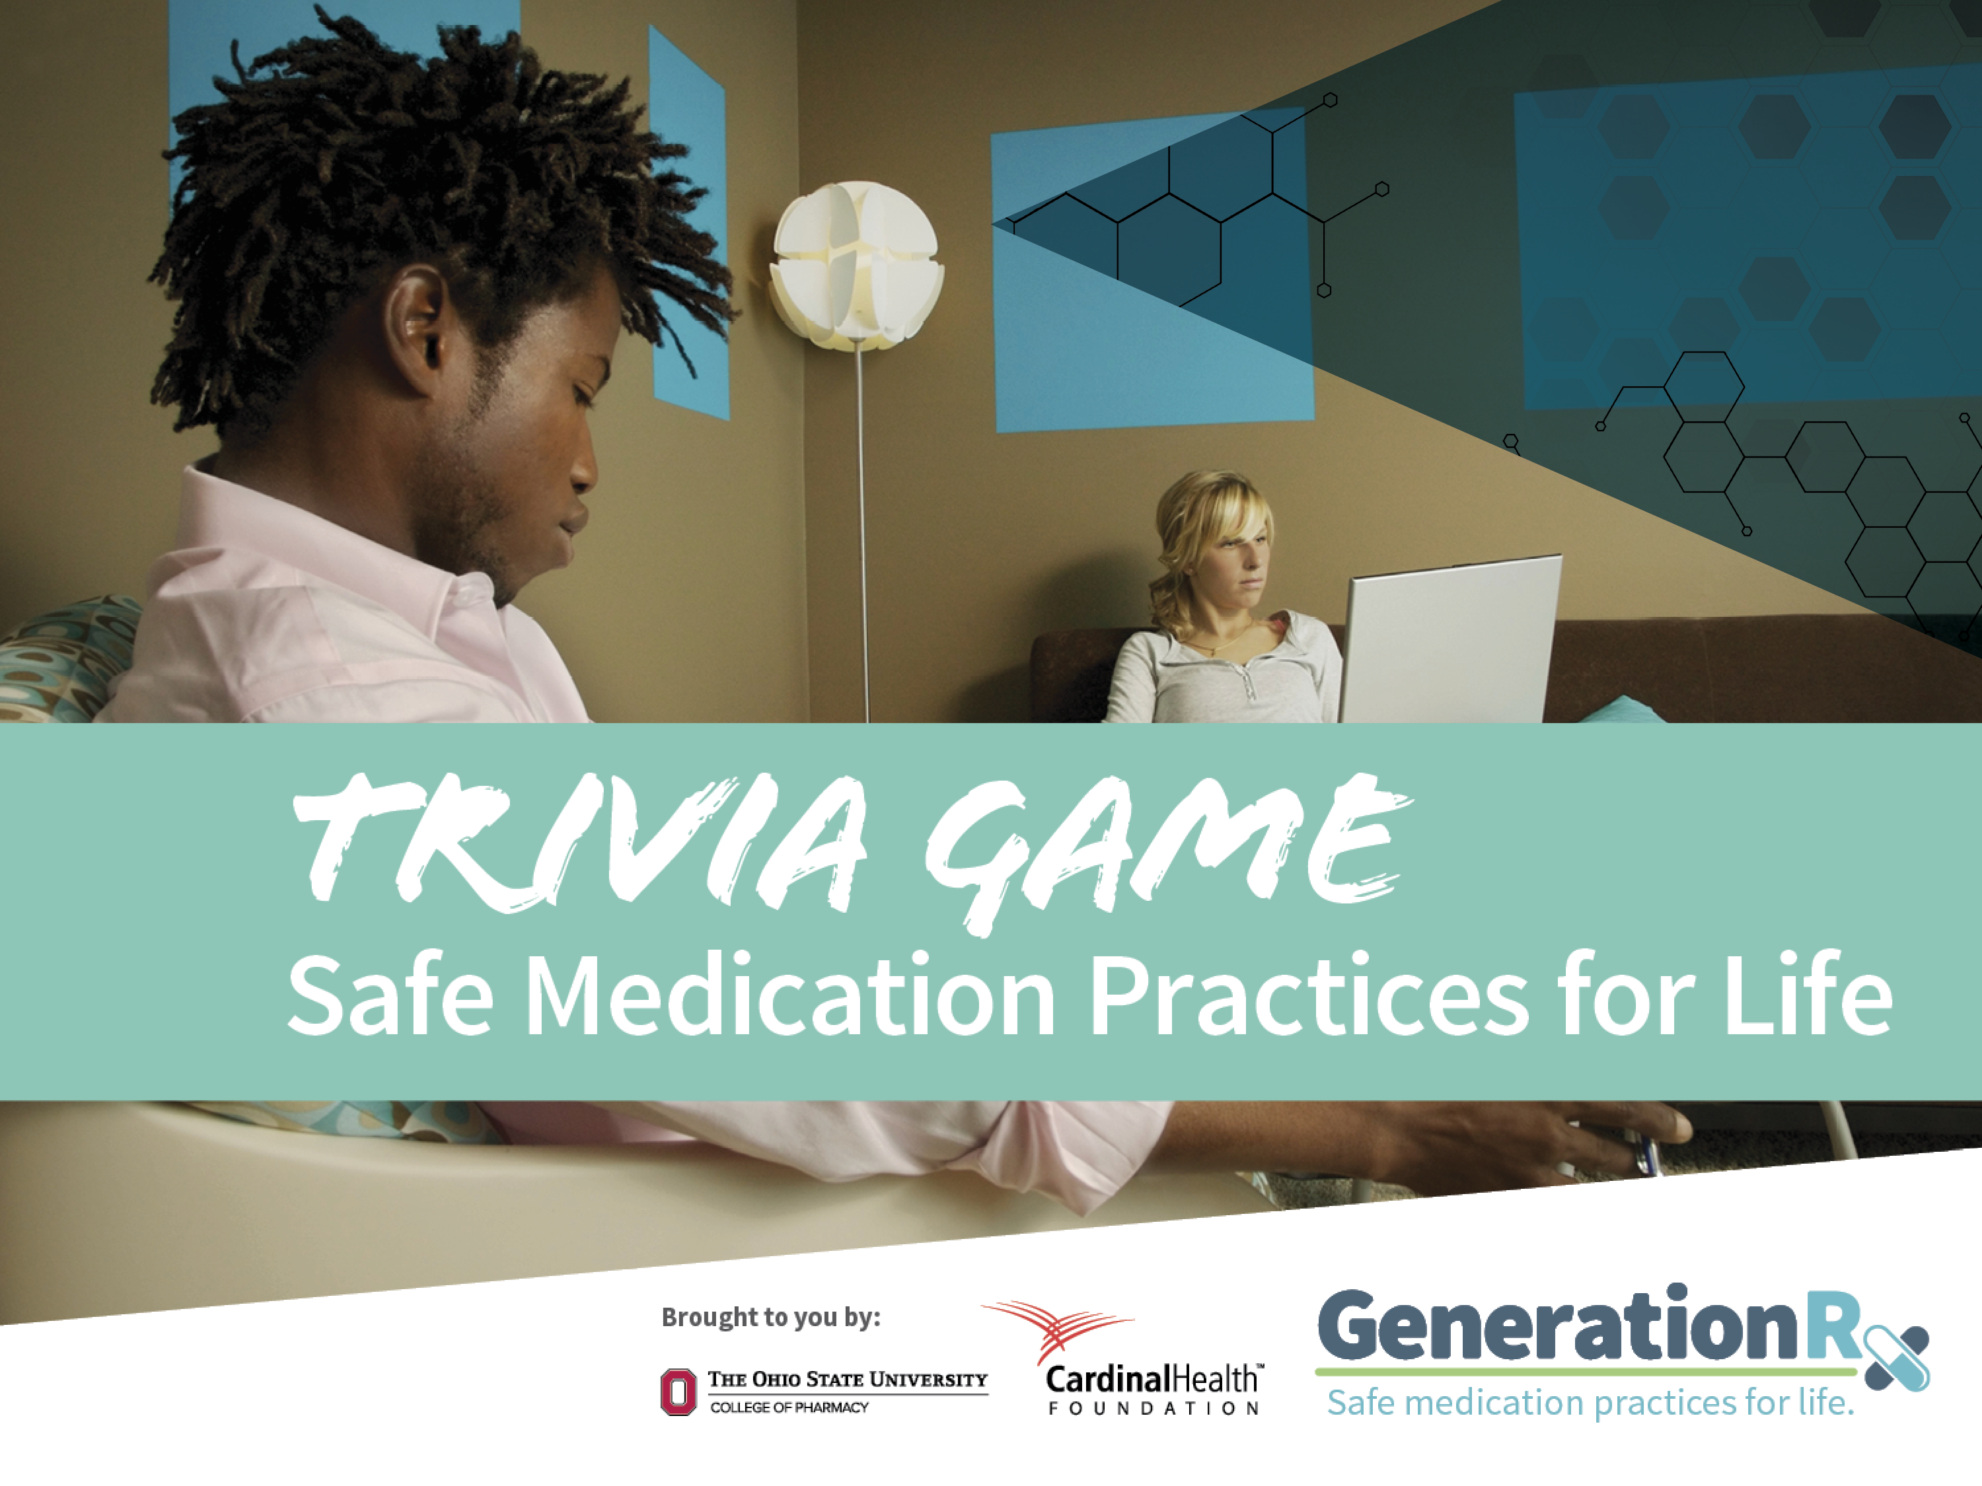
Presenter Name
Presenter Organization
Notes:
Welcome to today’s program: “Generation Rx University Trivia: Safe Medication Practices for Life”. You may be thinking, “What is Generation Rx University?” “Generation Rx University” encourages college students and young adults to incorporate the Generation Rx key messages into their individual, everyday lives. These messages focus on how to safely use medications in an effort to prevent their misuse. Today’s program will focus on these safe medication practices.
Note to facilitator: before the program begins, access the video, “Safe Medication Practices for Life” on GenerationRx.org. This video is listed with the other Generation Rx University resources. The game will prompt you to play the video (see Slide 3).

Slide 2

Game Rules
Divide into teams of 4-6 participants.
Identify a team name.
Each team takes turns choosing a
category and point value.
After the statement is read, each team will write an answer on their answer sheet.
Points will be awarded for correct answers only.
GenerationRx.org
Notes:
Note to facilitator: Before starting the game, complete these tasks:
Split the participants into teams of 4-6 people. Ask each team to create a team name.
Collect the team names and create a space to keep score.
Distribute a sheet of paper (or ask participants to use their own) to each group to serve as an answer sheet.
Assign roles among your facilitators. One person should serve as the “host”, who will ask the questions, advance the slides, and keep score. A second person should stand among the teams to check answers. If you are presenting by yourself, consider implementing one of these approaches:
Ask a participant to help check answers.
Ask groups to “grade and score” their own answers.
For some questions, answers will vary widely. We want to ensure we are reinforcing accurate answers that connect with our message, even if they do not exactly match the answers indicated in the slide. Use your judgement to decide if an answer is accurate, and thus deemed acceptable to earn points.
Once you answer the “Final Question”, simply continue advancing the slides by using the space bar to complete the activity.

Slide 3


But first, a word from our sponsors:
“Safe Medication Practices for Life”
GenerationRx.org
Notes:
Transition: We can prevent prescription drug misuse by following safe medication practices. Let’s watch a video that introduces these practices, and then we’ll play a game to discuss these practices in more detail.
Note to facilitator: When you are ready to play the video, minimize this presentation. Once the video is complete, resume this presentation.

Slide 4
Just Say “Know” | #keepforyourself | Myth Busters | Life Management 101
100 | 100 | 100 | 100
200 | 200 | 200 | 200
300 | 300 | 300 | 300
400 | 400 | 400 | 400
Final Question
GenerationRx.org
Notes:
Note to facilitator: when the slides are in “presentation mode”, clicking on a point value will trigger that specific question to appear. After asking the question, reveal the answer by simply clicking the space bar. When you are ready to return to this game board, click the link in the upper right corner of each answer slide.

Slide 5

I just received a new prescription medication… where should I store it?
GenerationRx.org
Notes:
Category: Just say “Know”, 100pts

Slide 6
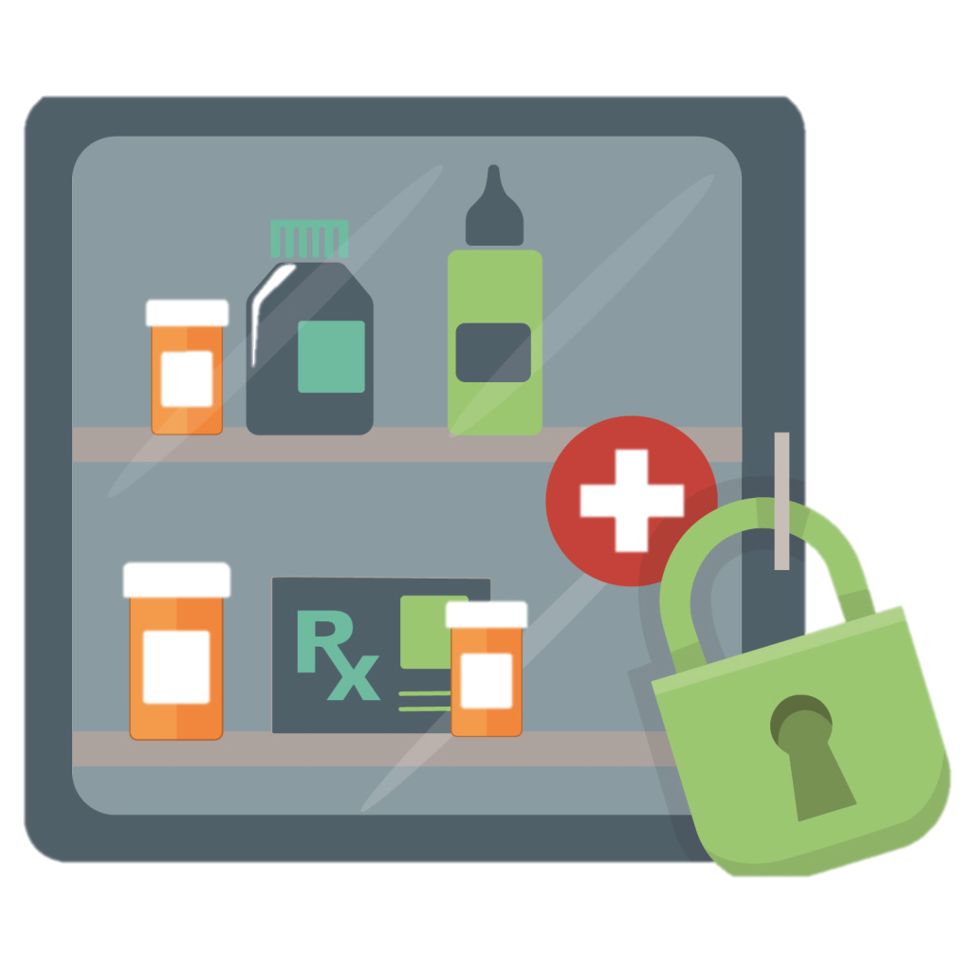
Return to Game Board
Store
medication in lockable spaces
GenerationRx.org
Notes:
Answer: Just Say “Know”, 100pts
Transition: As noted in the video, we can secure medications through safe storage practices, which includes storing them in lockable spaces.
When prescribed any medication, store it in secure locations such as lock-boxes, medication safes, or other lockable spaces.
Avoid storage places which children and others can easily access, such as purses, backpacks, un-locked drawers, nightstands, or counters.

Slide 7

The pain from pulling my wisdom teeth is gone, but I have several pain pills left. How should I safely dispose of unused medication?
GenerationRx.org
Notes:
Category: Just say “Know”, 200pts

Slide 8
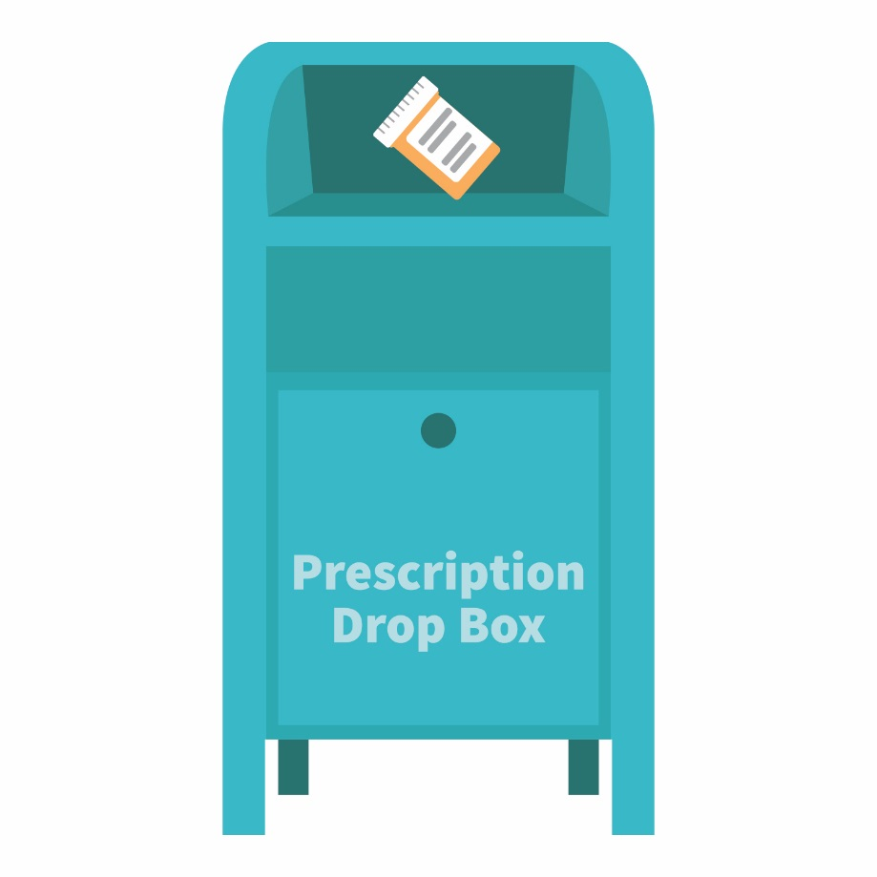
The best option for safe disposal?
Place the medication in a drug drop box or take advantage of a drug take-back event
Visit: rxdrugdropbox.org
GenerationRx.org
Notes:
Answer: Just Say “Know”, 200pts
Transition: Once you are finished with a prescription, it is important to safely dispose of the medication. The majority of individuals that misuse prescription medications access them from their family members or friends.
Once finished with a prescription medication, the best options for safe disposal include:
Option #1: place the medication in a drug drop box. To find a drop box in your area, visit: rxdrugdropbox.org
Option #2: take advantage of community drug take-back programs that allow the public to bring unused drugs to a central location for proper disposal. Call your local law enforcement agency or ask your pharmacist to see if a take-back program is available in your community.

Slide 9



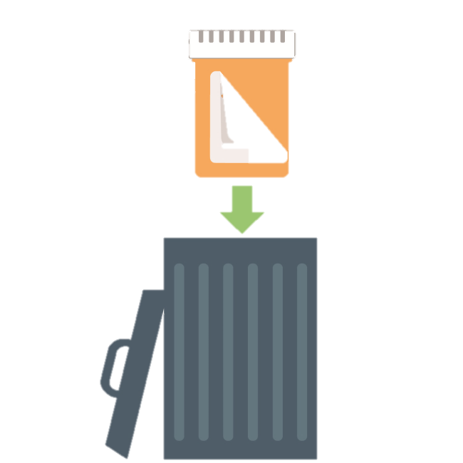

If needed, safely dispose of medications at home:
Return to Game Board
STEP
STEP
STEP
GenerationRx.org
Notes:
Answer: Just Say “Know”, 200pts
Transition: If a drug drop box or a drug take-back event is not available, you can dispose of the medication at home.
Option #3: dispose of the medication at home (steps illustrated on this slide). Before completing these steps, we encourage you to follow any disposal instructions on the prescription label or patient information sheet.
If disposal instructions are not given, complete these three steps:
Step 1: Remove the pills from the original container and mix them with an undesirable substance such as used coffee grounds or kitty litter.
Step 2: Throw away the sealed mixture into the trash.
Step 3: Remove the prescription label and dispose of the empty bottle.
[Note: In general, you should not flush medications down a toilet or drain; however, the FDA still recommends that certain drugs should be disposed by flushing (for a list, visit: www.fda.gov).]

Slide 10

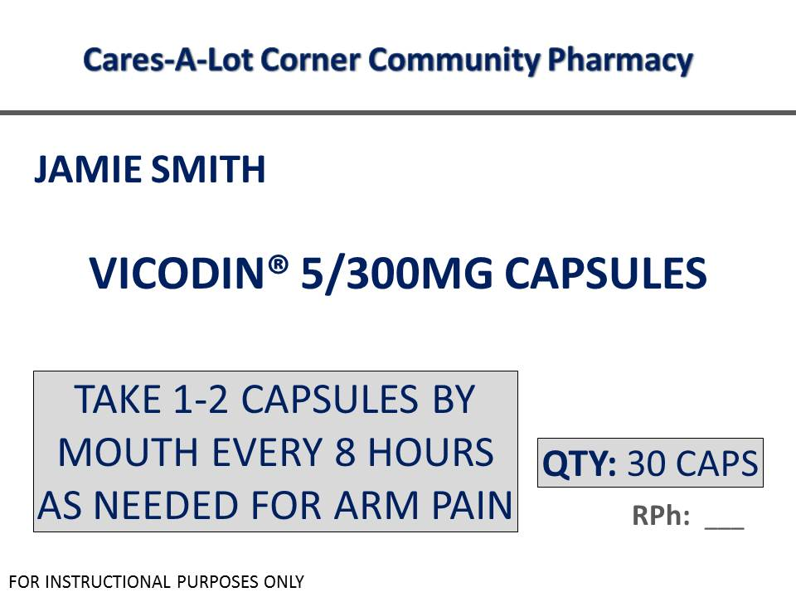
It seems that I’m supposed “to follow the instructions given by my healthcare provider”.
Why is that important?
GenerationRx.org
Notes:
Category: Just say “Know”, 300pts

Slide 11

Following instructions reduces risk of side effects, including drug dependency and addiction
Return to Game Board
GenerationRx.org
Notes:
Answer: Just Say “Know”, 300pts
Transition: As noted in the video—medications that require a prescription are safe and effective only when used as instructed and under the supervision of a healthcare provider.
Instructions are provided to keep us safe. When we don’t follow instructions, we increase the likelihood that negative side effects, including developing a dependency on and addiction to some medications, can occur.
We should always avoid tendencies to self-diagnose and self-prescribe. This includes making decisions related to how much and how often (dose and frequency) you take the medication, as well as the reason for taking the medication.

Slide 12

I have some pills that may help you study… do you want any?
Help! How am I supposed to handle this situation?!
GenerationRx.org
Notes:
Category: Just say “Know”, 400pts

Slide 13

Need help saying “no”?
Return to Game Board
Give a Reason:
No way…that’s illegal! I don’t want a drug-related offense on my record.
Leave the situation:
Sorry, my friend just texted—I’ve gotta go!
Suggest an alternative:
No…these pills can cause some serious side effects. Instead, how about we visit the professor’s office hours?
GenerationRx.org
Notes:
Answer: Just Say “Know”, 400pts
Transition: If you’re invited to misuse any prescription medication, how do you turn down this invitation? General approaches including giving a reason, leaving the situation, and suggesting an alternative. Examples are identified on this slide.

Slide 14
Create a hashtag that completes this statement:
When you ask for my
prescription medication,
you become #___________.
GenerationRx.org
Notes:
Category: #keepforyourself; 100pts

Slide 15
Return to Game Board
#awkward
#disrespectful
#myexfriend
#rude
#troubleforme
GenerationRx.org
Notes:
Answer: Keep for Yourself, 100pts
Transition: If you ask someone to sell or share their medication, have you ever considered how that friend may perceive your request?
By asking a friend (or even a stranger) for some of their medication, we put them in an incredibly vulnerable and uncomfortable position. For example, they often perceive that request as you:
Using your friendship to obtain drugs. Your friend may begin questioning whether your friendship is solely based on you gaining access to their medication.
Disrespecting their health needs. Your friend has a legitimate need for their medication—if they cannot take their medication as instructed, their health is jeopardized.
Putting them at risk for getting in trouble. Even if your friend simply gives (versus sells) you the medication, sharing medication is always illegal. Think about it—would a real friend ask someone to risk their future so that they could misuse a medication?
Be a good friend—if you feel that you need medication for a legitimate reason, talk with your healthcare provider.

Slide 16
Create a hashtag that completes this statement:
A biological factor that
makes each of us unique is #___________.
GenerationRx.org
Notes:
Category: #keepforyourself; 200pts

Slide 17

#DNA
Medication affects friends differently
Return to Game Board
GenerationRx.org
Notes:
Answer: Keep for Yourself, 200pts
Transition: DNA makes each of us unique. While it determines our hair color and helps shape our personality, it also helps determine how we each respond to medications.
In addition to DNA, our existing medical conditions, current medications we may be taking, even our age and weight, can all determine how we respond to a given medication. And that includes not only how we respond to the beneficial (therapeutic) effects, but also to the potentially harmful adverse effects.
Genetic risk factors that increase risk for drug dependency or addiction do exist—how your friend’s body handles a medication is not necessarily predictive of how your body will handle the same medication.
This is one reason that explains why we shouldn’t share or take someone else’s medication.

Slide 18
Create a hashtag that completes this statement:
Share your relationship status,
not your #___________.
GenerationRx.org
Notes:
Category: #keepforyourself; 300pts

Slide 19
Return to Game Board
#medication
#toothbrush
#underwear
GenerationRx.org
Notes:
Answer: Keep for Yourself, 300pts
Transition: While we may be conditioned to share our personal lives through social media, some things just weren’t meant to be shared.
For example, would you share your toothbrush or underwear with someone? Of course not!
Prescription medications aren’t any different. As noted in the video, prescription medications are intended to be used by the individual whose name is on the prescription—just like your toothbrush or underwear, some things just belong to you.

Slide 20
Create a hashtag that completes this statement:
A potential outcome from
sharing or taking
someone else’s medication: #___________.
GenerationRx.org
Notes:
Category: #keepforyourself; 400pts

Slide 21
Return to Game Board
#deucesinternship
#goodbyescholarship
#hellofelonyoffense
#laterrelationships
GenerationRx.org
Notes:
Answer: Keep for Yourself, 400pts
Transition: Several negative outcomes may result from sharing or taking someone else’s medication…
As noted in the video, sharing or taking someone else’s medication is actually illegal. Most prescription drugs that are misused are “controlled substances” (e.g., Vicodin, OxyContin, Valium, Xanax, Adderall, Ritalin), meaning they may be used for legitimate medical purposes but have a high potential for misuse and/or the development of dependence. These substances are controlled by the U.S. Drug Enforcement Administration, and it is prohibited under federal law to manufacture, distribute, dispense, or possess them without a legitimate prescription.
Depending on individual state laws, possession of a controlled substance without a prescription may result in a felony charge, with penalties which could include fines and/or imprisonment. Similarly, if someone is hurt when you give them your prescription drugs, you could be liable for any harm experienced by the person to whom you provided the medication.
If you were charged with a drug-related offense in college, how would that impact your future? It will likely impact your friendships, personal relationships, and potential for current and future educational opportunities or employment.

Slide 22
The percent of college students that have never misused medication
in their lifetime
?
GenerationRx.org
Notes:
Category: Myth Busters; 100pts

Slide 23

Return to Game Board
75
3 out of 4 college students actually use medications safely
GenerationRx.org
Notes:
Answer: Myth Busters; 100pts
Transition: It’s actually 75%--indicating that the majority of college students do not misuse prescription medications. This also suggests that 3 out of 4 college students use medications safely.
This also suggests that roughly 25% of college students have misused prescription medications in their lifetime. Even fewer do so regularly. This certainly isn’t the majority!¹
It is true that the average age to initiate prescription drug misuse is during the college years (average age 21-22)²—so while college students remain vulnerable to misuse, it is not the norm on campus to misuse prescription medications for studying, partying, or self-medicating.
References:
¹McDaniel, A. (2015). College Prescription Drug Study Executive Summary. Center for the Study of Student Life, The Ohio State University.
²Substance Abuse and Mental Health Services Administration, Results from the 2013 National Survey on Drug Use and Health: Summary of National Findings, NSDUH Series H-48, HHS Publication No. (SMA) 14-4863. Rockville, MD: Substance Abuse and Mental Health Services Administration, 2014. Retrieved from http://www.samhsa.gov/data/

Slide 24
Name two substances that don’t mix well together
GenerationRx.org
Notes:
Category: Myth Busters; 200pts

Slide 25
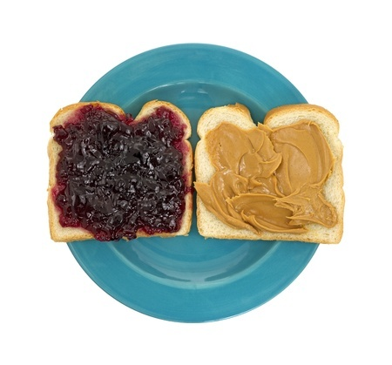
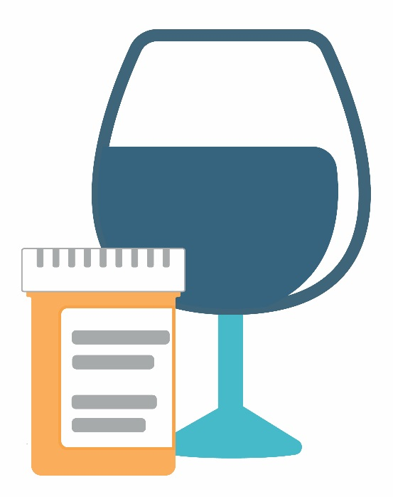
Return to Game Board
Some things mix well together…
…and some things don’t.
Mixing us can
cause dangerously slow breathing...
GenerationRx.org
Notes:
Answer: Myth Busters; 200pts
Transition: Some things mix well together (like PBJ), and some things don’t—like alcohol and prescription medications. All medications have side effects—and mixing alcohol (or other drugs) with these products often enhances these side effects, or the intoxicating effects of alcohol itself. Many overdoses result from mixing prescription medications with alcohol or with other drugs.
For example, the adverse effects for prescription opioid pain medications include drowsiness, confusion, sedation, and slowed breathing. Mixing alcohol with prescription opioids can actually worsen these adverse effects.
The adverse effects for prescription sedatives includes decreased heart rate and blood pressure, impaired coordination and judgement, confusion, sedation, slowed breathing. Again, adding alcohol can worsen these adverse effects.
The adverse effects for prescription stimulants includes increased heart rate and blood pressure, irregular heart beat, nervousness, and insomnia. When mixed with alcohol, prescription stimulants can mask the body’s natural warning signals of over-sedation, which can lead to alcohol intoxication or dangerously slow breathing.
In addition, only 1-5% of college students report that they “very often” or “often” misuse prescription drugs while drinking alcohol. In fact, over half of college students (52-58%) never misuse prescription drugs while drinking alcohol.¹
References:
¹McDaniel, A. (2015). College Prescription Drug Study Executive Summary. Center for the Study of Student Life, The Ohio State University.

Slide 26
Name something
that you could
become dependent on
GenerationRx.org
Notes:
Category: Myth Busters; 300pts

Slide 27

Return to Game Board
Friends
Tobacco
Caffeine
Alcohol
Family
Food
Sex
Medication
GenerationRx.org
Notes:
Answer: Myth Busters; 300pts
Transition: Some things we could become dependent upon may make us better as individuals—like family and friends. But others, substances like alcohol and medication, can actually damage those relationships and derail our lives.
Some medications, like prescription opioid pain relievers, sedatives, and stimulants have the potential to cause dependency and addiction. This is why it is critical to only take medications that are prescribed for you and to take them only as instructed by a healthcare provider.

Slide 28
These two chemicals produce similar effects in the body –
what are they?
GenerationRx.org
Notes:
Category: Myth Busters; 400pts

Slide 29
Some prescription drugs aren’t as safe as you think!
Return to Game Board
Oxycodone
(Opioid Pain Medication)
Heroin
GenerationRx.org
Notes:
Answer: Myth Busters; 400pts
Transition: The chemical on the left is the prescription opioid pain reliever oxycodone, while the chemical on the right is heroin.
Do these two chemical structures look similar? They certainly do! Because of their chemical similarity, both drugs produce similar effects in the body—including the risk of developing physical dependency and addiction.
A similar comparison can be made between the prescription stimulant Adderall, and the illegal drug, methamphetamine.
Remember—there is a reason for the prescription. Some prescription drugs aren’t as safe as you think, and they are never a safe alternative to illegal drugs.

Slide 30

The pressure to succeed feels unbearable. How should I deal with this stress?
GenerationRx.org
Notes:
Category: Life Management 101, 100pts

Slide 31
How to safely manage stress:
Return to Game Board
talk to friends
prioritize tasks
watch a movie
yoga
take a nap
eat ice cream
exercise
make a plan to meet project deadlines
GenerationRx.org
Notes:
Answer: Life Management 101, 100pts
Transition: Encourage participants to safely manage stress by engaging in the practices identified in the word cloud.

Slide 32

A new semester…hmm… Maybe I should make a plan for studying?!
This semester I’ll:
GenerationRx.org
Notes:
Category: Life Management 101, 200pts

Slide 33
Sustainable approaches for studying:
Return to Game Board
prioritize tasks
establish a study group
make flashcards
try to teach it
don’t skip class
create a study schedule
stay current with class material
take advantage of office hours
access online tutorials
use a tutor
GenerationRx.org
Notes:
Answer: Life Management 101, 200pts
Transition: Encourage participants to engage in sustainable approaches for studying—some ideas are identified in this word cloud.

Slide 34

I’m so frustrated! This medication isn’t managing my pain. What should I do?
GenerationRx.org
Notes:
Category: Life Management 101, 300pts

Slide 35

Avoid self-medicating— always seek help from your healthcare provider
Return to Game Board
GenerationRx.org
Notes:
Answer: Life Management 101, 300pts
Transition: As noted in the video—medications which require a prescription are determined to be safe and effective only when used as instructed and under the supervision of a healthcare provider. Therefore, if you are taking any medication as instructed and your condition is not improving—talk with your healthcare provider.
We should always avoid tendencies to self-diagnose and self-prescribe. This includes making decisions related to how much and how often (dose and frequency) you take the medication, as well as the reason for taking the medication.

Slide 36

An ‘A’ on my midterm and it is my birthday?!
Let’s celebrate by:
GenerationRx.org
Notes:
Category: Life Management 101, 400pts

Slide 37
Have fun by…
Return to Game Board
traveling
watching a movie
going to a concert
taking a hike
attending a sporting event
hosting a game night
volunteering
enjoying your hobbies
GenerationRx.org
Notes:
Answer: Life Management 101, 400pts
Transition: Encourage participants to engage in safe and healthy activities to have fun and celebrate—some ideas are identified in this word cloud.

Slide 38
Final Trivia
I pledge to use medications safely by: ________
GenerationRx.org
Notes:
Transition: for the final trivia round, complete this statement.
Note to facilitator: read the statement and encourage participants to share their thoughts with the larger group. Advance the slide to summarize the safe medication practices as well as identify campus resources where students can find help.

Slide 39
Use medications safely:
Follow instructions
Keep for yourself
Secure medications
Be a good role model
GenerationRx.org
Notes:
Transition: Let’s recap…you can use medications safely and prevent prescription drug misuse by following instructions, keeping medications for yourself, securing and safely disposing of medications, and lastly, by being a good role model. This includes modeling these practices at home, and encouraging your family and friends to do the same.

Slide 40

Need help?
Use Campus Resources:
Student health or
wellness center
Campus Recovery
Programs
College or university counseling services
Academic advisors
GenerationRx.org
Notes:
Transition: if you need help, we encourage you to use campus resources.
Note to facilitator: prior to the presentation, we encourage you to customize this slide for your university. Discuss each resource with participants, and consider providing this information to students through email or other digital platforms.

Slide 41

Help Others
Learn more
Share the information
Talk with a trusted adult
Visit: GenerationRx.org
GenerationRx.org
Notes:
Transition: How can you help others?
First, you (and others) can learn more about this issue by visiting the ‘Learn’ section at GenerationRx.org.
Second, you can share these messages with others. This may consist of discussing these messages with family members and friends, or sharing these messages through peer-to-peer education. Visit our website, GenerationRx.org, to access free, ready-to-use resources designed to educate others. You could present this program or a different activity. You could also present similar educational programs to other audiences, like teens, using our age-appropriate resources.
Lastly, if you are concerned about someone you care about, we encourage you to talk to a trusted adult. In addition, we’ve identified additional resources for helping others at GenerationRx.org.

Slide 42



Follow us
@TheGenRx
GenerationRx.org
Notes:
Transition: Does anyone have any questions or comments?
Before we end, we encourage you to stay connected by following us @TheGenRx on Twitter and Facebook.
Also, we encourage you to take a survey evaluating today’s program at GenerationRx.org. You can find a link to this survey at the bottom of the home page. We value your feedback to help us assess the impact of this work and continually improve Generation Rx materials.
Note to facilitator: we encourage you, as the presenter, to also complete this survey. Thank you for advocating safe medication practices in your community!
We also encourage you to share your experience with us. Consider submitting your tips and personal experiences about how you advocate safe medication practices at home or in your community. To do this, visit the ‘Contact’ section of GenerationRx.org. In this same section, you can also submit any questions you may have regarding how to use these educational resources.

