Slide 1
SAFE MEDICATION PRACTICES
FOR BETTER HEALTH
OLDER ADULT TOOLKIT | Trivia Game
Notes:
Note to facilitator: Before starting the game, complete these tasks:
Split the participants into teams of 4-6 people. Ask each team to create a team name.
Collect the team names and create a space to keep score.
Distribute a sheet of paper (or ask participants to use their own) to each group to serve as an answer sheet.
Assign roles among your facilitators. One person should serve as the “host”, who will ask the questions, advance the slides, and keep score. A second person should stand among the teams to check answers. If you are presenting by yourself, consider implementing one of these approaches:
Ask a participant to help check answers.
Ask groups to “grade and score” their own answers.
For some questions, answers will vary widely. We want to ensure we are reinforcing accurate answers that connect with our message, even if they do not exactly match the answers indicated in the slide. Use your judgment to decide if an answer is accurate and thus deemed acceptable to earn points.
Once you answer the “Final Question”, simply continue advancing the slides by using the space bar to complete the activity.

Slide 2

GAME RULES
1. Divide into teams of 4-6 participants. Identify a team name.
2. Each team takes turns choosing a category and point value.
3. After the statement is read, each team will write an answer on their answer sheet.
4. Points will be awarded for correct answers only.

Slide 3
Let’s Get Started…
We will ask you a question and have you write down your answer on your sheet.
Notes:
Transition: By playing this trivia game we are going to have fun while discussing how you can get the most from your medications and do so safely. This program was developed by Generation Rx at The Ohio State University College of Pharmacy, in partnership with The Cardinal Health Foundation.
Note to facilitator: Be sure each group has an answer sheet and an appointed person to write the answers on the sheet.

Slide 4
Game Board
Be Your Own Advocate | Medication Scenarios | Safe Medication Practices | Prescription Drug Misuse
100 | 100 | 100 | 100
200 | 200 | 200 | 200
300 | 300 | 300 | 300
400 | 400 | 400 | 400
Final Question
Notes:
Note to facilitator: when the slides are in “presentation mode”, clicking on a point value will trigger that specific question to appear. After asking the question, reveal the answer by simply clicking the space bar. When you are ready to return to this game board, click the link in the upper right corner of each answer slide.
Your Own Advocate - questions about being an informed user of medications
Medication Scenarios- common questions about medication use
Safe Medication Practices- important information about “safe medication practices for life”
Prescription Drug Misuse- facts about medication misuse in our country and what you can do about it

Slide 5

Be Your Own Advocate | 100 Pts
< Back to Game Board
QUESTION
What is an example of an adverse drug event?
Answer
Notes:
Category: Advocate, 100pts

Slide 6
Be Your Own Advocate | 100 Pts
< Back to Game Board
ANSWER
Examples of Adverse Drug Events Include:
Adverse drug reaction
Drug doesn’t work properly
Medication error
Overdose
Problems when stopping medication
Notes:
Answer: Advocate, 100pts
Transition: For the purpose of the trivia game, count your answer as correct if you have any one of these listed to describe an Adverse Drug Event. Most of you probably thought about medication side effects, also called adverse drug reaction.
Facilitator’s note: ask the participants, “How many of you thought about the other 4 types of adverse drug event categories?”
Medication errors – either taking the wrong drug, too much of a drug, doubling the daily dose are examples of medication errors
Drug doesn’t work properly– drug does not have the desired effect
Problems when stopping medications– side effects that happen when a drug is stopped suddenly Certain medications cannot be stopped suddenly.
Overdose – taking too much medication either on accident or on purpose
All of these medication related issues are considered Adverse Drug Events.

Slide 7
Be Your Own Advocate | 200 Pts
< Back to Game Board
TRUE OR FALSE
The more medications an older adult takes, the more likely they are to have an adverse drug event.
Answer
Notes:
Category: Advocate, 200pts

Slide 8
Be Your Own Advocate | 200 Pts
< Back to Game Board
ANSWER
TRUE
Every additional medication increases the risk for having an adverse drug event, such as a medication side effect.
Notes:
Answer: Advocate, 200pt
Transition: This is one reason to make sure to review your medications with your doctor or pharmacist to make sure there is still a good reason for each medication you are taking.

Slide 9
Be Your Own Advocate | 300 Pts
< Back to Game Board
QUESTION
What is an important tool to help guide you to safe medication use?
HINT: It is something you can carry with you either electronically or on paper and share with your doctors and pharmacist.
Answer
Notes:
Category: Advocate, 300pts

Slide 10
Be Your Own Advocate | 300 Pts
< Back to Game Board
ANSWER
Complete Medication Record
Notes:
Answer: Advocate, 200pts
Transition: Keeping, updating and sharing your complete medication record is a very important way of communicating with your health care team about ALL the medications that you are taking, including over-the-counter and prescription medications.
It is also useful as it allows your pharmacist to help screen your unique combination of medications for potential drug interactions. When you share your list with your pharmacist, be sure to ask about any drug interactions.

Slide 11
Be Your Own Advocate | 400 Pts
< Back to Game Board
TRUE OR FALSE
Nonprescription medications, also called
Over- the-Counter (OTC) medications, are required to have standardized medication information on the packaging.
Answer
Notes:
Category: Advocate, 400pts

Slide 12
Be Your Own Advocate | 400 Pts
< Back to Game Board
ANSWER
TRUE
The standard labeling is called the "Drug Facts" and includes information about:
  Active Ingredients
  Uses
  Warnings
  Directions
Notes:
Answer: Advocate, 400pts
Transition: This label can provide you with useful information to see if a product would be safe for you to take with your other medications. It is always wise to first check with your doctor or pharmacist before taking any new medications, including over-the-counter medications.

Slide 13

Medication Scenarios | 100 Pts
< Back to Game Board
QUESTION
I’ve been told by my doctor to start Calcium and Vitamin D supplements. Where can I get more information?
Answer
Notes:
Category: Medication Scenarios, 100pts

Slide 14
Medication Scenarios | 100 Pts
< Back to Game Board
ANSWER
Go to your community pharmacy and ask to speak to the pharmacist. Be sure to provide your complete Medication Record.
Notes:
Answer: Medication Scenarios, 100pts
Transition: Your pharmacist is a great resource, especially when it comes to picking a specific over-the-counter product and advising on how to use it properly.
So your pharmacist will know all the medications you are taking, be sure to share your complete medication record with them as you ask for help picking an over-the-counter product.

Slide 15
Medication Scenarios | 200 Pts
< Back to Game Board
QUESTION
"I've been dizzy lately.
Could it be due to my medications?"
Answer
Notes:
Category: Medication Scenarios, 200pts

Slide 16

Medication Scenarios | 200 Pts
< Back to Game Board
ANSWER
POSSIBLY
Several medications can cause dizziness, but it could also be due to a new health issue.
As with any new significant symptom, it is best to talk with your doctor or pharmacist to determine what might be causing your problem.
Notes:
Answer: Medication Scenarios, 200pts
Transition: Medication side effects are important to catch. Your doctor or pharmacist will ask you about the timing of the new symptom to help you figure out if the new symptom is likely medication related.

Slide 17
Medication Scenarios | 300 Pts
< Back to Game Board
QUESTION
“The last time I saw my doctor, he prescribed a new medication. When I went to get the prescription, I found out it would cost over $200/month. I just can’t afford that much. What should I do?”
Answer
Notes:
Category: Medication Scenarios, 300pts

Slide 18
Medication Scenarios | 300 Pts
< Back to Game Board
ANSWER
Ask your community pharmacist if there are more affordable options or other resources that might be helpful, such as:
  Is there a generic available?
  Does my insurance cover a similar medication?
  Is there a drug manufacturer's program for my medication?
Notes:
Answer: Medication Scenarios 300pts
Transition: Depending on the medication, there might be a few ways the pharmacist could help find a more affordable option:
If your prescription is for a brand-name drug, your pharmacist would know if it is available as a less costly generic.
Insurance would cover a medication very similar to the one prescribed by your doctor but costs less.
Most drug manufacturers have programs for supplying needed medications to those who can’t afford them – your pharmacist may be able to help.
The doctor’s office or manufacturer’s website may have coupons available, usually for brand-name medications.
Special clinics may be available in your area if you can’t afford the care you need. These may have names such as “free clinic” or “charitable pharmacy”.
Your state, county or city health department may also have programs to help with medication costs.

Slide 19
Medication Scenarios | 400 Pts
< Back to Game Board
QUESTION
"My new medication says to take it once daily. Does it matter when during the day I take it?"
Answer
Notes:
Category: Medication Scenarios, 400pts

Slide 20
Medication Scenarios | 400 Pts
< Back to Game Board
ANSWER
The best time of day to take your recommended dose can be different with each medication.
Your pharmacist is the perfect person to discuss timing of your medications.
Notes:
Answer: Medication Scenarios 400pts
Transition: This and other questions about the timing of medications are wonderful questions to discuss with your pharmacist either when you are at the pharmacy or via phone.
Can you tell with this Trivia Game category, we want you to realize what a great resource you have in your community pharmacist?
Facilitator’s note: the presentation handout resource has a list of good questions to ask your pharmacist. If you are providing this resource to your audience for this game, it would be good to direct them to this section on the handout at this time.

Slide 21

Safe Medication Practices | 100 Pts
< Back to Game Board
QUESTION
“Where should I store my medications?”
Answer
Notes:
Category: Safe Medication Practices, 100pts

Slide 22
Safe Medication Practices | 100 Pts
< Back to Game Board
ANSWER
Store medication in lockable spaces.
Notes:
Answer: Safe Medication Practices, 100pts
Transition:
When prescribed any medication, store it in secure locations such as lock-boxes, medication safes, or other lockable spaces.
Avoid storage places which children and others can easily access, such as purses, backpacks, un-locked drawers, nightstands, or counters.
Medicine cabinets in the bathroom are not a good place for medications as they are not secure and the heat and humidity from a bath or shower can break down tablets or capsules.

Slide 23
Safe Medication Practices | 200 Pts
< Back to Game Board
QUESTION
“The pain from my knee replacement is gone, but I still have some pain medication left.
How should I safely dispose of unused medication?”
Answer
Notes:
Category: Safe Medication Practices, 200pts

Slide 24
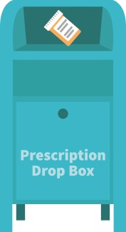
Safe Medication Practices | 200 Pts
< Back to Game Board
ANSWER
The best option for safe disposal? Place the medication in a drug dropbox or take advantage of a drug take-back event.
Next Answer
Notes:
Answer: Safe Medication Practices, 200pts
Transition: Once you are finished with a prescription, it is important to safely dispose of the medication. The majority of individuals that misuse prescription medications access them from their family members or friends.
Once finished with a prescription medication, the best options for safe disposal include:
Option #1: place the medication in a drug drop box. To find a drop box in your area, visit: rxdrugdropbox.org
Option #2: take advantage of community drug take-back programs that allow the public to bring unused drugs to a central location for proper disposal. Call your local law enforcement agency or ask your pharmacist to see if a take-back program is available in your community.
Facilitator’s Note: Click to following slide for Option #3

Slide 25
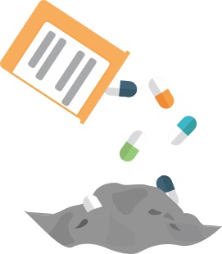

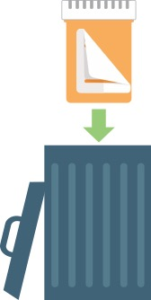
Steps for Safely Disposing of Medications at Home
< Back to Game Board
Safe Medication Practices | 200 Pts
If needed, safely dispose of medications at home:
STEP 1
STEP 2
STEP 3
Notes:
Answer: Safe Medication Practices, 200pts
Transition: If a drug drop box or a drug take-back event is not available, you can dispose of the medication at home.
Option #3: dispose of the medication at home (steps illustrated on this slide). Before completing these steps, we encourage you to follow any disposal instructions on the prescription label or patient information sheet.
If disposal instructions are not given, complete these three steps:
Step 1: Remove the pills from the original container and mix them with an undesirable substance such as used coffee grounds or kitty litter.
Step 2: Throw away the sealed mixture into the trash.
Step 3: Remove the prescription label and dispose of the empty bottle.
[Note: In general, you should not flush medications down a toilet or drain; however, the FDA still recommends that certain drugs should be disposed by flushing (for a list, visit: www.fda.gov).]

Slide 26
Safe Medication Practices | 300 Pts
< Back to Game Board
QUESTION
“Why is it important to follow the instructions on my prescription?”
Answer
Notes:
Category: Safe Medication Practices, 300pts

Slide 27
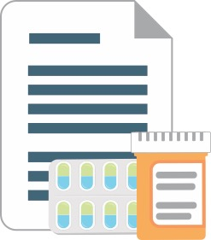
Safe Medication Practices | 300 Pts
< Back to Game Board
ANSWER
Following instructions maximizes benefits and reduces the risk of adverse drug events.
Notes:
Answer: Safe Medication Practices, 300pts
Transition: Medications that require a prescription are safe and effective only when used as instructed and under the supervision of a healthcare provider.
Instructions are provided to keep us safe. When we don’t follow instructions, we increase the likelihood that negative side effects, including developing a dependency on and addiction to some medications, can occur.
We should always avoid tendencies to self-diagnose and self-prescribe. This includes making decisions related to how much and how often (dose and frequency) you take the medication, as well as the reason for taking the medication.

Slide 28
Safe Medication Practices | 400 Pts
< Back to Game Board
QUESTION
“The doctor gave me a medication to help me sleep. Do you want to see if it will help you get a good night sleep, too? I’ll give you one.”
Why is it NOT a good idea to take a medication prescribed to someone else?
Answer
Notes:
Category: Safe Medication Practices, 400pts

Slide 29
Safe Medication Practices | 400 Pts
< Back to Game Board
ANSWER
A medication prescribed to someone else:
  may interact with other medication you are taking
  may not be safe to take based on your unique size, weight, genetics, and medical conditions
Notes:
Answer: Safe Medication Practices, 400pts
Transition: Two primary reasons NOT to take a medication prescribed to someone else:
May interact with other medications you are taking
May interact with another medical issue you are having
Even if it might seem like a good idea, it is never okay to take another person’s prescription medications. This is actually an illegal act in the United States. It would be better for the person to discuss their particular sleep issues with their own doctor to determine the best intervention.

Slide 30

Prescription Drug Misuse | 100 Pts
< Back to Game Board
TRUE OR FALSE
It’s okay to drink alcohol while taking medications.
Answer
Notes:
Category: Prescription Drug Misuse, 100pts

Slide 31
Prescription Drug Misuse | 100 Pts
< Back to Game Board
ANSWER
FALSE
Many medications interact with alcohol making it a risky combination, especially for older adults.
Notes:
Answer: Prescription Drug Misuse, 100pts
Transition: Often, interactions with prescription medications and alcohol are due to the sedating effects of alcohol. This can be compounded by medications which also have sedating effects.
If you drink alcohol such as wine, beer or mixed drinks, discuss the possible affects this might have on your medications with your doctor or pharmacist.

Slide 32
Prescription Drug Misuse | 200 Pts
< Back to Game Board
QUESTION
What is the definition of prescription drug misuse?
Answer
Notes:
Category: Prescription Drug Misuse, 200pts

Slide 33
Prescription Drug Misuse | 200 Pts
< Back to Game Board
ANSWER
Prescription Drug Misuse is:
Taking more of a prescription medication than prescribed
Taking a prescription medication for a reason different than prescribed
Sharing or taking someone else’s prescription medication
Notes:
Answer: Prescription Drug Misuse, 200pts
Transition: We define prescription drug misuse as engaging in three key behaviors:
Taking more of a prescription medication than prescribed
Taking a prescription medication for a reason different than prescribed
Sharing or taking someone else’s prescription medication
Regardless of the intention or reason, engaging in any of these behaviors is misuse.
Facilitator's Note: For scoring purposes, if a team or individual gets one of the 3 answers correct we recommend awarding them the 200 points.

Slide 34
Prescription Drug Misuse | 300 Pts
< Back to Game Board
QUESTION
The misuse of medications affects all of us in various ways. Where do people most often get the prescription drugs they misuse?
Answer
Notes:
Category: Prescription Drug Misuse, 300pts
Drug overdose is the leading cause of accidental death in the United States.
Misuse of prescription medications is often the first step toward the use of illegal drugs.

Slide 35
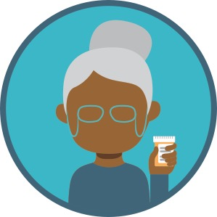
Prescription Drug Misuse | 300 Pts
< Back to Game Board
ANSWER
Friends and Family Members
Notes:
Answer: Prescription Drug Misuse, 300pts
Transition: This is the main reason it is important to safely secure all medications in a lockable space and away from others.

Slide 36
Prescription Drug Misuse | 400 Pts
< Back to Game Board
QUESTION
Can older adults become addicted to or dependent on medications?
Answer
Notes:
Category: Prescription Drug Misuse, 400pts

Slide 37
Prescription Drug Misuse | 400 Pts
< Back to Game Board
ANSWER
YES
Unfortunately, the number of older adults addicted to or dependent on medications is on the rise.
Notes:
Answer: Prescription Drug Misuse, 400pts
Transition: Some of the reasons for this trend may be:
aging of the Baby Boomer population who grew up with a different perspective on medication use. They are more likely to take medications.
harder to recognize and screen for medication misuse so it goes unaddressed
frequently prescribed medications for an original good reason but not re-evaluated or stopped
various other physical, mental and social issues elevating the risk for misuse
Programs to help older adults with addiction or dependence are available and important as the treatment needs for older adults may be different.

Slide 38
Final Round
< Back to Game Board
FINAL TRIVIA QUESTION
Who is the most important member of your healthcare team?
Answer
Notes:
Transition: for the final trivia round, complete this statement.
Note to facilitator: read the statement and encourage participants to share their thoughts with the larger group. Advance the slide to summarize the safe medication practices as well as identify resources where individuals can find help.

Slide 39
Final Round
< Back to Game Board
ANSWER
YOU
are the most important member of your healthcare team!
Thank You
Notes:
Transition: You are certainly the most important member of your healthcare team.
Becoming informed about the medications you take
Following safe medication practices for life
Being informed about prescription drug misuse
These are all things you can do to help with safe and effective medication use. It starts with you!!

Slide 40
THANK YOU FOR PLAYING
Safe Medication Practices for Better Health
Be Your Own Advocate
Learn Safe Medication Practices
Know the Risks of Medication Misuse

Slide 41
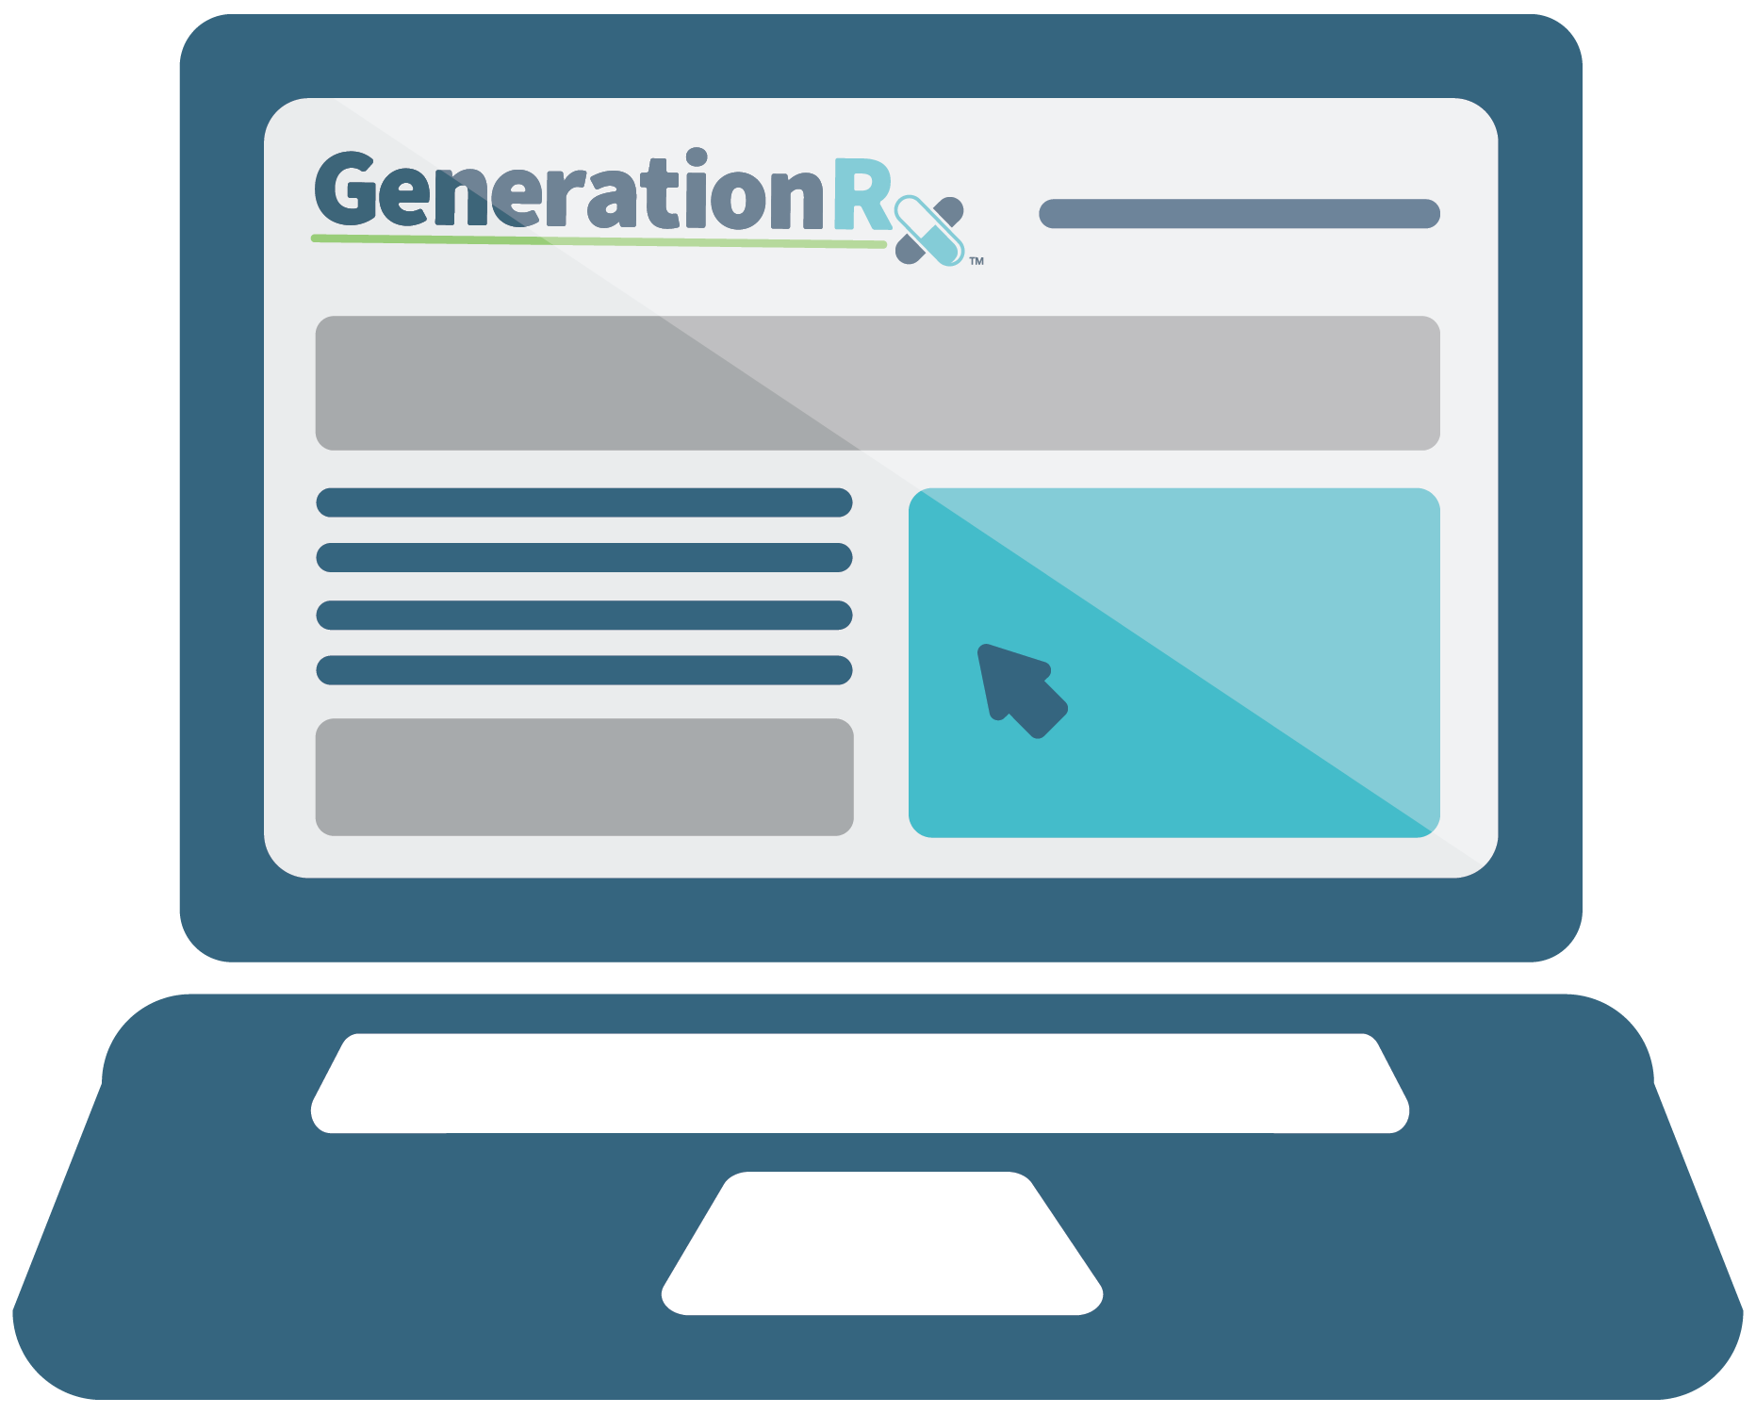
HELP OTHERS
Share the information
Be a good example for others
Notes:
Transition: How can you help others?
First, you can share these messages with others. This may consist of discussing these messages with family members and friends or sharing these messages through peer-to-peer education. Visit our website, generationrx.osu.edu, to access free, ready-to-use resources designed to educate others. You could present this program or a different activity. You could also present similar educational programs to other audiences, like teens, using our age-appropriate resources.
Lastly, if you are concerned about someone you care about, we encourage you start a conversation. In addition, we’ve identified resources for helping others at generationrx.osu.edu.

Slide 42
Questions?
Questions?
Notes:
Transition: Does anyone have any questions or comments?
Before we end, we encourage you to stay connected by following us @TheGenRx on Instagram and Facebook.
Note to facilitator: We also encourage you to share your experience with us. Consider submitting your tips and personal experiences about how you advocate safe medication practices at home or in your community. To do this, visit the ‘Contact’ section of generationrx.osu.edu. In this same section, you can also submit any questions you may have regarding how to use these educational resources.

