Slide 1
SAFE MEDICATION PRACTICES
FOR BETTER HEALTH
OLDER ADULT TOOLKIT | Presented by INSERT NAME |
Notes:
(Title slide – insert presenter names and date, if desired)
We are here, today, to discuss how you can get the most from your medications and do so safely.
This program was developed by Generation Rx at The Ohio State University College of Pharmacy, in partnership with the Cardinal Health Foundation.

Slide 2

Overview
Be Your Own Advocate
Learn Safe Medication Practices
Know the Risks of Medication Misuse
Notes:
Transition: We will spend our time focusing on three areas relating to medication use:
Be your own health advocate – straightforward tips for being an informed user of medications
Be safe with your medicines – important information about “safe medication practices for life”
Know the risks of medication misuse – facts about medication misuse in our country and what you can do about it

Slide 3

Medications Can Help—If Used Safely
Medications help us live longer and healthier lives, but when not used properly, they can produce harmful effects.
Notes:
Transition: The prescribing of medications is the most common type of medical treatment in the United States, and pharmacists dispense over four billion prescriptions each year. (Kaiser Family Foundation statistics)¹
These medications help us live longer and healthier lives, but they can also produce harmful effects when not used properly.
In fact, medication problems are thought to cause between 10-30% of all hospital admissions in older people. (Age and Ageing 2014;43(2):174-187 and J Am Geriatr Soc 2018; 66:282-288.)^{2,3}
American Academy of Family Physicians recommend limiting the number of prescription medications whenever possible because each new medication adds more than one adverse drug event each year. With 6 or more medications this risk goes up four-fold. (Am Fam Physician 2013;87(5):331-336)⁴
So, how can you get the best results from your medications and do so safely?

Slide 4
BE YOUR OWN
HEALTH ADVOCATE
Notes:
Transition: Let’s start off by focusing on how to be your own health advocate, especially as it pertains to medications.
You are the most important member of your healthcare team. Take the time to become an expert about your medications. Ask questions and get all the information you need to get the best results from your medications!

Slide 5
Overview
When is the best time of day to take the medication?
Is it safe to crush or split tablets?
Should I take it with or without food?
What side effects most commonly occur?
What should I do if I forget to take a dose?
Notes:
Transition: Being an informed consumer is the best way to get the most out of any purchase, and medications are no different. In fact, learning about your medications is critical for getting the best health outcomes.
Here are suggestions for questions you may wish to ask your doctor or pharmacist (read slide). Take the initiative to learn about your medications, ask questions of your doctor and pharmacist, and become an expert about your medicines!

Slide 6
Keep a Complete Medication Record
Medication Name | Other Names | Directions | Use | Prescriber | Other Information
Lisinopril 20 mg | Prinvil | Take 1 tablet once daily | Blood Pressure | Dr. Sam Jones | Avoid salt substitutes
Omeprazole 20 mg | Prilosec | Take 1 capsule in the evening | Heartburn/ Indigestion | Dr. Sam Jones | Take on an empty stomach
Tylenol Extra Strength 500 mg | Acetaminophen | Take 1-2 tablets every 6 hours as needed | Arthritis Pain | OTC | Do not take more than 6 tablets in a day Do not drink alcohol
Senior Multivitamin |  | Take 1 tablet once daily | Supplement | OTC
Notes:
Transition: An updated medication record is probably the most important tool to help guide you to safe medication use. Always keep an updated, complete record of your prescription and nonprescription medications and carry it with you.
Download the medication record form at www.generationrx.osu.edu and use it to record:
The brand and generic name of your medications
Strength and dosing directions (be specific about the time of day you are taking the medication)
The name of the prescriber, meaning the person that wrote the prescription for you
Brief descriptions of the specific use of each medication (i.e., What are you taking it for?)
Any special instructions (e.g., “Take with food”)
Those involved in your care must know all the medications you are taking to help you maintain good health. This is the best way to avoid potentially harmful interactions between your medications and other prescription or nonprescription drugs or herbal products. So, be sure to share your complete medication record with your doctor and pharmacist. It is always wise to have all of your prescriptions filled at the same pharmacy so that your pharmacist is aware of everything you are taking.

Slide 7

Use your pharmacist as a resource
Notes:
Transition: Your community pharmacist can be a useful resource.
Your pharmacist is a wonderful resource for information about your prescription and non-prescription medications. She or he is an expert in “medication management.” Your insurance plan may even pay for a visit with a pharmacist for a comprehensive review of all your medications, as well as assistance in trouble-shooting any problems that you may be having with your medication. For example, Medicare Part D may pay for your pharmacist to sit down and review your medications with you at no charge! Consider asking your community pharmacist if you qualify for this service.
Medications can be very expensive even if you have some prescription coverage. Your pharmacist may be able to help you find a more affordable option. A few options they might suggest would be:
If your prescription is for a brand-name drug, your pharmacist would know if it is available as a less costly generic.
Most drug manufacturers have programs for supplying needed medications to those who can’t afford them – your pharmacist may be able to help.
The doctor’s office or manufacturer’s website may have coupons available, usually for brand-name medications.
Special clinics may be available in your area if you can’t afford the care you need. These may have names such as “free clinic” or “charitable pharmacy”.
Your state, county or city health department may also have programs to help with medication costs.
(see medicare.gov resource)⁵

Slide 8
The Prescription Label
Notes:
Transition: Another great place to look for medication information is the label on your prescription.
In addition to the name of the medication and directions on how to take it, you will also find other useful information like the number of tablets or capsules dispensed to you from the pharmacy, the name of the prescriber, the date of dispensing as well as the date the prescription was written by the doctor, available refills remaining, and other helpful information about the medication such as caution statements like “Take with Food” or “Avoid Alcohol.”
If given a prescription with the label shown on this slide, when would you take it? (Allow audience responses) In this case, the best time to take the medication is not necessarily 12 hours apart (twice daily), but with the morning and evening meals since it is a medication to help with blood sugar and is best taken with food.
Your pharmacist can always provide advice about how and when to take your medications. All you have to do is ask!

Slide 9
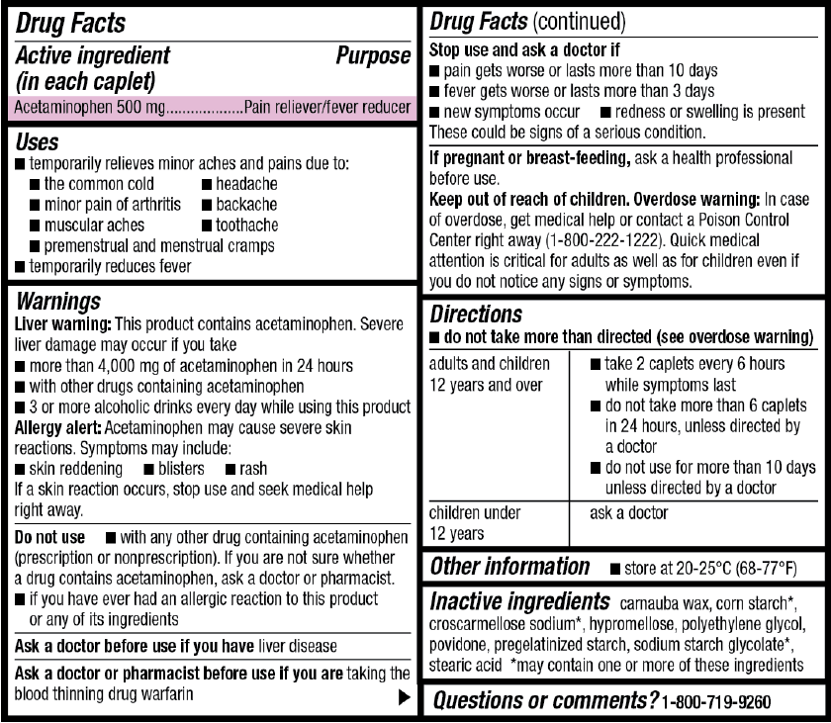
Drug Facts Label
Notes:
Transition: Similarly, a convenient place to get information about non-prescription medications is the standard label found on such products.
The “Drug Facts” label, as it is called, has useful information about the product such as⁶:
Active ingredients: many non-prescription products contain more than one active ingredient. (In the example above the active ingredient is Acetaminophen, generic Tylenol)
Uses: symptoms or conditions the product will treat or prevent
Warnings: when not to use the product
Inactive ingredients: for example, color dyes or flavorings
Purpose: product action or category such as antihistamine, antacid or cough suppressant
Directions: how much to take, how to take and how often and how long to take the medication
Other information: such as how to store the medication
The information on the Drug Facts label can be helpful, but the best advice is to always consult your doctor or pharmacist about using nonprescription medications along with your prescribed medications.
(information taken from https://www.fda.gov/drugs/understanding-over-counter-medicines/over-counter-drug-facts-label )⁶

Slide 10
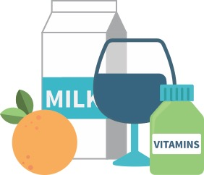
Anything you take can impact your medication therapy
Food
Drink (including alcohol)
Other prescriptions
Non-prescription medications
Herbal products
Vitamins
Notes:
Transition: Keep in mind anything that you take can impact your medication therapy. This could include food, drinks (both alcohol and non-alcohol), other prescription or nonprescription medications, herbal products, or dietary supplements.
For example, patients who are taking the drug Coumadin, also called Warfarin (WAR-far-in), to keep their blood thin and prevent clotting as easily must be careful. A number of things including other drugs, and even some foods, could interfere with their therapy. For instance, patients taking Coumadin must be careful not to take products containing ibuprofen or naproxen. Doing so could increase their chance for bleeding side effects. Unless their doctor advises them to do so, they should avoid ibuprofen or naproxen when taking Coumadin (Warfarin).
Red Yeast Rice, an herbal supplement, interacts with many cholesterol lowering medications such as Simvastatin (generic for Zocor) and Atorvastatin (generic for Lipitor). Herbal products like Red Yeast Rice may provide benefits, but they are not closely regulated by the FDA. It is extremely important to be well informed before deciding to try an herbal product. A wonderful free resource for unbiased information is from The National Center for Complementary and Alternative Medicine in the National Institutes of Health (see: www.nccam.nih.gov)⁷.
These are just two examples of the many potential interactions between the medications, food and drink you consume on a regular basis. Be sure to use your pharmacist as a resource to make sure you can take your specific combination together, safely.

Slide 11
Medication Information Resources
Name of Resource | Usefulness | Website
Medline Plus | Information on prescription medications and health conditions | https://medlineplus.gov
National Center for Complementary and Integrative Health | Information on herbs and supplements | https://www.nccih.nih.gov
Notes:
Transition:
There are so much information at our fingertips. We want to provide you will two web-based resources for reliable health and medication related information.
Facilitators:
Click on the links to take you to these resources and demonstrate how to find a specific medication such as metformin using Medline Plus⁸.
Next, use the National Center for Complementary and Integrative Health⁷ to look up a specific herbal product such as ginger.

Slide 12
Having a new symptom or health issue?
Ask yourself: “Did this start after doing something different with my medications?”
If you think you are having a side effect from a medication:
If severe (e.g., trouble breathing or bleeding), call 9-1-1
Otherwise, contact your doctor or pharmacist to discuss your new symptoms
Notes:
Transition: If you are having a new symptom or health issue, it is always a good idea to consider if it could be due to any of your medications.
When used properly, medications can help us live longer and healthier lives. They can treat diseases, relieve symptoms, and prevent certain diseases from occurring in the first place. But any medication can also produce harmful effects, so it is important to remember this. If you are having difficulties, consult your doctor or pharmacist.
If you are having problems, think about the timing of when it started. Ask yourself, “Did I start feeling this way soon after doing something different?” such as:
starting a new prescription or over-the-counter medication
a change (increase or decrease) in my medication strength or dose
a change in the way I am taking my medication
drinking an alcoholic beverage
a change in my diet (e.g., grapefruit can affect some medications such as blood pressure and cholesterol medications)
If you think you are having a side effect from a medication, here are actions to take:
If it is a severe side effect such as trouble breathing or bleeding, call 911
Otherwise, contact your doctor or pharmacist to discuss your new symptoms and ask if this is a usual side effect of your medications. Ask if there are steps you can take to make you feel better.

Slide 13
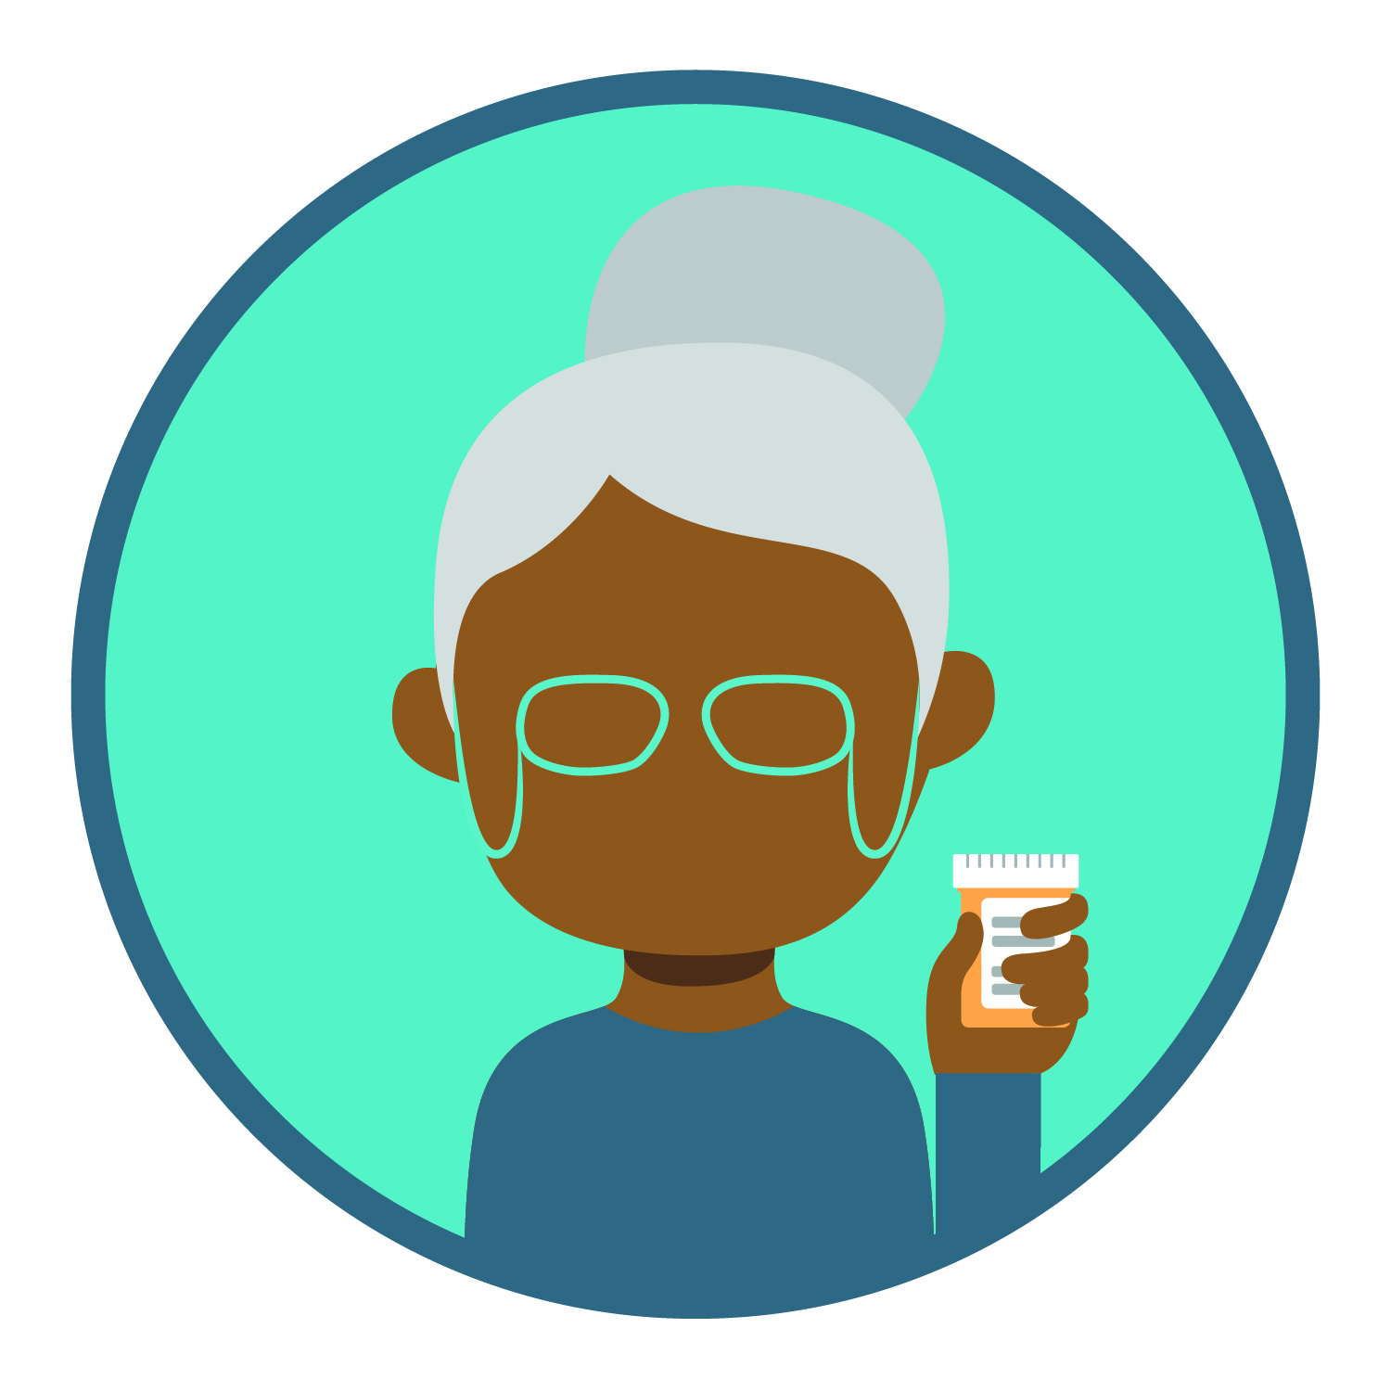
Medication Adherence
What is this?
World Health Organization Definition:
“The degree to which the person’s behavior corresponds with the agreed recommendations from a health care provider.”
Notes:
Transition:
The only way we can get the health benefit from medications is to take them. In healthcare we call this medication adherence. Here is a definition of this term from the World Health Organization⁹:
“The degree to which the person’s behavior corresponds with the agreed recommendations from a health care provider.”
Please note this definition implies that there was agreement between the patient and the prescriber about taking the medication.
It is at this point it is very important to ask questions of the prescriber about the reason and expectation of the medication.
This information is essential to determining if you are going to listen to the recommendation and regularly take the medication.

Slide 14

Discussion
What are some things that help you take medications regularly?
Anyone willing to share?
Notes:
Facilitators:
Pause to ask your audience to explain the system they have worked out to remember to take their medications. The next slide will list a few suggestions.

Slide 15
Medication Adherence Tips
Connect taking the medication to something you do every day.
Consider a pillbox.
Consider a smartphone app or daily alarm to prompt you to take your medications.
If there is a reason you are not taking your medication, be sure to discuss it with your doctor or pharmacist.
1
2
3
4
Notes:
Transition: Here are a few tips that might help you with consistently taking your medications:
Linking your medication-taking to something you do everyday can be very helpful (example: take morning medication with your coffee or tea).
If you are someone who wonders if you have taken your medication or not, a pillbox could be useful.
The use of alarms either on a smartphone or smart systems such as Alexa or Google are also something to consider.
If there is a reason you are not taking you medication, please talk with your doctor or pharmacist about it to see what could be done
An example of this would be if a medication is causing you to have a very upset stomach, it could understandably get in the way of your taking it regularly. Talking with the doctor or pharmacist would help you both create a plan to deal with this, together.

Slide 16
LEARN SAFE
MEDICATION PRACTICES
Notes:
Transition: We have been focusing on ways to be your own health advocate when it comes to medications, Now, we will discuss four steps you can take toward ”safe medication practices to follow for life”

Slide 17
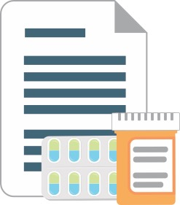
Safe Medication Practice #1
1
Only use prescription medications as directed by a health professional
Notes:
Transition: It is important to follow the directions provided with your prescription medications. Only make changes in your own medication therapy after talking with your doctor. Even stopping your therapy on your own can be harmful. For example, stopping antibiotic therapy too soon could result in a more severe infection, and the dosage of some drugs must be slowly decreased before stopping them all together.
Sticking with the plan - your medication regimen can be challenging when you have a chronic condition like diabetes or high blood pressure, but not doing so can cause harm. For example, diabetes that is not properly treated can result in heart disease, blindness, kidney failure, nerve damage, and other problems. It is estimated that we spend approximately $300 billion each year in our healthcare system simply because patients don’t take their medications as directed.⁹
It is also important to take your medications regularly. For most medications, this means every day or even multiple times a day. If you have trouble remembering, there are some simple things you can do. For example, some people use a calendar to keep track of the pills they have taken. Pill boxes which contain your medications for each day are also helpful, and there are more sophisticated tools available including special medication alarms or electronic reminders.
Note to Facilitator: Ask your audience to share ideas they use to remember to take their medications.
Avoid stopping a medication without talking to your doctor or pharmacist, even if it doesn’t seem to be working. Sometimes medication therapy takes a while to take effect, or the effects may not even be noticeable.

Slide 18
Safe Medication Practice #2
2
Do not share or take someone
else’s medication
Notes:
Transition: Second, never share your prescription medications with others or use someone else’s prescription drugs.
Many factors determine how we respond to medication—our genetics, weight, and pre-existing medical conditions, amongst others. Therefore, individuals can respond to the same medication differently.
Engaging in behaviors of self-diagnosis and self-prescribing is dangerous—always report any health concerns to a healthcare professional. Don’t self medicate!
Regardless of intention, sharing or taking someone else’s medication is not safe. Only use medications under the guidance of a healthcare professional.

Slide 19
Safe Medication Practice #3a
3
Keep your medications safe: storage
Notes:
Transition: Third, keep your medications secure through safe storage and disposal practices. First, we’ll discuss storage. How do you safely store medications?
Note to facilitator: encourage participants to suggest safe storage places.
When prescribed a prescription medication, store medications in secure locations such as lock-boxes, medication safes, or other lockable spaces.
Avoid storage places which children and others can easily access, such as drawers, nightstands, or kitchen counters/cabinets.
Unfortunately, most people who misuse prescription drugs get them from family members or friends. Help keep others safe by storing your medications safely!

Slide 20
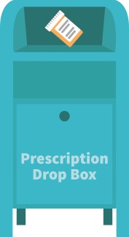
Safe Medication Practice #3b
3
Keep your medications safe: disposal
Notes:
Transition: Next, we’ll discuss disposal. Once finished with a prescription medication, you have three options for safe disposal:
Option Number One: Place the medication in a drug dropbox. To find a dropbox in your area, visit: rxdrugdropbox.org.
Option Number Two: Take advantage of community drug take-back programs that allow the public to bring unused drugs to a central location for proper disposal. Call your local law enforcement agency or ask your pharmacist or local health department to see if a take-back program is available in your community.

Slide 21
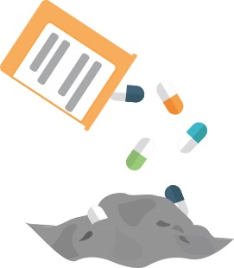

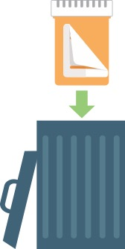
No Drug Drop Box or take-back event near you?
STEP 1
STEP 2
STEP 3
Notes:
Transition: If there is not a drug dropbox or take-back program near you, there is a third option that allows for safe disposal at home.
Before completing these steps, we encourage you to follow any disposal instructions on the drug’s label or patient information sheet.
If disposal instructions are not given, complete these three steps:
Step 1: Remove the pills from the original container and mix them with an undesirable substance such as used coffee grounds or kitty litter
Step 2: Throw away the sealed mixture into the trash.
Step 3: Remove the prescription label and dispose of the empty bottle.
In general, you should not flush medications down a toilet or drain; however, the FDA still recommends that certain drugs should be disposed by flushing (for a list, visit: www.fda.gov)¹⁰.
Again, those who misuse prescription medications often get them from friends and family – this is why it is so important to safely store and dispose of medications.

Slide 22
Safe Medication Practice #4
4
Model safe medication practices
Notes:
Transition: Fourth, be a good example to those around you by modeling these safe medication-taking practices. What others see you do matters!
When appropriate, discuss the dangers of misusing prescription drugs with your family, friends and others in your community. You can make a difference!

Slide 23
KNOW THE RISKS OF
MEDICATION MISUSE
Notes:
Transition: It’s important when talking with others to spread the word about an increasing problem in our country – prescription drug misuse. Prescription drugs are misused by millions of Americans at every age.¹¹
Note to facilitator: Ask “What do you consider prescription misuse?”

Slide 24
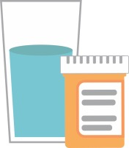
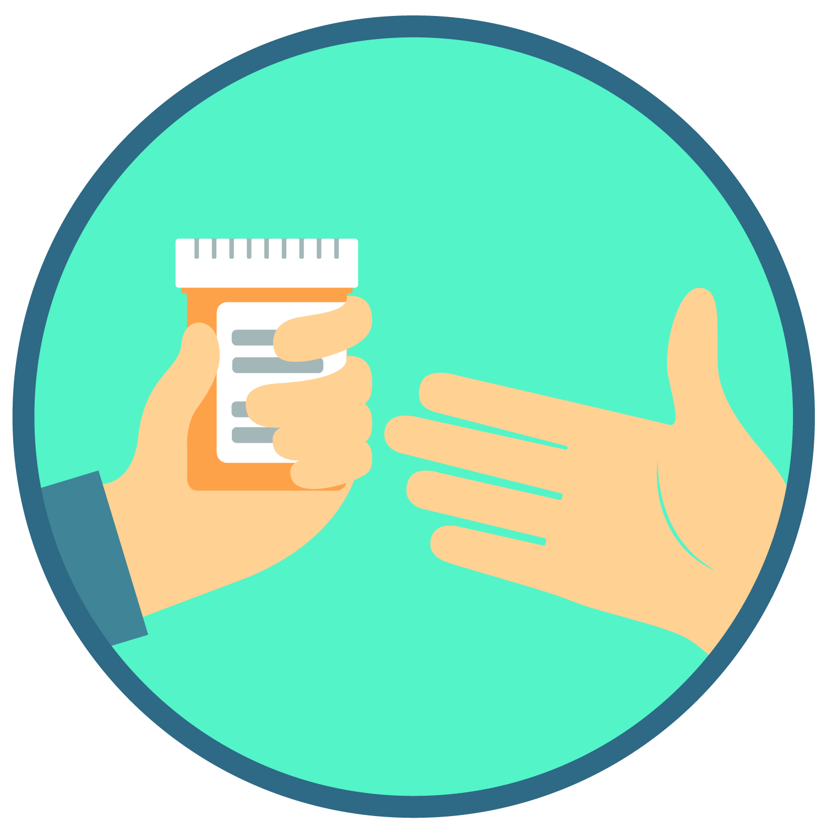
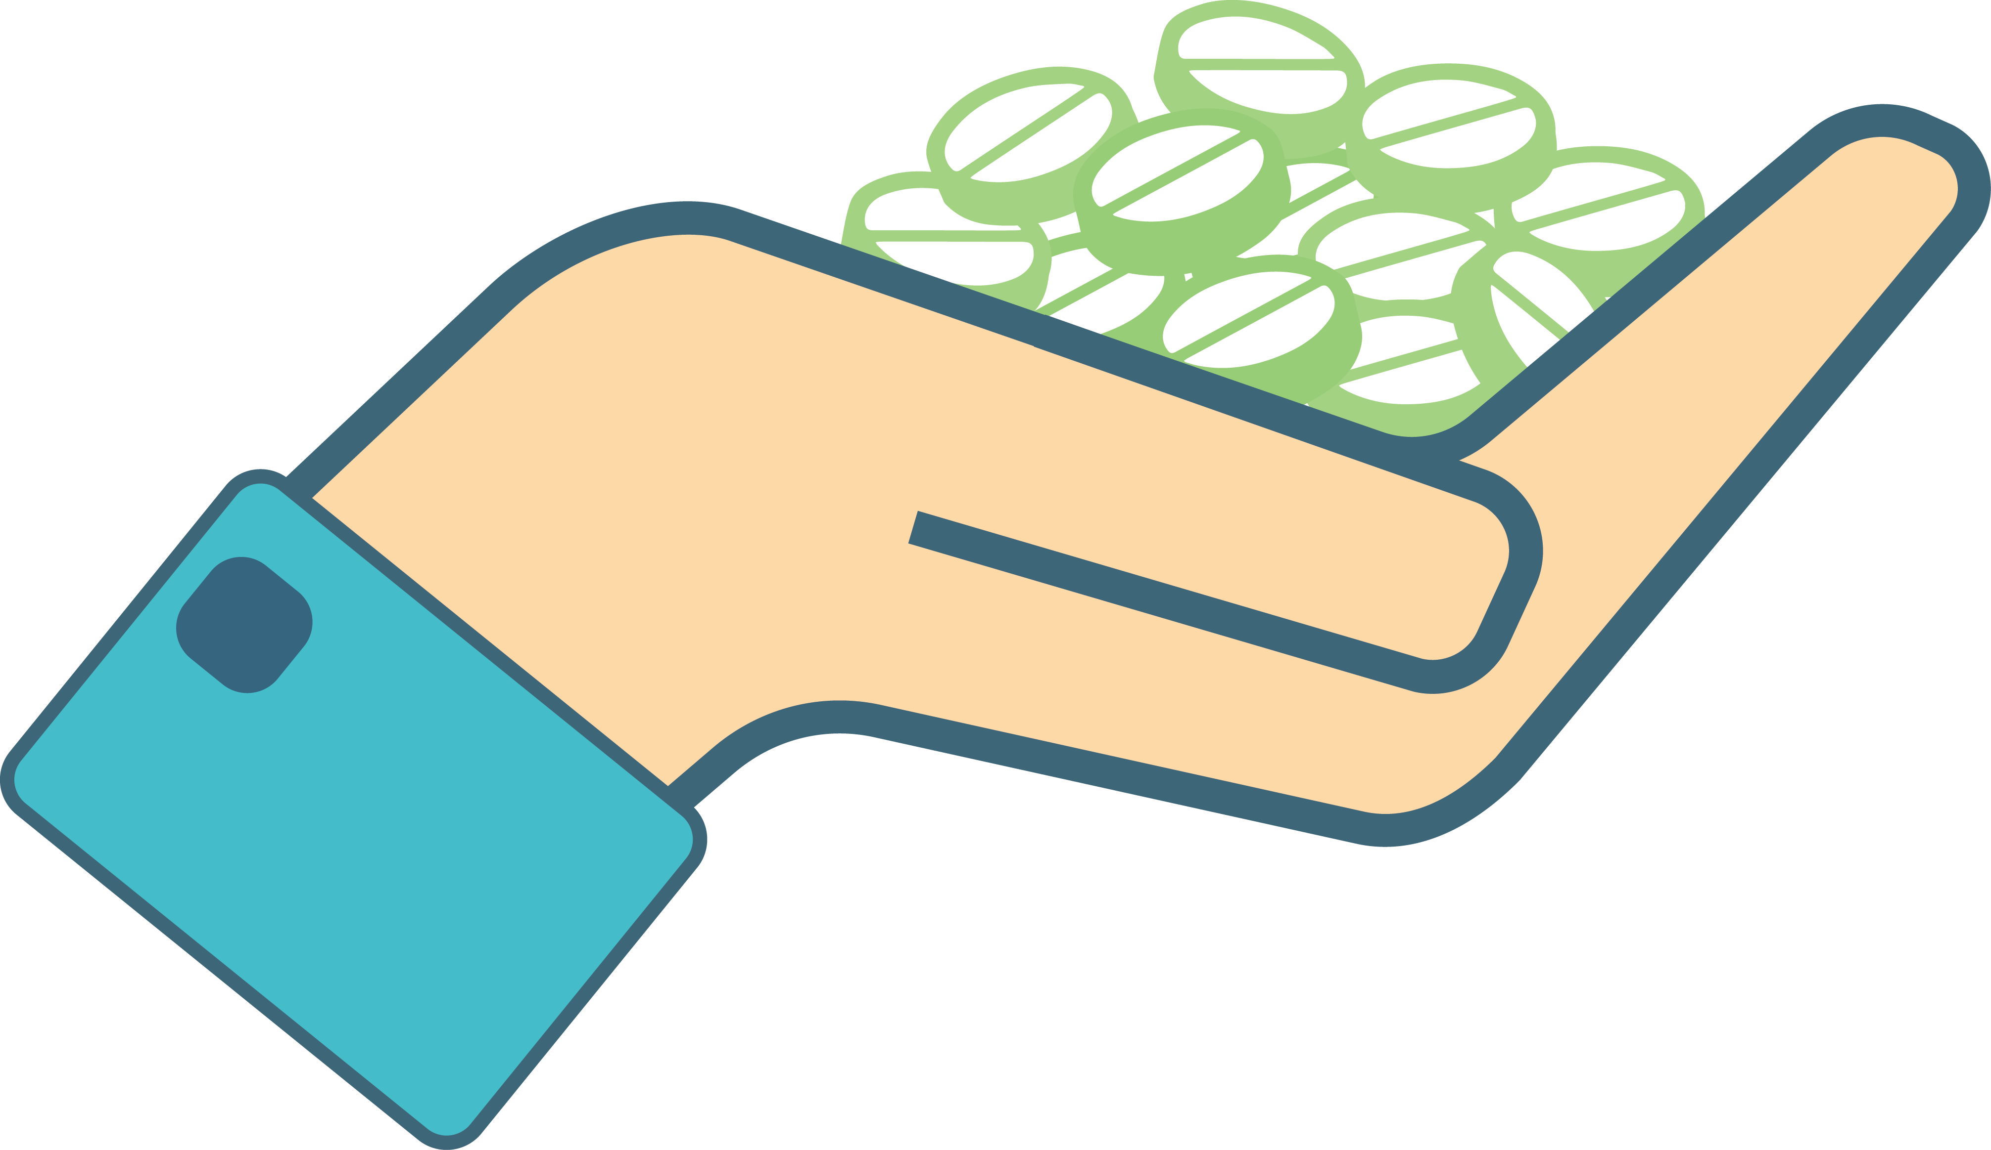
Prescription drug misuse is:
Taking more medication than prescribed
Taking medication for a reason different than prescribed
Sharing or taking someone else’s medication
Regardless of intentions
Notes:
Transition: We define prescription drug misuse as engaging in three key behaviors.
Taking more of a prescription medication than prescribed.
Taking a prescription medication for a reason different than prescribed.
Sharing or taking someone else’s prescription medication.
(Note for facilitator: If asked, the National Institute on Drug Abuse currently supports these definitions of prescription drug misuse.)¹²
Regardless of the intention or reason, engaging in any of these behaviors is misuse. Unfortunately, prescription drug misuse has become an epidemic in our country, and it can lead to tragic consequences!

Slide 25

This issue affects all of us
Drug overdose is our country’s leading cause
of accidental death.
Some people who use fentanyl or other illicit drugs first misuse a prescription medication.
Notes:
Transition: This epidemic affects all of us.
There is no stereotypical “type” of person susceptible to prescription drug misuse.
Prescription drug misuse occurs from the very young through the very old. It occurs in rural and suburban communities among those of all socioeconomic status. This is not a “youth” issue. These risks apply to everyone, including older adults.
The National Center for Drug Abuse statistics tells us that nearly 14 million Americans misuse prescription medications like opioid pain medications (e.g., OxyContin, Vicodin, Lortab), sedatives (e.g., Xanax, Valium), or stimulants (e.g., Adderall, Ritalin) every year.¹²
This is an important reason to properly use, store and dispose of these medications to protect ourselves and those around us.
Note for facilitator: based on your audience, you may wish to share some of the statistics listed below.
Statistics to share with older adults:
Prescription drug misuse has estimated to have increased from 1.2% in 2001 to 2.4 % in 2020 among older adults.¹³
SAMHSA (Substance Abuse and Mental Health Services Administration) reported the number of older adults needing substance misuse treatment in 2022 to be 8.5 million (increased from 1.7 million in 2003)¹⁴.
Research estimates 11.4% of older adults struggle with a substance misuse problem (SAMHSA, 2024)¹⁴.
Emergency department visits involving misuse of prescription opioids by older adults increased 121% between 2004 – 2008 (SAMHSA, 2012)¹⁴.

Slide 26

Here is what you can do to help
Be informed
Discuss all medication issues with your doctor and pharmacist
Safely store and dispose of medications
Join in the effort to spread the word about safe and appropriate medication use
Together we will make a difference
Notes:
Transition: With your help, we can make an impact on the medication misuse epidemic.
It is important to:
Be informed about your specific medications
Discuss all medication issues you may have with your doctor and pharmacist
Safely store and dispose of medications to help make sure they do not end up in the wrong hands
Join in the effort to spread the word about safe and appropriate medication use – get involved in the educational efforts!
Together we will make a difference!

Slide 27
Summary
Be Your Own Advocate
Learn Safe Medication Practices
Know the Risks of Medication Misuse
Notes:
Getting the most from your medications and doing so safely can be done!
Remember to:
Be your own health advocate:
Learn about your medications
Keep a Complete Medication Record
Use your pharmacist as a trusted resource
Having a new symptom or health issue?- consider if it could be due to a new medication
Learn safe medication practices:
Only use prescription medications as directed
Do not share or take someone else’s medication
Properly store and dispose of your medications
Model safe medication practices
Know the risks of prescription drug misuse and help us spread the word!

Slide 28
References
Prescription drugs - research and data from KFF. KFF. (2026, January 30). www.kff.org/tag/prescription-drugs
Thomas R, Huntley LA, Mann M, et al. Pharmacist-led interventions to reduce unplanned admissions for older people: a systematic review and meta-analysis of randomized controlled trials. Age and Ageing 2014;43 (2):174–187. doi.org/10.1093/ageing/aft169.
Gray SL, Hart LA, Perrera S, et al. Meta-analysis of interventions to reduce adverse drug reactions in older adults. J Am Geriatr Soc 2018;66:282-288.
Pretorius RW, Gataric G, Swedlund SK, Miller JR. Reducing the risk of adverse drug events in older adults. Am Fam Physician 2013;87(5):331-336.
Help with drug costs. Medicare. (n.d.). https://www.medicare.gov/basics/costs/help/drug-costs
Center for Drug Evaluation and Research. (n.d.). The over-the-counter drug facts label. U.S. Food and Drug Administration. https://www.fda.gov/drugs/understanding-over-counter-medicines/over-counter-drug-facts-label
U.S. Department of Health and Human Services. (n.d.). NCCIH. National Center for Complementary and Integrative Health. https://www.nccam.nih.gov
U.S. National Library of Medicine. (n.d.). Health information from the National Library of Medicine. MedlinePlus. https://medlineplus.gov
See Facilitator’s Guide for more information

Slide 29
References
World Health Organization 2003. Adherence to long-term therapies: evidence for action. https://iris.who.int/server/api/core/bitstreams/121c6b73-8651-442f-9560-e3b1d9c8a75c/content
Center for Drug Evaluation and Research. (n.d.-a). Information for consumers and patients: Drugs. U.S. Food and Drug Administration. www.fda.gov/drugs/resourcesforyou/consumers/default.htm
Prescription drug abuse statistics [2025]: Opioids, Fentanyl & More. NCDAS. (2025, October 3). https://drugabusestatistics.org/prescription-drug-abuse-statistics/
U.S. Department of Health and Human Services. (2023, March 6). Summary of misuse of prescription drugs. National Institutes of Health. www.drugabuse.gov/publications/research-reports/misuse-prescription-drugs/summary
Colliver JD, Compton, et al. Projecting drug use among baby boomers in 2020. Ann Epidemiology 2006;16:257-265.
Substance abuse and mental health services administration. SAMHSA. (n.d.). www.samhsa.gov
See Facilitator’s Guide for more information

