Slide 1

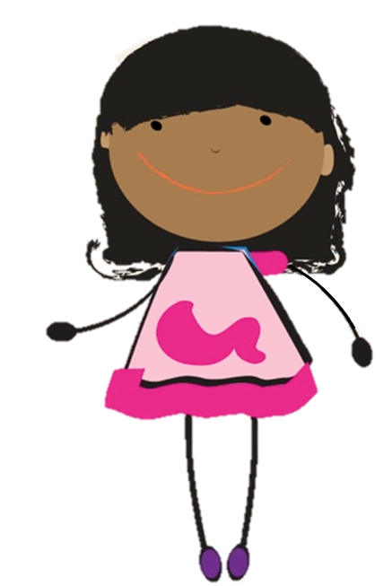
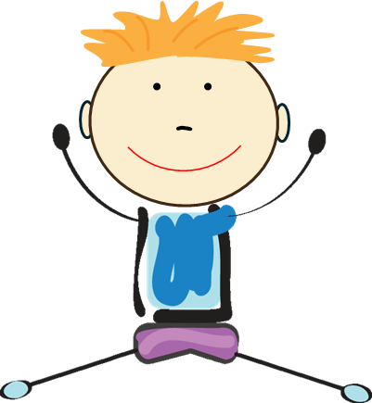


Medication Safety Patrol:
Safe Choices Game
ELEMENTARY TOOLKIT | Grades K - 2
Presenter Name
Presenter Organization
Brought to you by:
Notes:
Game Introduction:
Hello everyone…my name is _______ . Today we are going to discuss medication safety by playing a game called “Safe Choices”. Ready to play?

Slide 2
Medication Safety Rules
Ask trusted adults for help with medicine.
Only take medicine that is meant for you.
Keep medicine in safe places.
Share what you learn today with family and friends.
Notes:
Before we begin, let’s review the four medication safety rules. We will discuss these rules as we play our game.
Rule 1: Ask trusted adults for help with medicine
Rule 2: Only take medicine that is meant for you.
Rule 3: Keep medicine in safe places
Rule 4: Share what you learn today with family and friends

Slide 3
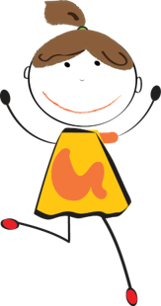
Directions
Help friends learn the medication safety rules:
There are two thoughts or choices on each slide: one is a “safe” choice, the other is an “unsafe” choice.
Decide whether each choice keeps friends “safe” or “unsafe”.
Raise the colored card of the "safe" choice and together, we will select the “safe” choice for friends to make.
Notes:
Let’s review the game directions.
Note to facilitator:
Consider adaptations for students selecting the correct bubble, if printing is limited. (See facilitator guide)
Pick the safe choice based on what the majority of the class says. You will need to hover your mouse on the outline of the speech bubble to trigger the link.

Slide 4
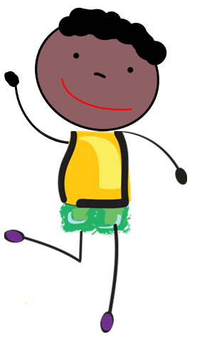
1. Which choice helps keep us safe?
Oops! Incorrect!
Adults are older than kids, but a trusted adult makes you feel safe and comfortable, and answers your questions about medication.
CORRECT!
Adults are older than kids, but a trusted adult makes you feel safe and comfortable, and answers your questions about medication.
A trusted adult is someone who keeps me safe.
A trusted adult can be anyone that is older than me.
Try Again
Next
Notes:
Note to facilitator:
For each “choice” slide, read each choice to participants and encourage them to select the choice that would keep them safe and healthy by having them raise the color card of that same thought bubble.
When ready, click the speech bubble participants selected. Read the response and select either “Next” if they answered correctly or “Try Again” if they answered incorrectly.
Repeat this process for all remaining “choice” slides.

Slide 5
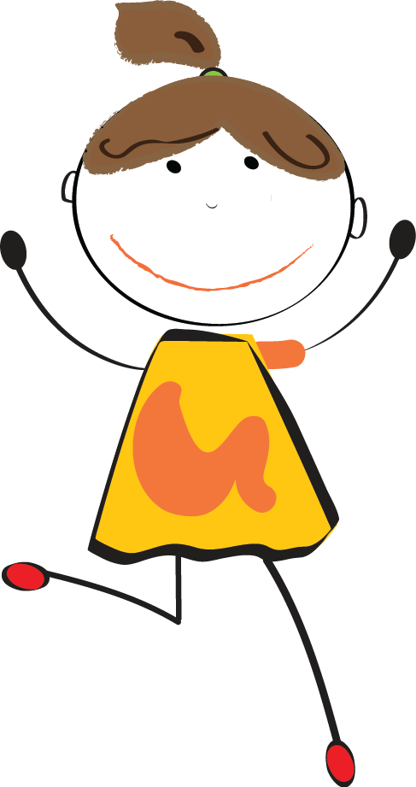
Safe choice answer board
A trusted adult is someone who keeps me safe
Safe Choices about Medicine
A trusted adult can be anyone that is older than me
A trusted adult is someone who keeps me safe.
Next
Notes:
Note to facilitator:
This slide will cumulate the safe choices participants select throughout the game.
After the safe choice populates on the slide, click “Next” to continue playing the game.

Slide 6
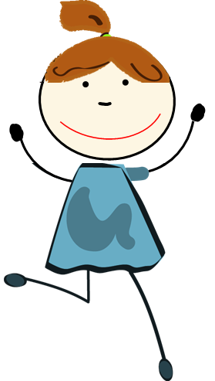
2. Which choice helps keep us safe?
Oops! Incorrect!
Your 8-year-old friend does not meet the definition of a trusted adult. They should not help you with medication.
CORRECT!
Pharmacists are trusted adults in the community that can teach you how to safely use medication.
My 8-year-old friend is a trusted adult.
Pharmacists are trusted adults in the community.
Try Again
Next

Slide 7
Safe choice answer board 2
Safe Choices about Medicine
My 8 year-old friend, Maggie, is a trusted adult..
Pharmacists are trusted adults in the community.
A trusted adult is someone who keeps me safe.
Pharmacists are trusted adults in the community.
Next

Slide 8
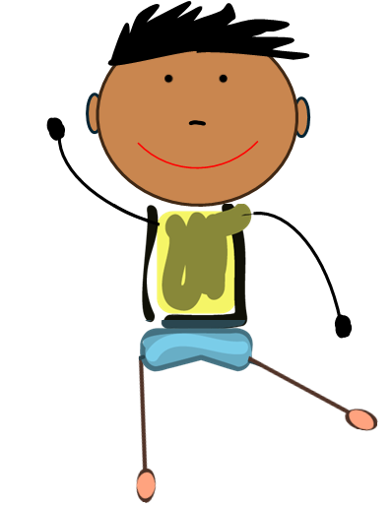
3. Which choice helps keep us safe?
Oops! Incorrect!
Even if you can read, ask trusted adults for help with medicine.
They help you only take medicine meant for you and follow instructions.
CORRECT!
Even if you can read, ask trusted adults for help with medicine.
They help you only take medicine meant for you and follow instructions.
I can take medicine all by myself since I can read the instructions.
Ask trusted adults for help with medicine.
Try Again
Next

Slide 9
Safe choice answer board 3
Safe Choices about Medicine
I can take medicine all by myself since I can read the instructions.
Ask a trusted adult for help with my medicine.
A trusted adult is someone who keeps me safe.
Ask trusted adults for help with medicine.
Pharmacists are trusted adults in the community.
Next

Slide 10
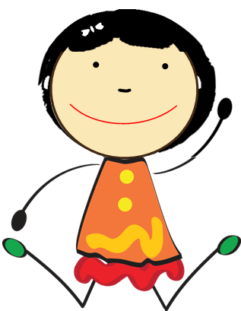
4. Which choice helps keep us safe?
Oops! Incorrect!
Medicine can help when sick but can also harm us if not taken safely.
Ask trusted adults for help and only take medicine meant for you.
CORRECT!
Medicine can help when sick but can also harm us if not taken safely.
Ask trusted adults for help and only take medicine meant for you.
Medicine can both help and possibly harm my body.
Medicine can only help and not harm my body
Try Again
Next

Slide 11
Safe choice answer board 4
Safe Choices about Medicine
Medicine can both help and possibly harm my body.
Medicine can only help and not harm my body.
A trusted adult is someone who keeps me safe.
Ask trusted adults for help with medicine.
Pharmacists are trusted adults in the community.
Medicine can both help and possibly harm my body
Next

Slide 12
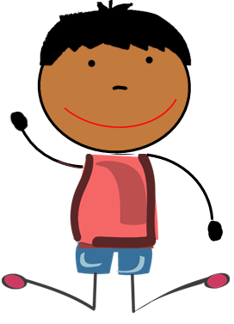
5. Which choice helps keep us safe?
CORRECT!
When medicine instructions are not followed, this increases the chance that medicine may harm our bodies.
Oops! Incorrect!
When medicine instructions are not followed, this increases the chance that medicine may harm our bodies.
You can ignore a medicine’s instructions.
Following medicine's instructions keeps us safe.
Try Again
Next

Slide 13
Safe choice answer board 5
Safe Choices about Medicine
You can ignore a medicine’s instructions
Following medicine's instructions keeps us safe.
A trusted adult is someone who keeps me safe.
Ask trusted adults for help with medicine.
Pharmacists are trusted adults in the community.
Medicine can both help and possibly harm my body
Following medicine's instructions keeps us safe.
Next

Slide 14
6. Which choice helps keep us safe?
CORRECT!
Sharing isn’t always caring! Do not share items that may harm others (like medicine) or items that share your germs (like toothbrushes).
Oops! Incorrect!
Sharing isn’t always caring! Do not share items that may harm others (like medicine) or items that share your germs (like toothbrushes).
Some things (like medicine) are not safe to share.
It is important that I always share everything with my friends.
Try Again
Next

Slide 15
Safe choice answer board 6
It is important that I always share everything with my friends.
Safe Choices about Medicine
Some things (like medicine) are not safe to share.
A trusted adult is someone who keeps me safe.
Ask trusted adults for help with medicine.
Medicine can both help and possibly harm my body
Pharmacists are trusted adults in the community.
Following medicine’s instructions keeps us safe.
Some things (like medicine) are not safe to share.
Next

Slide 16
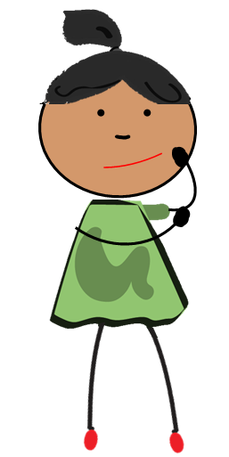
7. Which choice helps keep us safe?
Oops! Incorrect!
We may be similar to friends and family, but we are all unique and medicine might work differently in each of us. To keep everyone safe, you should never share medicine with others.
CORRECT!
We may be similar to friends and family, but we are all unique and medicine might work differently in each of us. To keep everyone safe, you should never share medicine with others.
My friends and I are similar, so it is okay to share medicine with them.
Medicine affects friends differently. Never share medicine.
Try Again
Next

Slide 17
Safe choice answer board 7
My friends and I are similar, so it is okay to share medicine with them.
Safe Choices about Medicine
Medicine affects friends differently. Never share medicine.
A trusted adult is someone who keeps me safe.
Ask trusted adults for help with medicine.
Pharmacists are trusted adults in the community.
Medicine can both help and possibly harm my body
Following medicine’s instructions keeps us safe.
Medicine affects friends differently. Never share medicine.
Some things (like medicine) are not safe to share.
Next

Slide 18
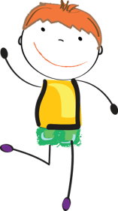
Remember the
Medication Safety Rules:
Ask trusted adults for help with medicine.
Only take medicine that is meant for you.
Keep medicine in safe places.
Share what you learn today with family and friends.
Thank you for playing!
Notes:
Note to facilitator:
Summarize the four medication safety rules . Ask children to identify something they learned, as well as identify one person they could share that information with.
Use this slide to conclude the game.

