Slide 1

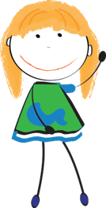
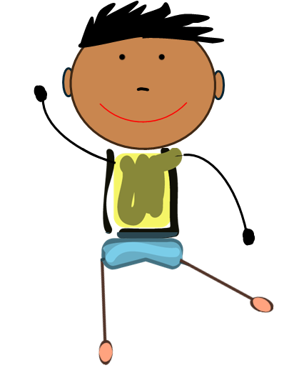


Medication Safety Patrol:
Trivia Game
ELEMENTARY TOOLKIT | Grades K - 2
Presenter Name
Presenter Organization
Brought to you by:
Notes:
Introduction:
Hello everyone…my name is _______ . Today we are going to discuss medication safety by playing a game called “Medication Safety Patrol Trivia”.

Slide 2
Medication Safety Rules
Ask trusted adults for help with medicine.
Only take medicine that is meant for you.
Keep medicine in safe places.
Share what you learn today with family and friends.
Notes:
Before we begin, let’s review the four medication safety rules. We will discuss these rules as we play our game.
Rule 1: Ask trusted adults for help with medicine
Rule 2: Only take medicine that is meant for you.
Rule 3: Keep medicine in safe places
Rule 4: Share what you learn today with family and friends

Slide 3
Directions
Each team takes turns choosing a category and
point value.
After the statement or question is read, each team will write an answer on their answer sheet.
Points will be awarded for correct answers only. If your team answers the question correctly, circle the answer on your answer sheet.
Notes:
Let’s review the game directions.
Each team will take turns choosing a category and point value.
After I read the statement or question, each team will write an answer on their answer sheet (this is the “Trivia Answer Sheet”).
If your team answers the question correctly, circle the answer on your answer sheet.
Note to facilitator:
By each team circling the correct answers, this will help them (or you) calculate a total score at the end of the game.
If you plan to exercise a “print-free” option and not distribute the answer sheets, you can keep score for each team using a whiteboard/chalkboard.
If participants do not want to write answers, you can also encourage them to mark each space with a sticker or color the space to track their progress.

Slide 4
Game board
I Spy…
What Should
I do?
Rhyme Time
1 point
1 point
1 point
2 points
2 points
2 points
3 points
3 points
3 points
Final Question
Notes:
This game includes three categories – I Spy, What should I do?, and Rhyme Time. Each team will take turns selecting a category and point value. When we are ready to end the game, I’ll ask the final question. Let’s get started.
Note to facilitator:
When a team selects a category and point value, click the point value to reveal the question.
Read the statement or question. On each question slide, click the “Answer” icon to reveal the answer.
Award points to teams that select an answer that aligns with the medication safety rules – remind students to circle their answer if it was declared correct.
After revealing the answers, elaborate on their response using the talking points provided for that slide.
On each answer slide, click the “Game Board” link to return to this game board.
Continue playing until all questions are answered (or until time ends). Then, click the ‘Final Question’ box on the game board.
Ask the ‘Final Question’ and allow each group to answer. Tally the earned points for each group and determine a winner.

Slide 5


I spy a trusted adult who can answer your questions about medicine…
1
2
Answer
Notes:
Category: I Spy, 1 point
Note to Facilitator:
Ask children if they can identify the name of the community helper on the left. You can give clues such as, “a community helper that is a medication expert and teaches us how to take medications safely” (pharmacist).
If you need to define medicine, consider: “a substance used to treat an illness or injury”.

Slide 6
Pharmacist
Game Board
Notes:
Category: I Spy, 1 point
Pharmacists are examples of trusted adults in the community. Trusted adults make you feel safe, listen to you, demonstrate they care about you, and answer your questions. Trusted adults can exist both in the home and in the community. Many teachers and school nurses are also examples of trusted adults available to help you make healthy and safe choices about medicine.

Slide 7
I spy items that are safe to share…
Answer
Notes:
Category: I Spy, 2 points

Slide 8
Items safe to share…
Game Board
Notes:
Category: I Spy, 2 points
Some things aren’t meant to be shared. We should not share items that may hurt others (like medicine or items that share our germs, like toothbrushes and underwear). Medicine affects people differently. For example, medicine that helps you could make your friend sick. To keep everyone safe, we should never share medicine or take somebody else’s medicine.

Slide 9
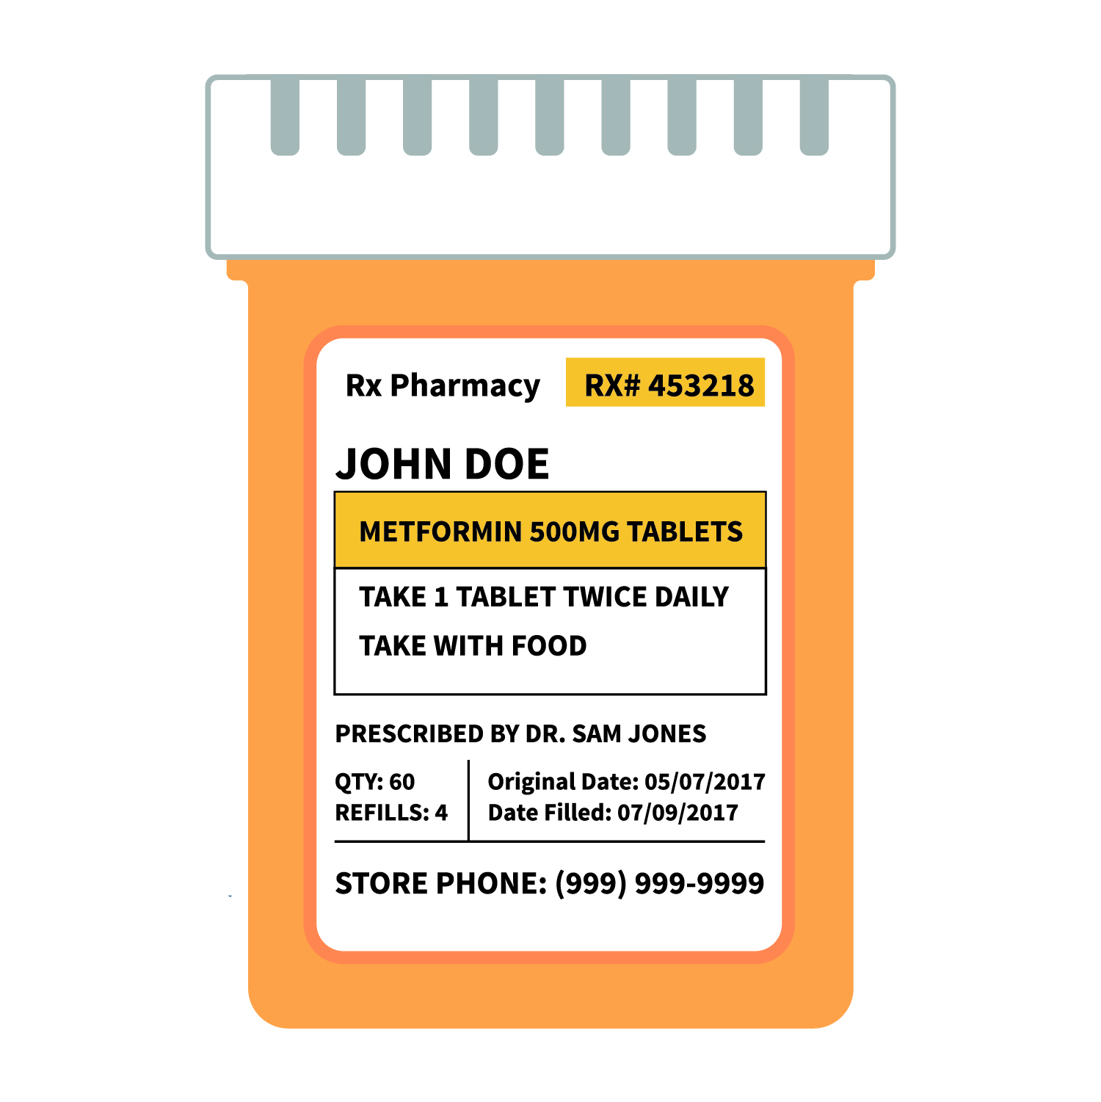
I spy the medication that is safe for Derrick to take…
1
2
DERRICK GRAY
JOSIE GRAY
Answer
Notes:
Category: I Spy, 3 points

Slide 10
Only take medicine meant for you
DERRICK GRAY
Game Board
Notes:
Category: I Spy, 3 points
The medication with Derrick’s name on it is the medication safe for him to take. Medicine affects people differently. For example, medicine that helps you could make your friend sick. So, we should only take medicine with our name on it. To keep everyone safe, we should never share medicine or take somebody else’s medicine.

Slide 11
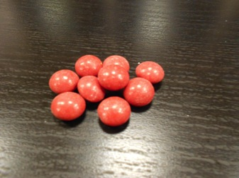
What Should I Do?
You find these red things on the counter. It looks like candy, should you eat it?
Answer
Notes:
Category: What should I do?, 1 point

Slide 12

No!
Ask a trusted adult for help.
Game Board
Notes:
Category: What should I do?, 1 point
If you do not know what it is, you should not eat it! Always ask a trusted adult before eating anything. Medicine and candy look similar, but they work very differently in our bodies. This is why we should ask our parents and guardians to keep medicine in its original container and ask trusted adults for help.

Slide 13
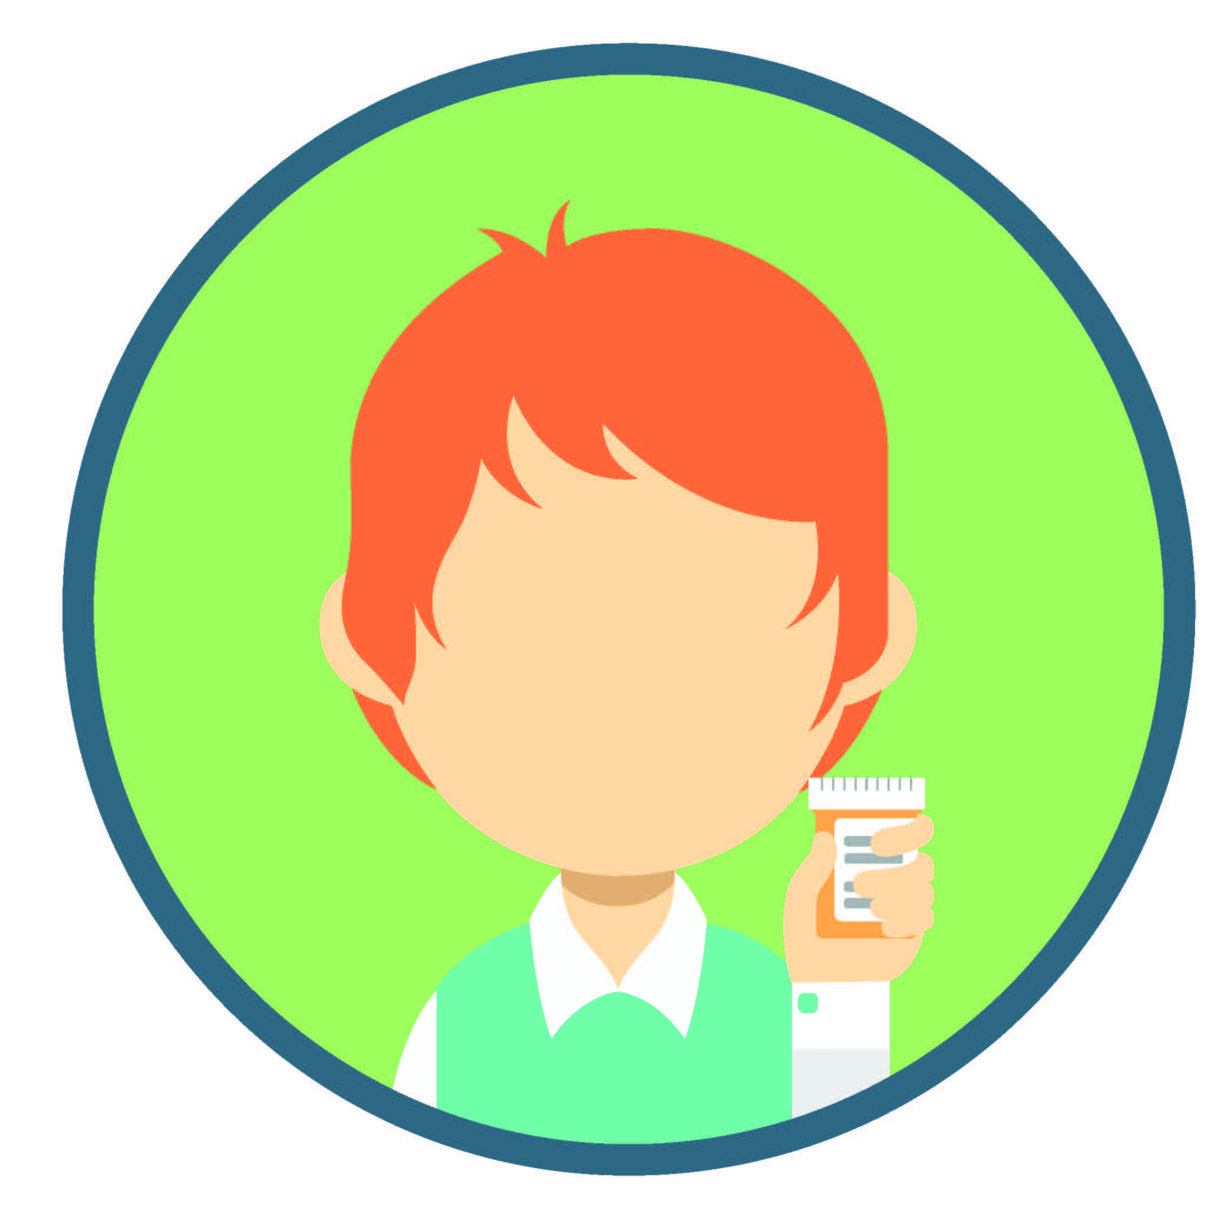
2. What Should I Do?
If you need to take medicine, should you take the medicine by yourself?
Answer
Notes:
Category: What should I do?, 2 points

Slide 14
No!
Only take medicine from trusted adults.
Game Board
Notes:
Category: What should I do?, 2 points
You should only take medicine from a trusted adult. Medicine can help us, but it may hurt us if we do not follow instructions, take the wrong medicine, or take someone else’s medicine. This is why it is important to only take medicine from a trusted adult in your life – they will help keep you safe when making choices about medicine.

Slide 15

3. What Should I Do?
Your friend is visiting your house and feels sick.
You want to help your friend – should you ask a trusted adult for help?
Answer
Notes:
Category: What should I do?, 3 points

Slide 16
Yes!
Ask a trusted adult for help.
Game Board
Notes:
Category: What should I do?, 3 points
Sharing medicine can be very dangerous. Medicine affects people differently, and medicine that helps you might actually hurt your friend. So, it is never safe to share medicine. Medicine should only be taken from a trusted adult – ask a trusted adult for help.

Slide 17
To take medicine safely, you should always ______ the instructions!
Rhymes with swallow.
Answer
Notes:
Category: Rhyme Time, 1 point

Slide 18
Follow
Trusted adults helps us follow instructions.
DERRICK GRAY
Game Board
Notes:
Category: Rhyme Time, 1 point
Following instructions or rules keep us safe. We follow rules at school, when playing a sport, or when swimming in a pool. Medicine also comes with instructions that tell us how to safely take the medicine. Only take medicine from a trusted adult. Trusted adults help us follow the medicine’s instructions - this makes it more likely the medicine will help us and not hurt our bodies.

Slide 19
Someone that makes you feel safe and helps you with medicine is a trusted ____.
Rhymes with fault.
Answer
Notes:
Category: Rhyme Time, 2 points

Slide 20

Trusted Adult
Pharmacists are examples of trusted adults.
Game Board
Notes:
Category: Rhyme Time, 2 points
Trusted adults make children feel safe and comfortable. They listen, answer their questions, and act in ways that demonstrate they care about the child’s health and safety. Trusted adults exist both in the home and in the community. Each of you may have different trusted adults in your life at home. In the community, examples of trusted adults include school nurses, pharmacists, and teachers.

Slide 21
Keep medicines safe by storing them way up _____ and out of reach.
Rhymes with pie.
Answer
Notes:
Category: Rhyme Time, 3 points

Slide 22
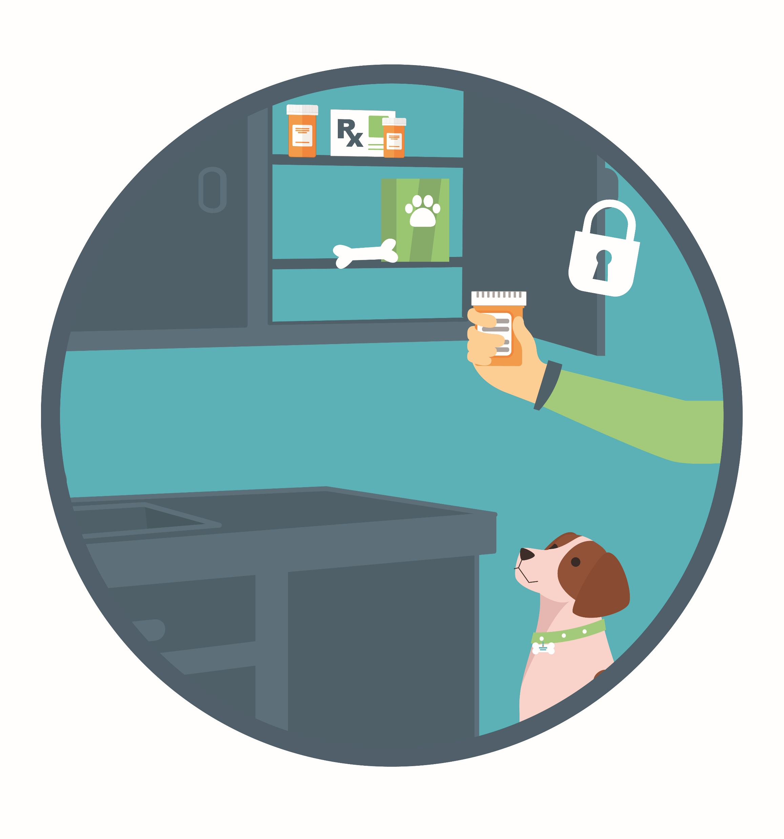
High
Ask trusted adults to store medicines up high and out of reach.
Game Board
Notes:
Category: Rhyme Time, 3 points
Medicines should be kept up high and out of reach to make sure young children and animals cannot accidently eat or take them. At home, we can encourage our family members to store medicine in safe places in the home (high cabinets, high shelves, or locked spaces).

Slide 23

Final Question!
Add 4 points for correct answers…
Next
Notes:
Note to facilitator: if teams get the final question correct, they can add four bonus points to their total score.

Slide 24
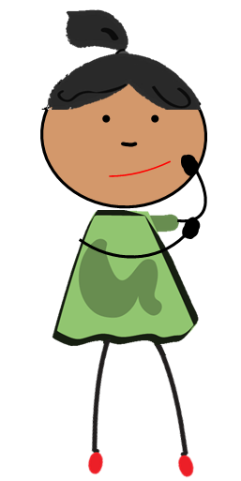
Final Question
List 1 of the medication safety rules…
Answer
Notes:
Note to facilitator:
Consider stopping by each group and asking them to state their medication safety rule. If children have strong writing skills, consider asking them to write the rule instead.
Depending on how you’re utilizing this game and the age of your participants, consider asking participants to name two or three medication safety rules.
Advance the slide to reveal the answer(s).

Slide 25
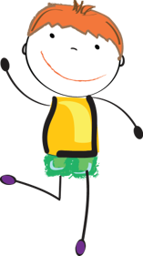
Remember the
Medication Safety Rules:
Ask trusted adults for help with medicine.
Only take medicine that is meant for you.
Keep medicine in safe places.
Share what you learn today with family and friends.
Thank you for playing!
Notes:
Note to facilitator:
Summarize the four medication safety rules . Ask children to identify something they learned, as well as identify one person they could share that information with.
Use this slide to conclude the game. If you kept score, calculate the final point totals for each team and announce a winner.

