Slide 1

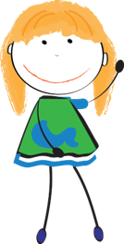
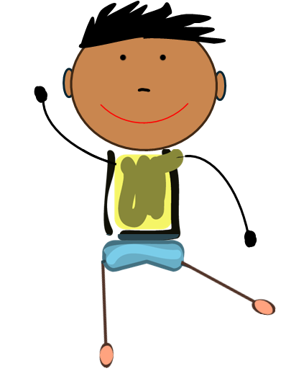

Medication Safety Patrol:
Keeping Medicines Safe Game
ELEMENTARY TOOLKIT | Grades 3 - 5
Presenter Name
Presenter Organization
Brought to you by:
Notes:
Before your program:
Print the “Keeping Medicines Safe Game Facilitator Guide” (1 facilitator guide/facilitator) – play the game according to the directions on Slide 3. Use the talking points on each slide as a guide for presenting each question and discussing relevant and appropriate answers.
Game Introduction:
Hello everyone…my name is _______ . Today we are going to discuss medication safety by playing a game called “Keeping Medicines Safe Game” where you will review safe places to store medicine.

Slide 2
Medication Safety Rules
Ask trusted adults for help with medicine.
Only take medicine that is meant for you.
Keep medicine in safe places.
Share what you learn today with family and friends.
Notes:
Before we begin, let’s review the four medication safety rules.
Rule 1: Ask trusted adults for help with medicine
Rule 2: Only take medicine that is meant for you.
Rule 3: Keep medicine in safe places
Rule 4: Share what you learn today with family and friends
This game will help us understand the third rule – keep medicine in safe places.

Slide 3
Directions
This game consists of two rounds:
Round 1
Candy vs. Medicine
Round 2
I Spy…
Ready to learn how to keep medicines
safe in your home? Let’s play!
Notes:
This game will consist of two rounds:
Round 1: Candy vs. Medicine
Round 2: I Spy
Ready to learn how to keep medicines safe in your home? Let’s play!

Slide 4

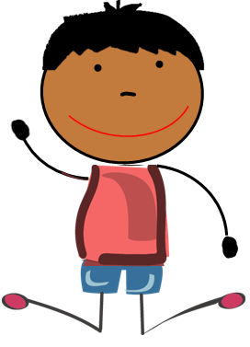
Round 1
Candy vs. Medicine

Slide 5
Directions – Round 1
There are two photos on each slide: one photo is candy and one photo is medicine.
When I point to one of the photos, decide whether that photo is medicine or candy.
Take turns sharing your answer by saying “Candy” or “Medicine”.
Notes:
Let’s review the directions for Round 1:
There are two photos on each slide – one photo is candy, one photo is medicine.
I’ll point to one of the photos – decide whether that photo is medicine or candy.
Indicate your answer by saying “Candy” or “Medicine”
Note to facilitator:
For each match, point to one of the photos.
Click the space bar to reveal the answers.
After revealing the answers, elaborate on their response using the talking points provided for that slide.

Slide 6
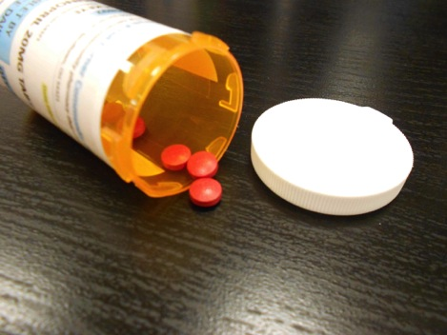
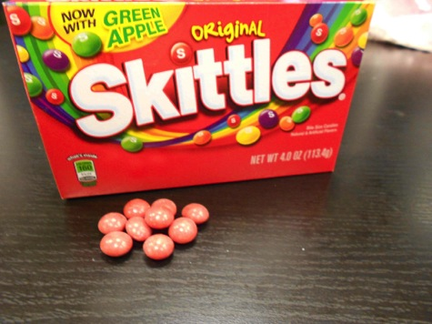
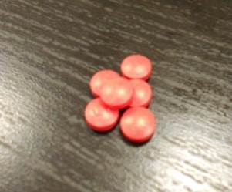
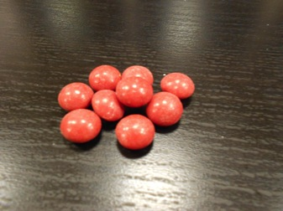
Candy or Medicine?
Notes:
After revealing the answers, consider asking these questions:
What traits are similar between this match? Correct – size (small), shape (round), and color (red).
What traits are different between this match? Although candy and medicine look similar, they have different actions in the body. This type of medicine is a prescription medication – meaning, a healthcare provider must give you permission to take this medicine. In fact, the label lists the name of the person that is allowed to take the medication. Remember that with medicine, its container provides important information – like instructions and who can safely take the medicine.

Slide 7
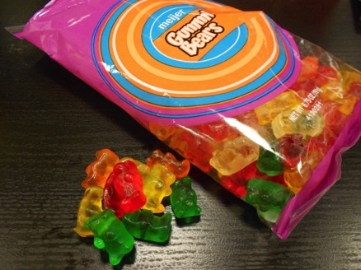
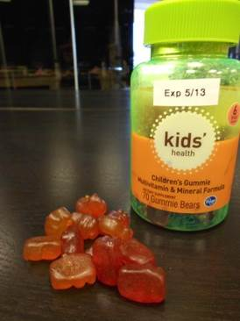
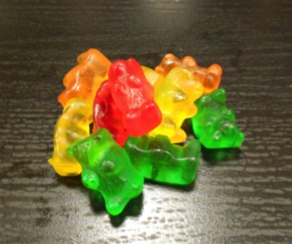
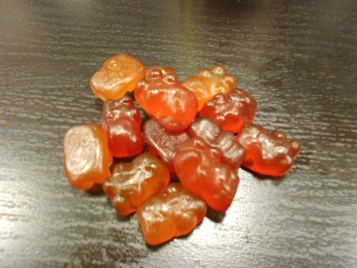
2. Candy or Medicine?
Notes:
After revealing the answers, consider asking these questions:
What traits are similar between this match? Both the medicine (vitamins) and candy (gummies) are multicolored and shaped like bears.
What traits are different between this match? Correct – they act differently in the body.
Why is it important to store both candy and medicine in their original containers? Medicine and candy can look very similar. However, they can work very differently in our bodies. Avoid the confusion by leaving both medicine and candy in its original container, which provides important labeling information that identifies the substance as medicine or candy.

Slide 8
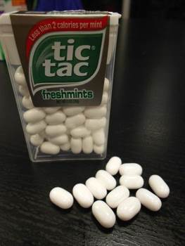
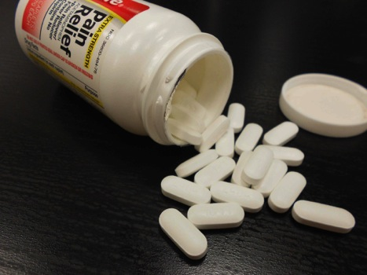
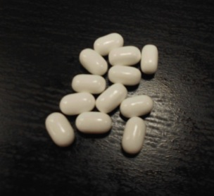
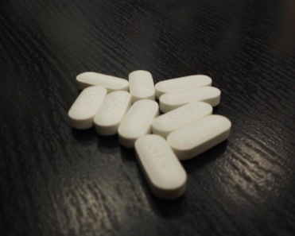
3. Candy or Medicine?
Notes:
After revealing the answers, consider asking these questions:
What traits are similar between this match? Both the medicine and candy have a similar size, shape (oval), and color (white).
The medicine in this photo is considered an over-the-counter medicine, which is different than a prescription medicine. This medicine is available without a doctor’s prescription. Does the same rules apply? Should we still keep this medicine in its original container? Yes! This product is still a medicine; thus, all of the medication safety rules apply. This includes only taking the medicine from a trusted adult, not sharing the medicine (even without a name, the same rule applies) and keeping the medicine safe by storing it in its original container.

Slide 9
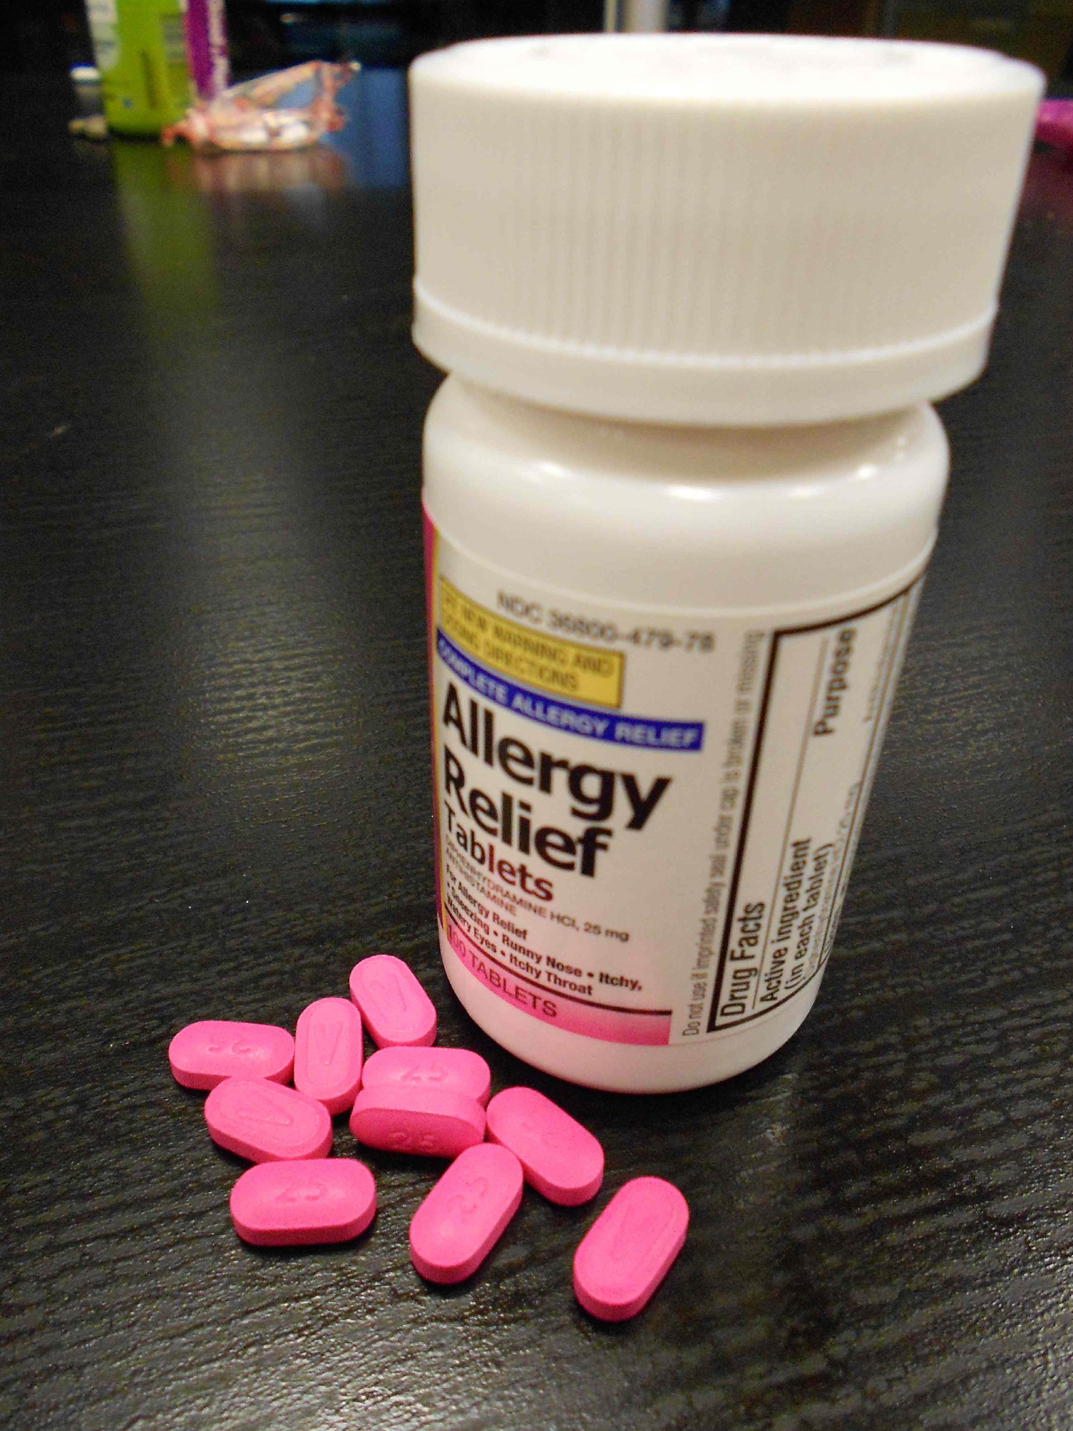
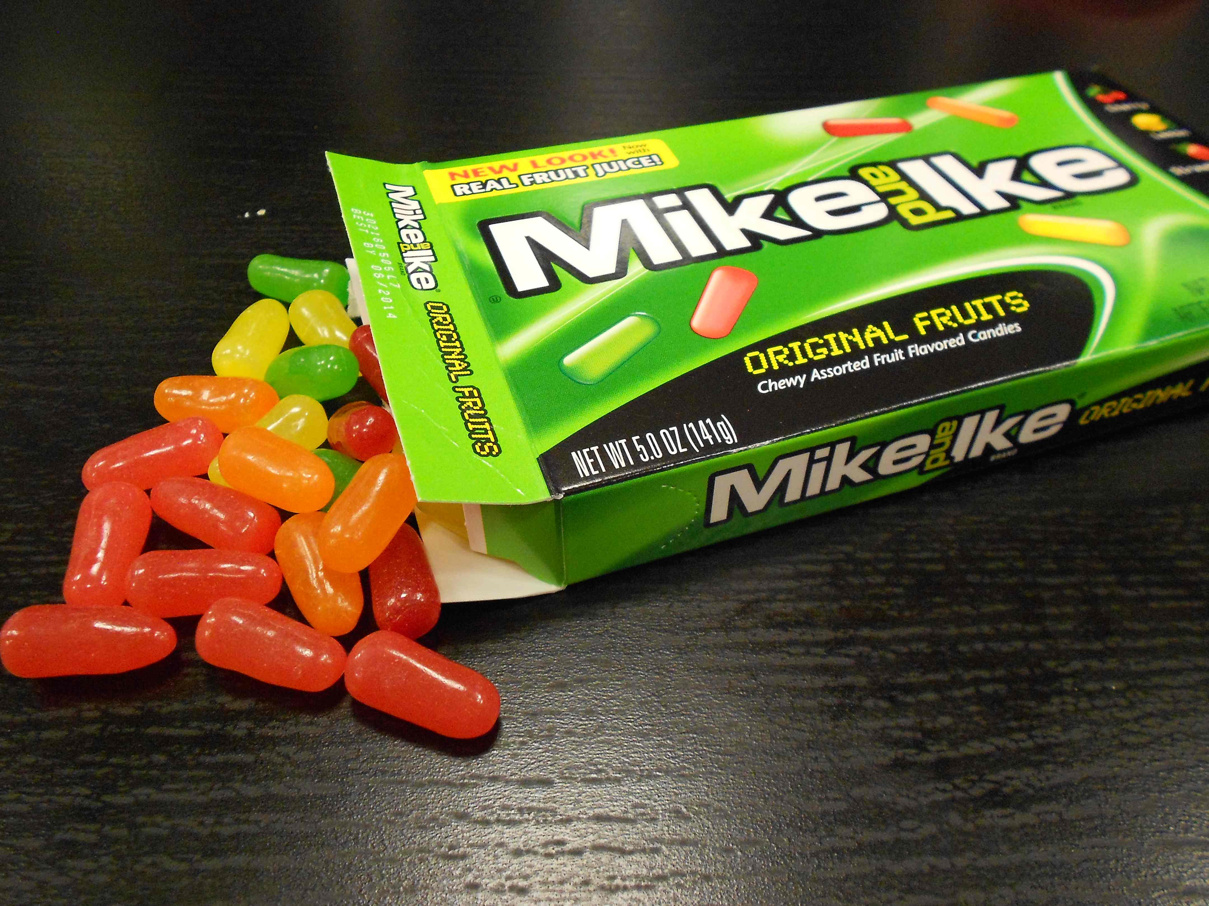
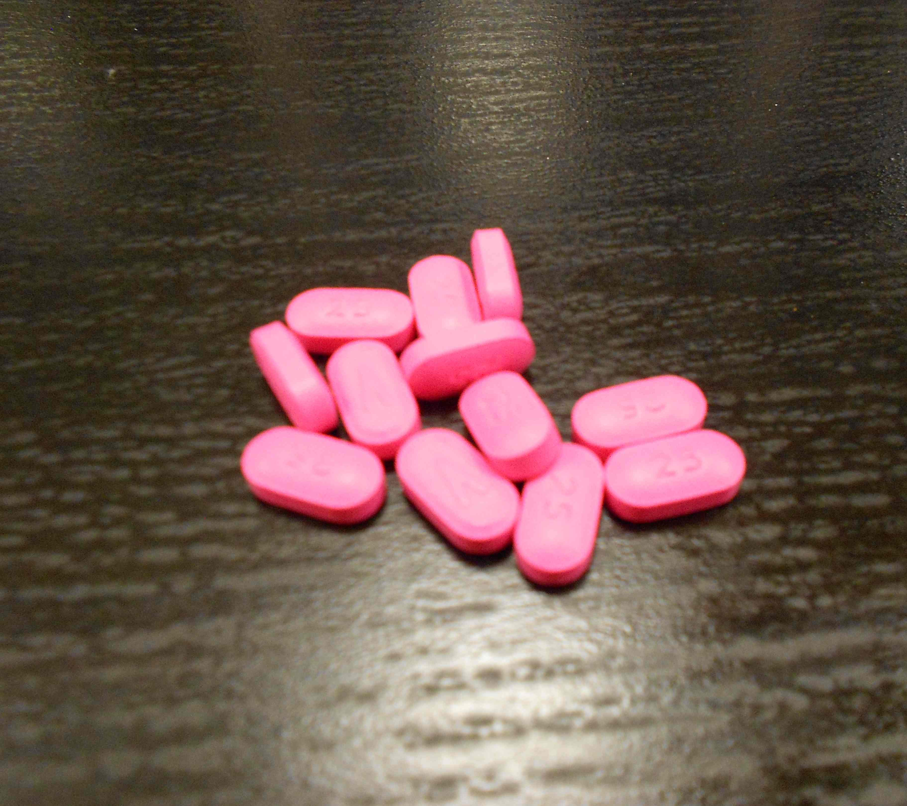
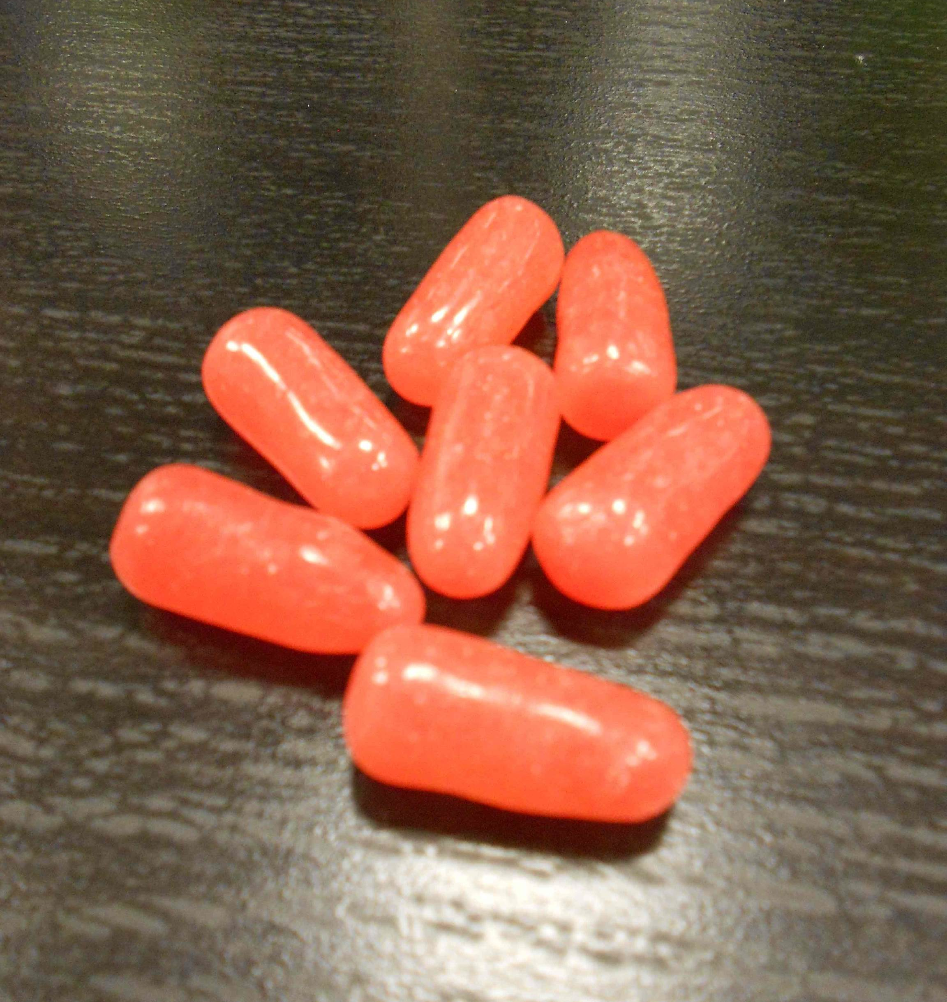
4. Candy or Medicine?
Notes:
After revealing the answers, consider asking these questions:
What traits are similar between this match? Both the medicine and candy have a similar size, shape (oval)
What would you do if you found one of these and weren't sure what it was? Tell a trusted adult. They can help identify it and keep it somewhere safe.

Slide 10
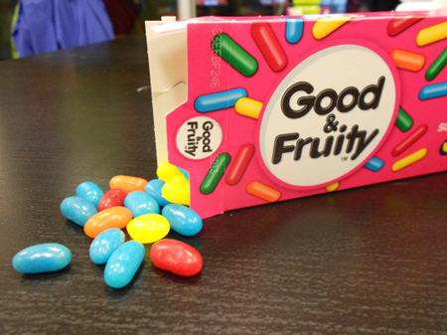
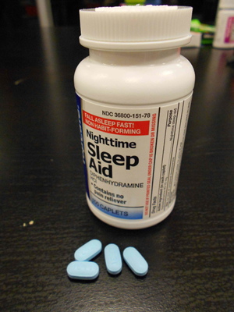
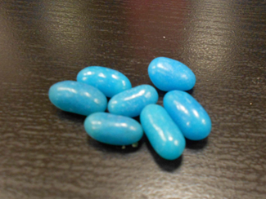
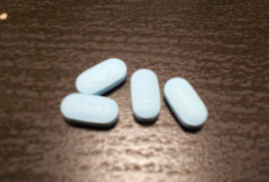
5. Candy or Medicine?
Notes:
After revealing the answers, consider asking these questions:
What traits are similar between this match? Both the medicine and candy have a similar size, shape (oval), and color (blue).
What can happen if you take medicine that isn’t yours? That’s right it can make you sick. Medicine can help us if it is meant for us but if we take medicine that isn’t meant for us it can make us sick.

Slide 11
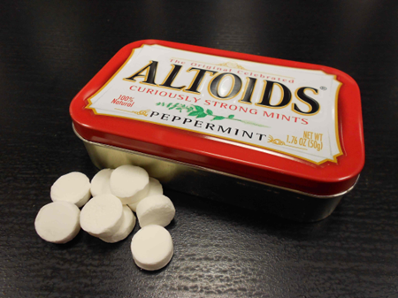
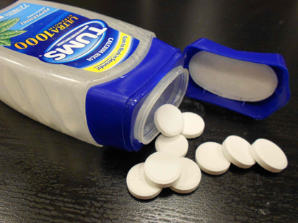
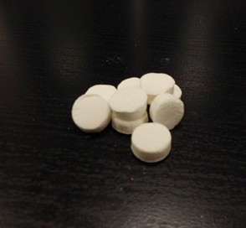
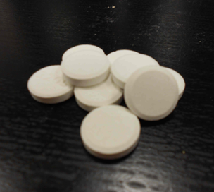
6. Candy or Medicine?
Notes:
After revealing the answers, consider asking these questions:
What traits are similar between this match? Both the medicine and candy have a similar size, shape (circle), and color (white)
Why is it important to keep medicines in safe places? To keep others from accidently taking medicine they shouldn’t such as small children and pets.

Slide 12
To stay safe, please remember:
Candy and medicine can look very similar but can act very differently in our bodies.
Talk with a trusted adult about keeping candy and medicine in their original container. The containers for medicine provide important information.
If you have questions, ask trusted adults for help with medicine.
Notes:
Note to facilitator: reinforce the take-home messages from Round 1.

Slide 13
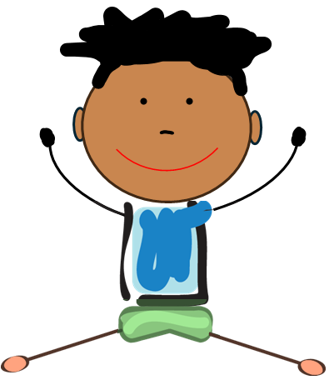
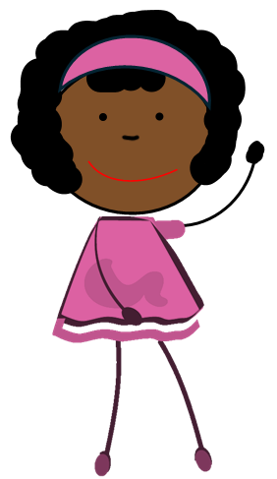
Round 2
I Spy...

Slide 14
Directions – Round 2
There are three photos on each slide. Each photo shows a possible place to store medicine.
Find the medicine in each photo. Decide whether the medicine is being stored in a safe or unsafe place.
Take turns sharing your answer. Explain why you think the place is safe or unsafe.
Notes:
Let’s review the directions for Round 2:
There are three photos on each slide that show possible places to store medicine.
You will look at each photo and decide which photo is the safe place to store medicine.
Take turns sharing which places you think is the safe place
Note to facilitator:
Point to each picture and ask the participants if they think it is a safe or unsafe place.
Reveal the answers by clicking on the space bar and elaborate on why it is safe using the talking points provided for that slide.

Slide 15
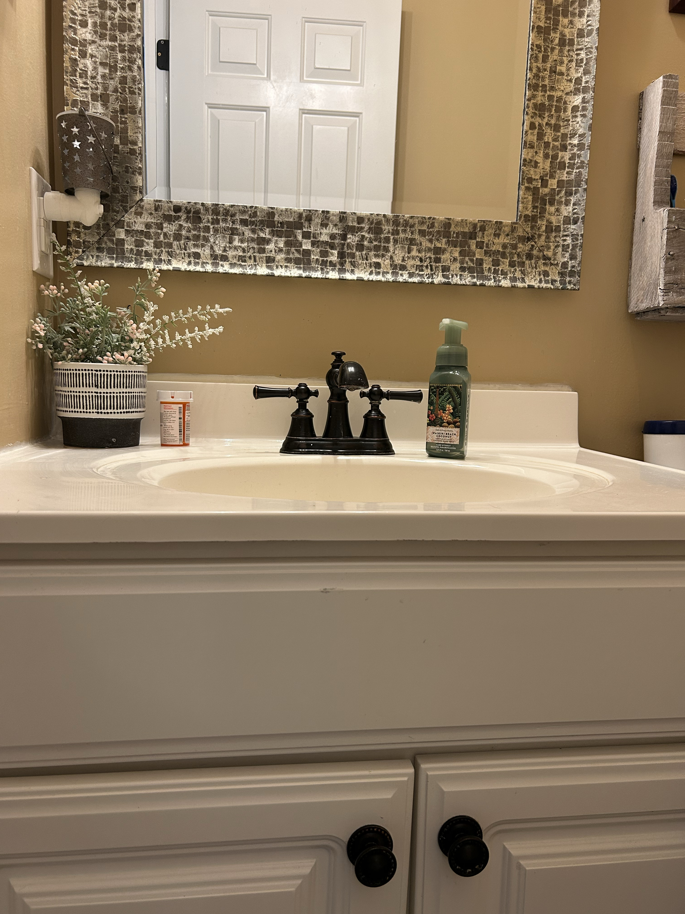
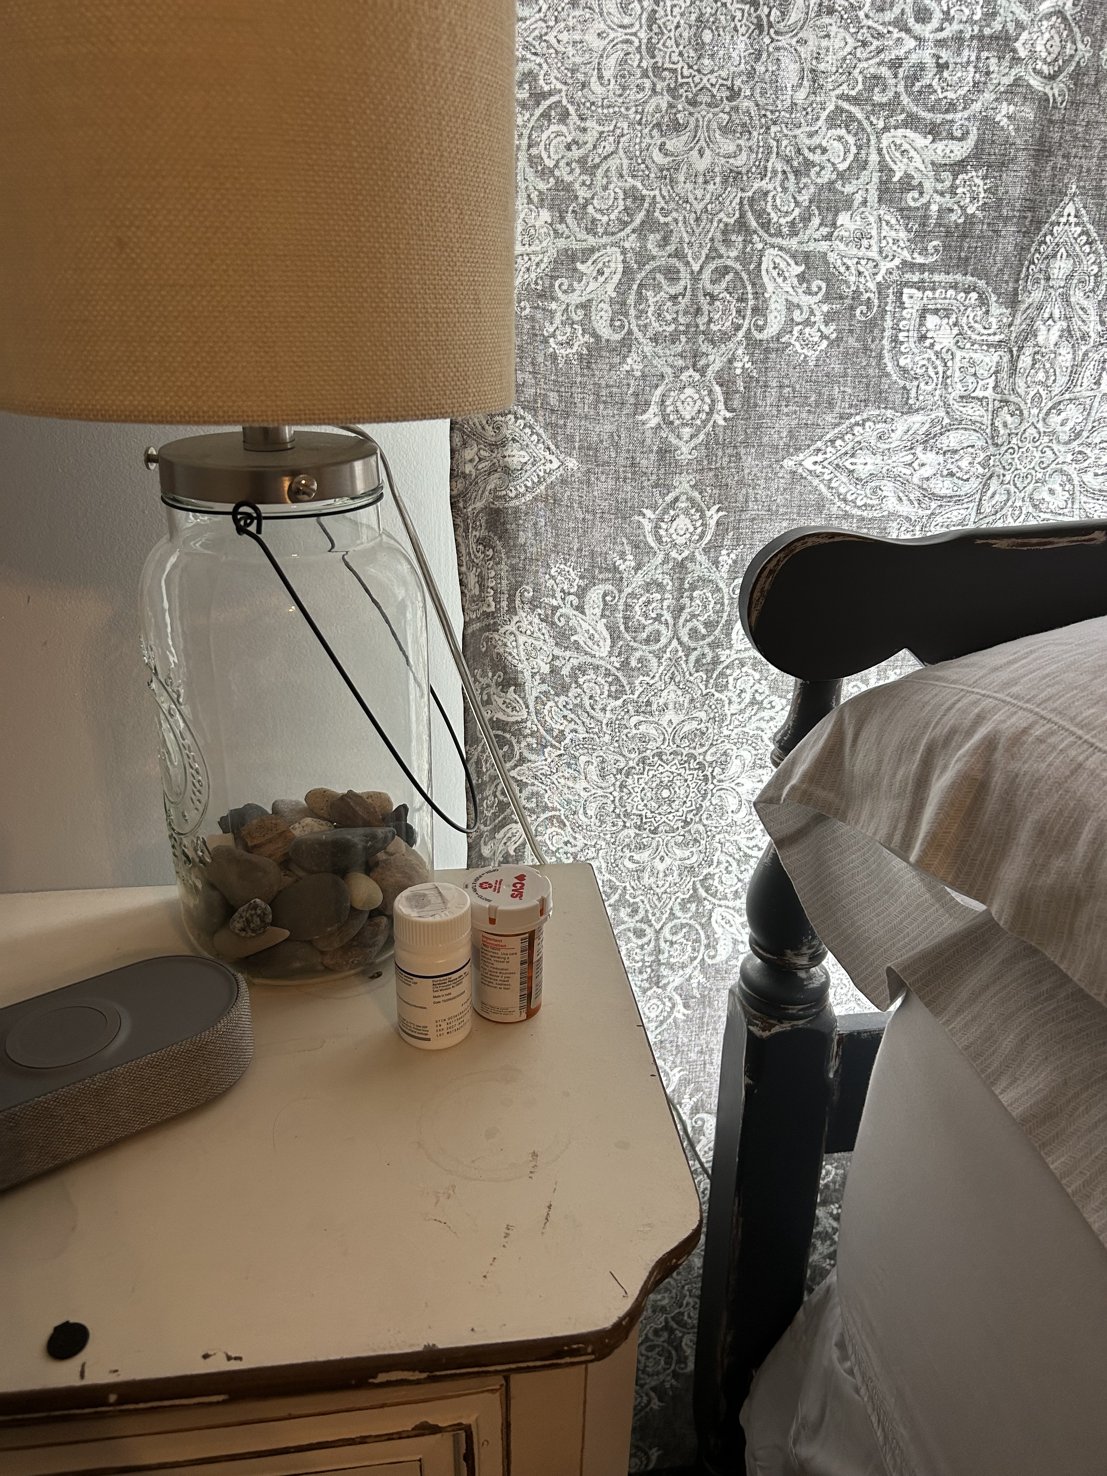
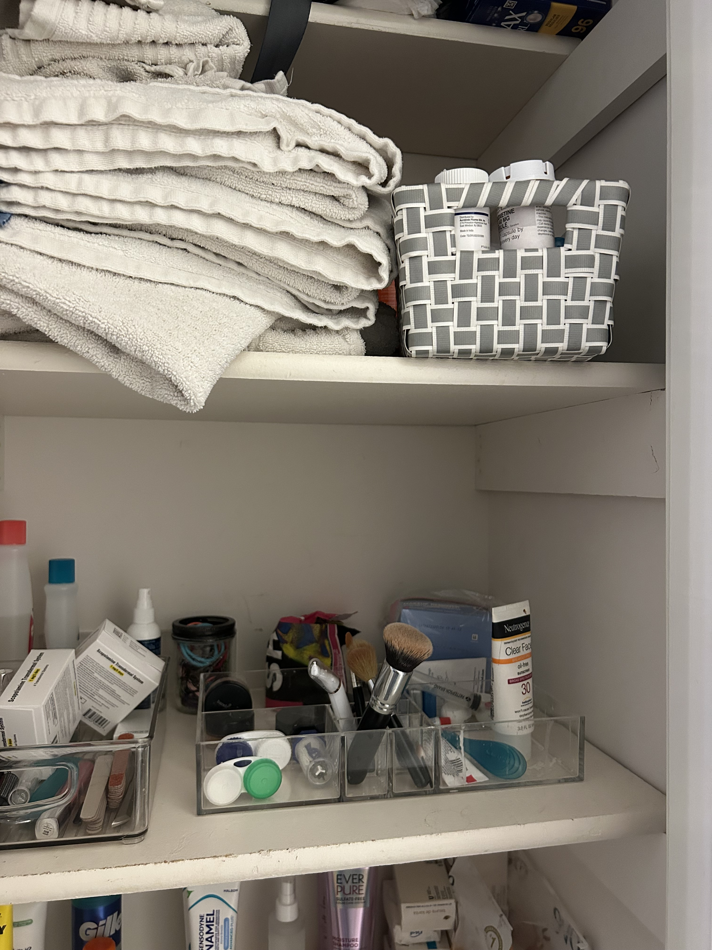


I Spy a safe place for storing medicine in a bathroom or bedroom…
Unsafe
Unsafe
Safe!
Notes:
Let’s first identify the three places where medicine is being stored. Can someone identify one place and label it safe or unsafe? (Repeat this step for the remaining two places).
Note to facilitator: After participants predict whether each place is safe or unsafe, click the space bar to reveal the answers. After revealing the answers, consider asking this question:
What is similar among the two unsafe places? Both the unsafe locations can be easily accessed by others, especially curious children and even pets. Although it might be easy to store medicine in these places, medicine should be stored up high and out of reach like a high shelf.

Slide 16
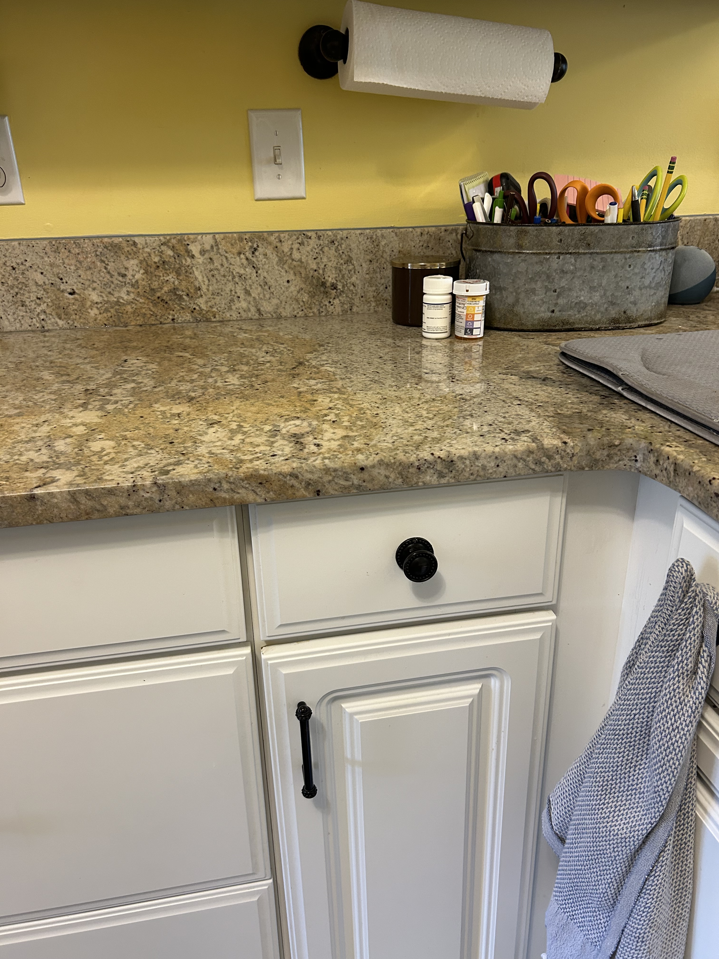
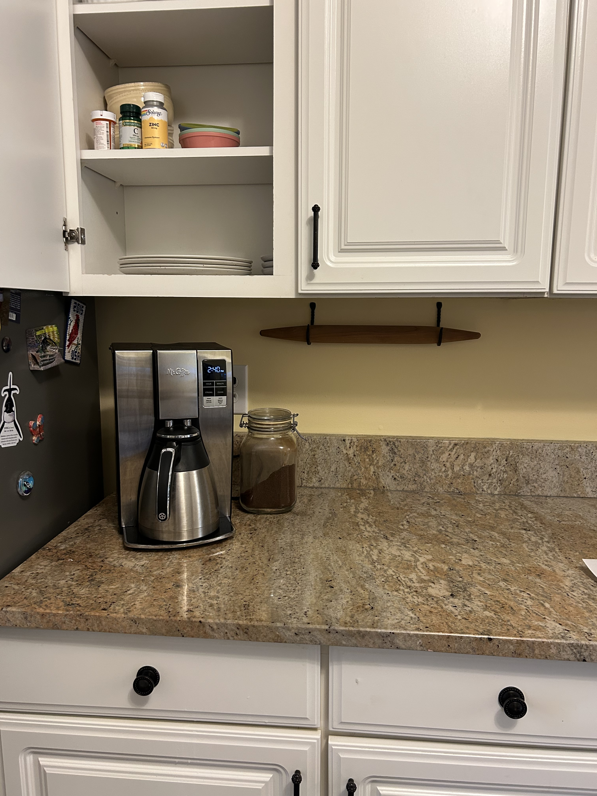
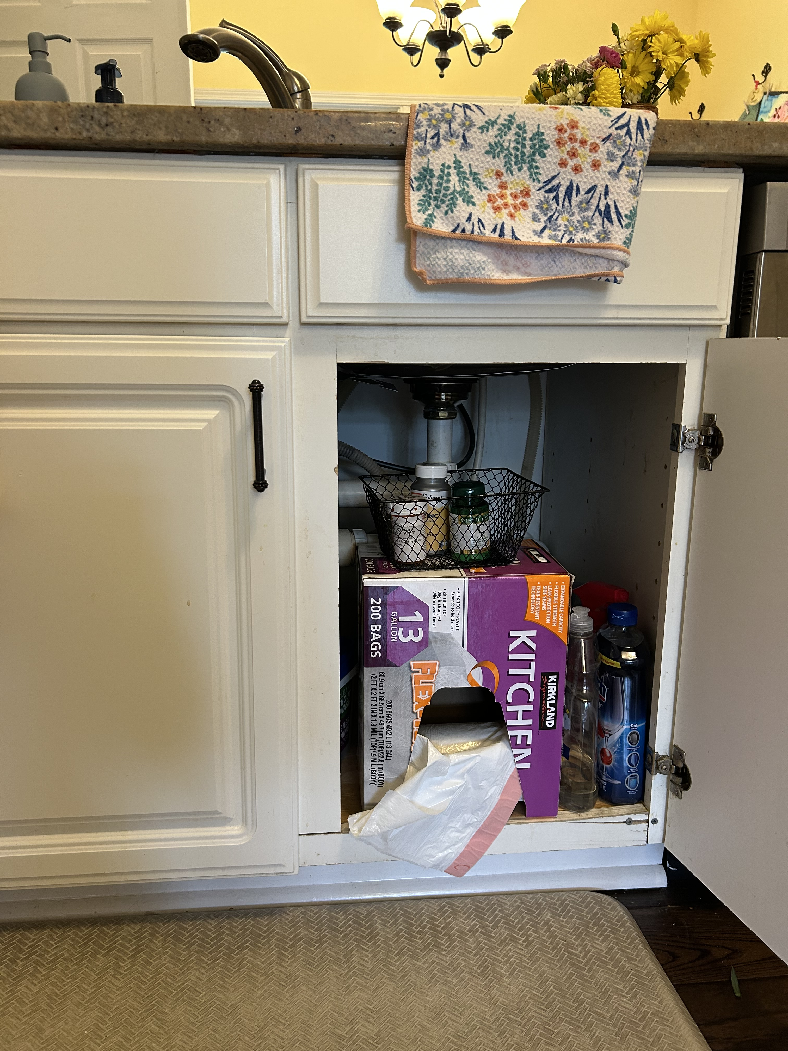
I Spy the safe place for storing medicine in a kitchen…
Unsafe
Safe!
Unsafe
Notes:
Let’s first identify the three places where medicine is being stored. Can someone identify one place and label it safe or unsafe? (Repeat this step for the remaining two places).
Note to facilitator: After participants predict whether each place is safe or unsafe, click the space bar to reveal the answers. After revealing the answers, consider asking this question:
What is different between the medicine cabinet above the counter and the cabinet beneath the sink? The cabinet below the sink can be reached by small children while the cabinet above the counter is up high and harder to get to for small children.

Slide 17
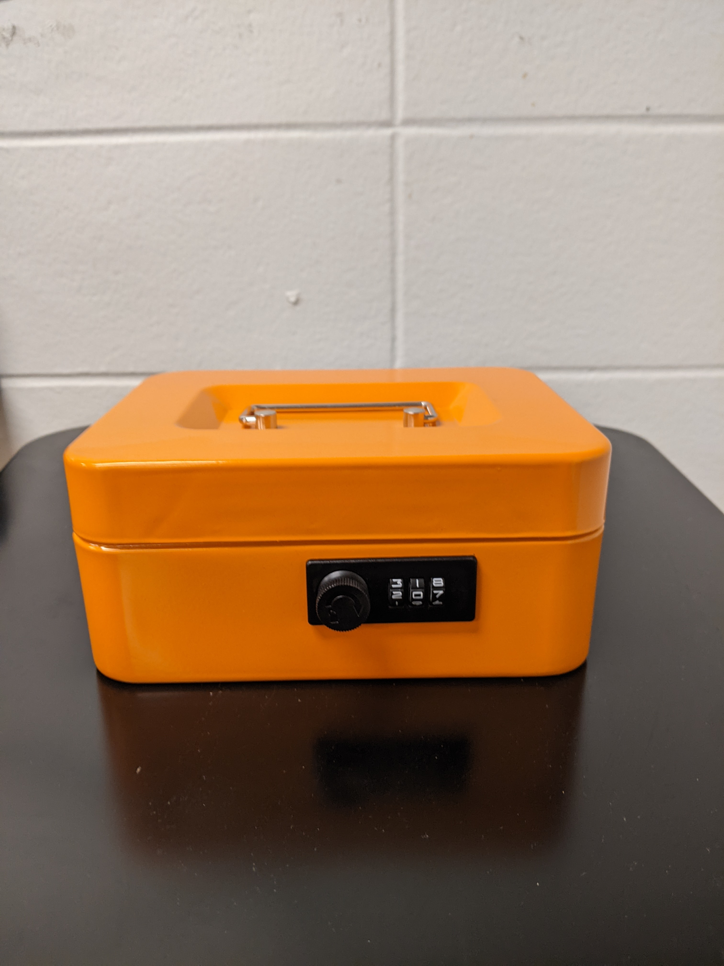
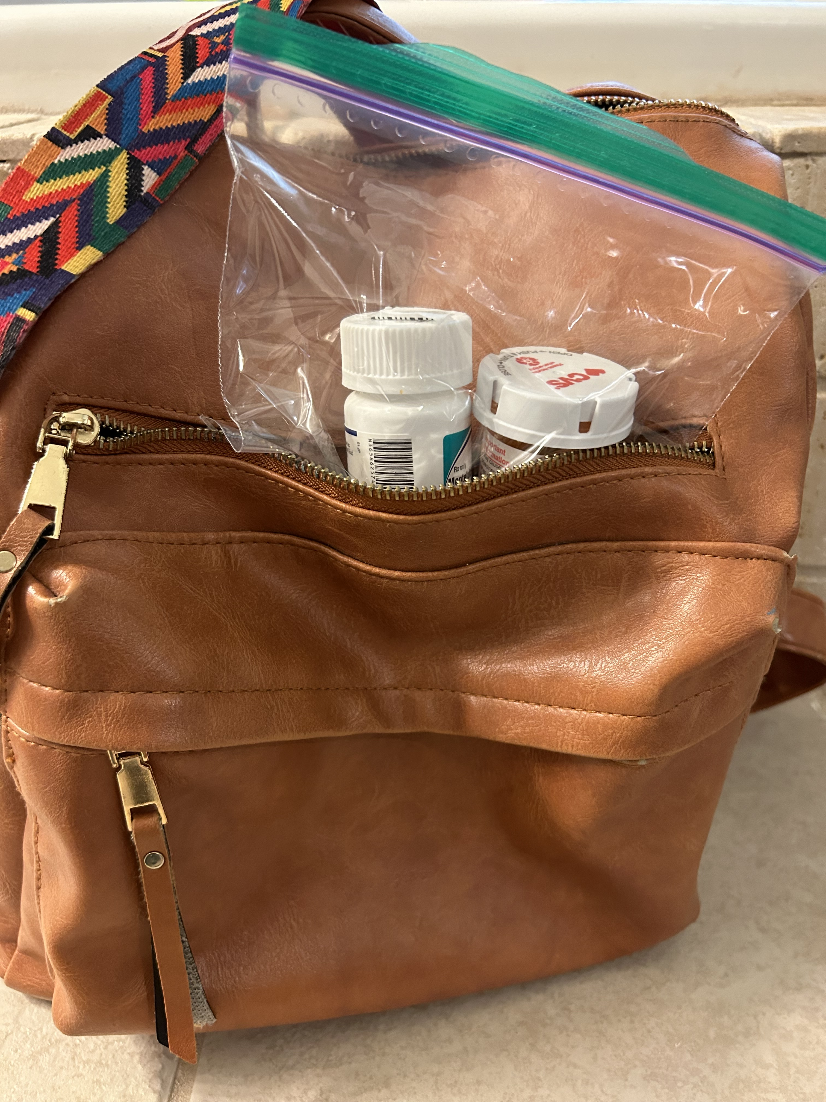
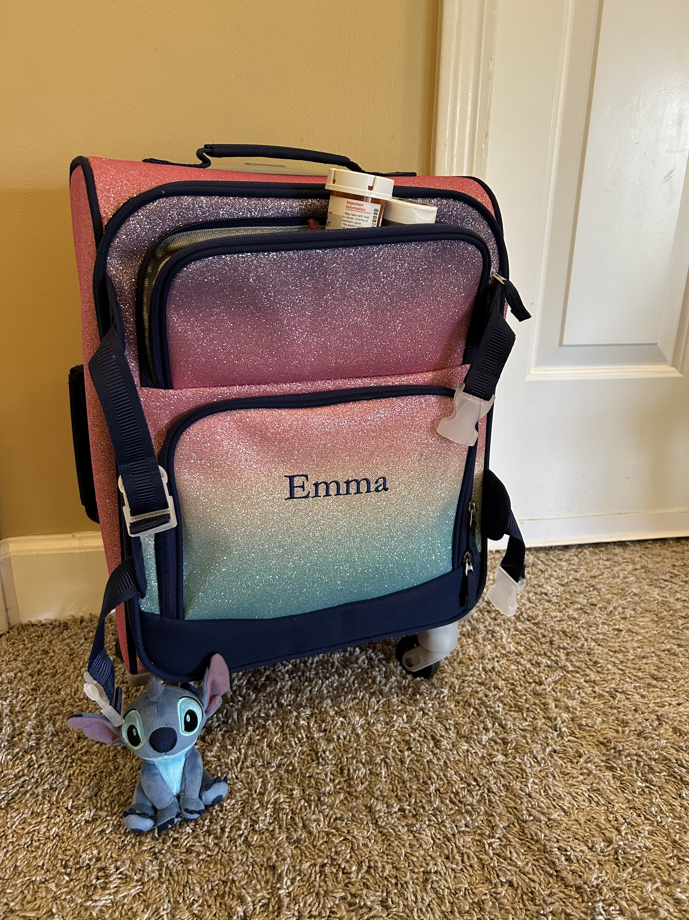
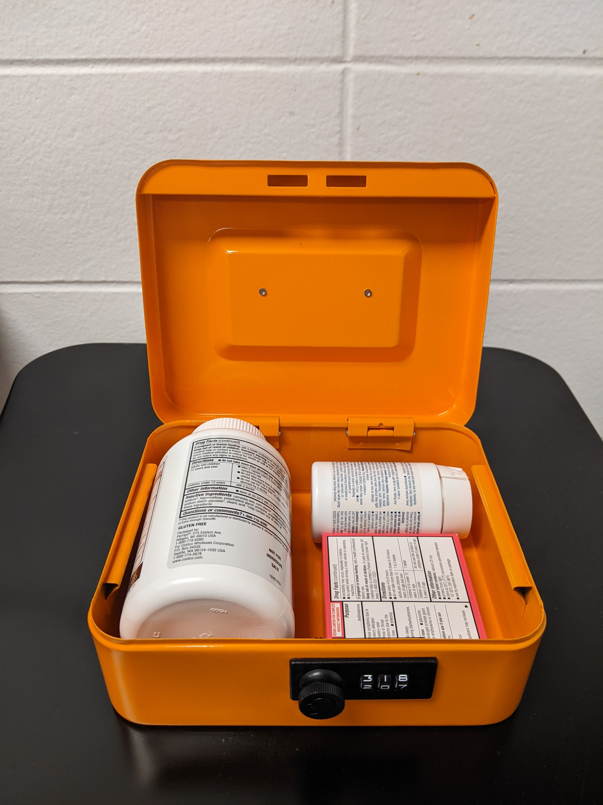
I Spy the safe place for storing medicine when leaving the house…
Safe!
Unsafe
Unsafe
Notes:
Let’s first identify the three places where medicine is being stored. Can someone identify one place and label it safe or unsafe? (Repeat this step for the remaining two places).
Note to facilitator: After participants predict whether each place is safe or unsafe, click the space bar to reveal the answers. After revealing the answers, consider asking this question:
Why is the locked box the only safe place to store medicine? To keep medicine safe when traveling or at home, it cannot be easily accessed by others. A locked box can only be accessed by your trusted adults that have the code or key and prevent anyone else from getting into the medicine.

Slide 18
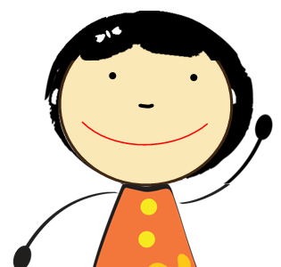
To stay safe, please remember:
Talk with a trusted adult about keeping medicine safe in the home.
Store medicine in locked spaces or in high places out of reach from people and pets.
If you have questions, ask trusted adults for help with medicine.

Slide 19
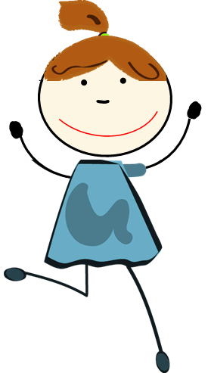
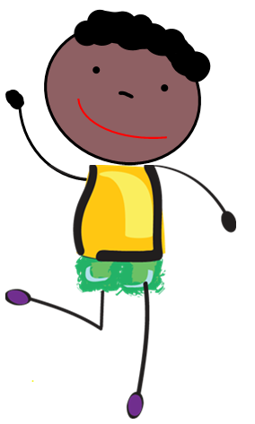
Remember the
Medication Safety Rules:
Ask trusted adults for help with medicine.
Only take medicine that is meant for you.
Keep medicine in safe places.
Share what you learn today with family and friends.
Thank you for playing!

