Slide 1

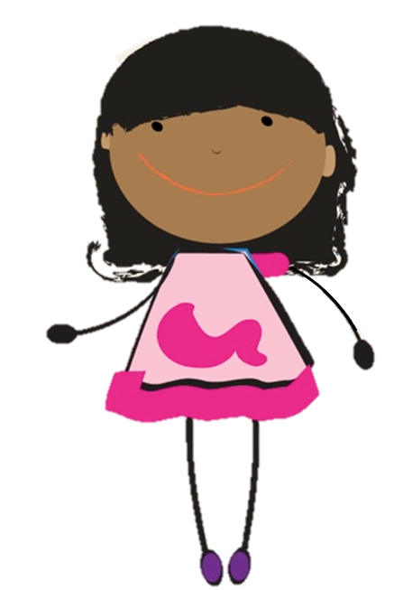
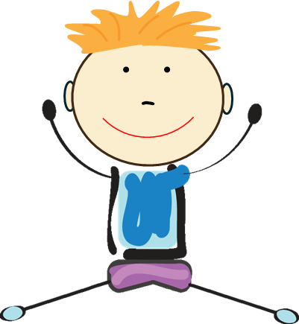


Medication Safety Patrol:
Safe Choices Game
ELEMENTARY TOOLKIT | Grades 3 - 5
Presenter Name
Presenter Organization
Brought to you by:
Notes:
Before the program:
Play the game according to the directions on Slides 3 and 4. Use the talking points on each slide as a guide for presenting each question and discussing relevant and appropriate answers.
Game Introduction:
Hello everyone…my name is _______ . Today we are going to discuss medication safety by playing a game called “Safe Choices”. Ready to play?

Slide 2
Medication Safety Rules
Ask trusted adults for help with medicine.
Only take medicine that is meant for you.
Keep medicine in safe places.
Share what you learn today with family and friends.
Notes:
Before we begin, let’s review the four medication safety rules. We will discuss these rules as we play our game.
Rule 1: Ask trusted adults for help with medicine
Rule 2: Only take medicine that is meant for you.
Rule 3: Keep medicine in safe places
Rule 4: Share what you learn today with family and friends

Slide 3
Game Rules: How to Play
This game includes six rounds. For each round:
1
2
The host will ask an “opener” question to all teams. If you know the answer, raise your hand!
The host will then ask a “survey” question to all teams. Do not shout the answer!
Write the answer on your team’s answer sheet. When you are finished, raise your hand. A facilitator will check your answers.

Slide 4
Game Rules: Scoring
1
2
3
Opener Questions:
Survey Question:
Keep in Mind:
  First to answer correctly or individual with the closest answer earns 1 point for their team.
  If ALL answers are correct: 2 points/round
  If SOME answers are correct: 1 point/round
  Multiple answers may exist for a question. Your answers do not have to exactly match the answers in the slide, but they must correctly answer the question.
  The facilitator will use their judgement to determine if your answer earns points.
Notes:
Note to facilitator: For some questions, answers will vary widely. We want to ensure we are reinforcing accurate answers that connect with our key messages, even if they do not exactly match the answers indicated in the slide. Use your judgement to decide if an answer not indicated in the slide is accurate and thus deemed acceptable to earn points.

Slide 5



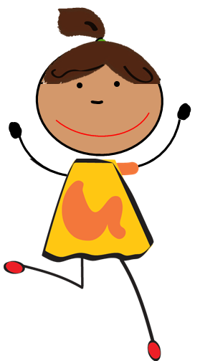


Round 1

Slide 6
Round 1: Opener Question
Who should always be with you when you take medicine?
A trusted adult
Notes:
A trusted adult should always be with you when taking medicine to ensure you take it safely.

Slide 7
Round 1: Survey Question
List three trusted adults that you can ask for help with medicine:
1
Parent or Guardian
2
School Nurse
3
Pharmacist or Doctor

Slide 8


A trusted adult is someone who:
  Makes you feel safe.
  Listens to you when you have a problem.
  Takes care of you.
Ask a parent/guardian to approve your list of trusted adults!
Notes:
Trusted adults that can help with your health often exist both in our homes and in our community. For example, did you know pharmacists, doctors, and nurses are community helpers that can teach your family how to safely use medicine?
Everyone will have different trusted adults in their life. Think of a few trusted adults in your own life and ask a parent/guardian to approve or double-check your list.

Slide 9
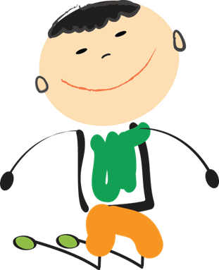
Round 2

Slide 10
Round 2: Opener Question
Two types of medicine include prescription and over-the-counter. Which type of medicine does a doctor prescribe?
Prescription medication
Notes:
Prescription medicine is specific for each person and can be only taken if a doctor prescribes it.

Slide 11
Round 2: Survey Question
List three important parts of a prescription medication label.
1
Patient name
2
Medicine name
3
Instructions
Notes:
Note to facilitator: other parts of the medication label exist, such as doctor’s name, address and phone number of the pharmacy, refill amount, quantity, date filled, and prescription number. Award points if participants have any of these answers as well.

Slide 12
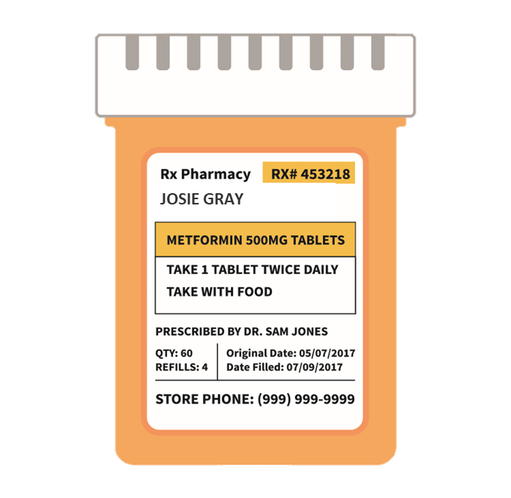
Prescription medicines are only meant for the person on the label.
Patient name
1
2
Medicine name
3
Instructions
Notes:
The information on the prescription label helps us know who the medicine is for and how to take it in a safe way.
Another type of medicine is called over-the-counter medicines which can be bought without a doctor’s prescription. This medicine does not have a specific patient’s name on it, but it does have special instructions depending on your age and other traits.
To stay safe, always ask a trusted adult for help with either over-the-counter or prescription medicine.

Slide 13
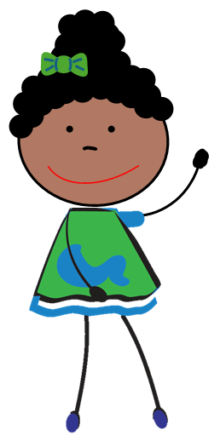
Round 3

Slide 14
Round 3: Opener Question
Study the medicine label.
True or False: Josie’s sister can safely take this medicine.
False
Notes:
The medicine label indicates that it is meant for Josie Gray; therefore, this medicine is not meant for Josie's sister and should not be taken by her sister even if she has the same illness as Josie.

Slide 15
Round 3: Survey Question
Study the medicine label.
Who should give Josie this medicine?
How should Josie take the medicine to keep her safe?
1
Josie’s trusted adult
2
Follow instructions! Take 1 tablet twice daily with food.
Notes:
Note to Facilitator: There are multiple answers for how should Josie take the medicine to keep her safe. Consider accepting answers that may also include taking it with a trusted adult, taking it for the right illness, taking the right amount, or not sharing with others.

Slide 16
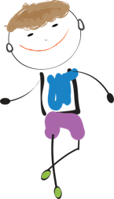
Round 4

Slide 17
Round 4: Opener Question
True or false: Medicine always helps us and can never hurts us.
False
Notes:
Medicine can play an important role in helping us when sick, but it can harm us if we do not take the medicine safely. This is why it is important to follow the medication safety rules and ask a trusted adult for help.

Slide 18
Round 4: Survey Question
List three ways to take medicine safely:
1
Follow instructions.
2
Only take medicine meant for you.
3
Ask trusted adults for help with medicine.
Notes:
Note to facilitator: This question can have multiple answers. Use your judgement to determine if it is a safe medication-taking practice.

Slide 19
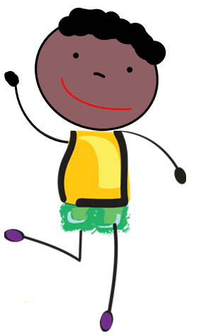
Round 5

Slide 20
Round 5: Opener Question
True or False: Everyone is different. So, medicine may affect friends differently.
True
Notes:
We are all unique and medicine that works well for one person might work differently in another person.

Slide 21
Round 5: Survey Question
List three traits or characteristics that make people unique.
1
Age
2
Eye color
3
Allergies to some medication
Notes:
Note to facilitators: This question can have multiple answers. The main goal for this question is to understand that we all have unique traits, and the combinations of these traits can also affect how medicine works in our bodies. The next slide gives examples.

Slide 22
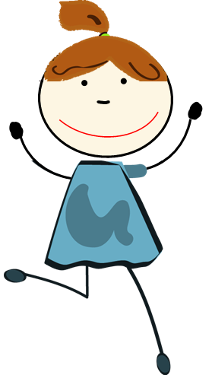


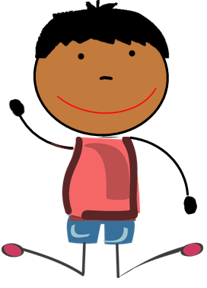
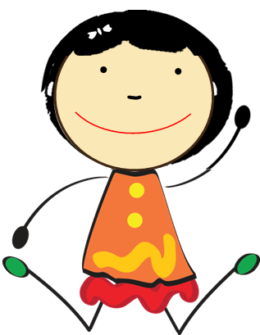
Only take medicine meant for you.
We are all unique. Medicine affects friends differently.
Notes:
Note to facilitator: below are examples to help participants understand this concept.
Age can determine the safe dose for a medication.
Allergies to food dyes or to some medications may cause harm if those substances are consumed (liquid medicines often contain food dyes).
Similarly, some people are allergic to peanuts and can safely eat them, others cannot. Children are often encouraged to not share food due to food allergies or insensitivities. A similar concept exists with medicine.

Slide 23
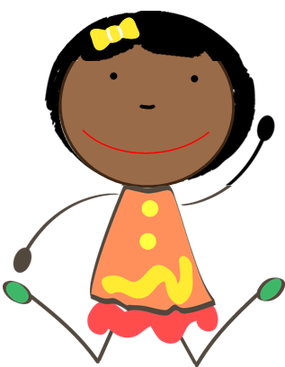
Round 6

Slide 24


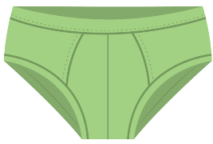
Round 6: Opener Question
Name something that you
should not share with others…
Medicine, toothbrushes, or underwear!
Notes:
Note to facilitator: This question can have multiple answers. Regardless of the participant’s answer, we want to emphasize that we should treat prescription medications similarly to toothbrushes and underwear—these personal items should not be shared!

Slide 25
Round 6: Survey Question
List two of the medication safety rules:
1
Ask trusted adults for help with medicine.
3
Keep medicine in safe places.
2
Only take medicines meant for you.
4
Share what you learned with family and friends.

Slide 26
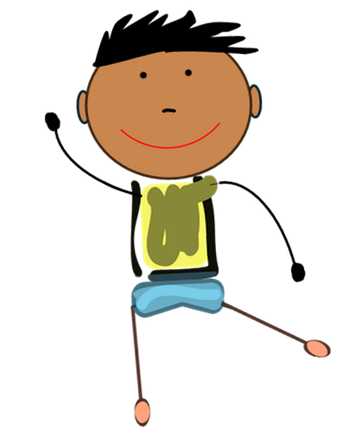
Remember the
Medication Safety Rules:
Ask trusted adults for help with medicine.
Only take medicine that is meant for you.
Keep medicine in safe places.
Share what you learn today with family and friends.
Thank you for playing!
Notes:
Note to facilitator: Review the safety tips on this slide. Then, add up the scores and determine the winner for the game!

