Slide 1

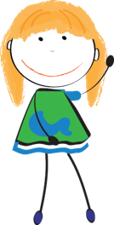
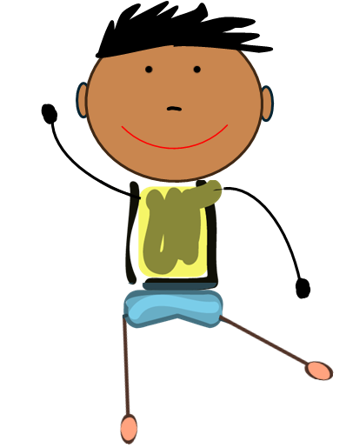


Medication Safety Patrol:
Trivia Game
ELEMENTARY TOOLKIT | Grades 3 - 5
Presenter Name
Presenter Organization
Brought to you by:
Notes:
Introduction:
Hello everyone…my name is _______ . Today we are going to discuss medication safety by playing a game called “Medication Safety Patrol Trivia”.

Slide 2
Medication Safety Rules
Ask trusted adults for help with medicine.
Only take medicine that is meant for you.
Keep medicine in safe places.
Share what you learn today with family and friends.
Notes:
Before we begin, let’s review the four medication safety rules. We will discuss these rules as we play our game.
Rule 1: Ask trusted adults for help with medicine
Rule 2: Only take medicine that is meant for you.
Rule 3: Keep medicine in safe places
Rule 4: Share what you learn today with family and friends

Slide 3
Directions
Each team takes turns choosing a category and
point value.
After the statement or question is read, each team will write an answer on their answer sheet.
Points will be awarded for correct answers only. If your team answers the question correctly, circle the answer on your answer sheet.
Notes:
Let’s review the game directions.
Each team will take turns choosing a category and point value.
After I read the statement or question, each team will write an answer on their answer sheet (this is the “Trivia Answer Sheet”).
Points will be awarded for correct answers only. If your team answers the question correctly, circle the answer on your answer sheet.
Note to facilitator:
By each team circling the correct answers, this will help them calculate a total score at the end of the game.
If you plan to exercise a “print-free” option and not distribute the answer sheets, you can keep score for each team using a whiteboard/chalkboard.

Slide 4
Game Board
I Spy…
Safe Selections
What should
I do?
What’s the word?
1 point
1 point
1 point
1 point
2 points
2 points
2 points
2 points
3 points
3 points
3 points
3 points
4 points
4 points
4 points
4 points
Final Question
Notes:
This game includes four categories – I Spy, Safe Selections, What should I do?, and What's the Word. Each team will take turns selecting a category and point value. When we are ready to end the game, I’ll ask the final question. Let’s get started.
Note to facilitator:
When a team selects a category and point value, click the point value to reveal the question.
Read the statement or question. On each question slide, click the “Answer” icon to reveal the answer.
Award points to teams that select an answer that aligns with the medication safety rules – remind students to circle their answer if it was declared correct.
After revealing the answers, elaborate on their response using the talking points provided for that slide.
On each answer slide, click the “Game Board” link to return to this game board.
Continue playing until all questions are answered (or until time ends). Then, click the ‘Final Question’ box on the game board. Ask each group to wager all or a portion of their earned points.
Ask the ‘Final Question’ and allow each group to answer. Tally the earned points for each group and determine a winner.

Slide 5


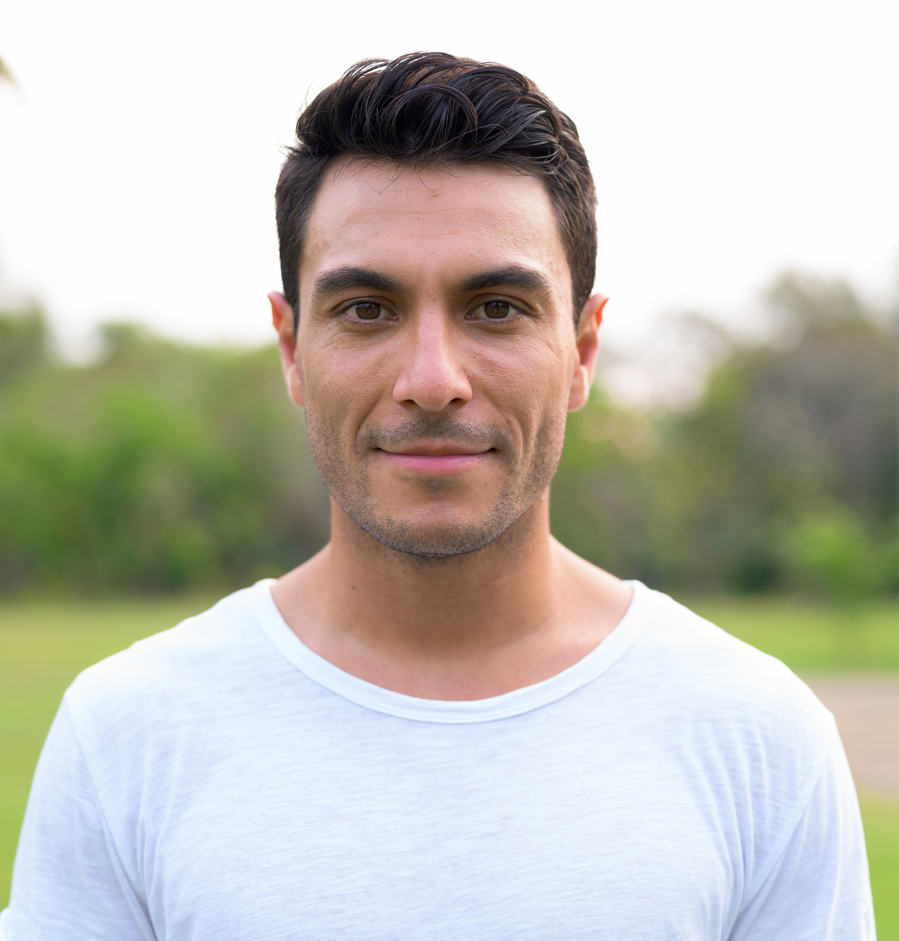
I spy a trusted adult who can answer your questions about medicine…
1
2
3
Answer
Notes:
Category: I Spy, 1 point
Note to Facilitator:
Ask children if they can identify the name of the community helper in the middle. You can give clues such as, “a community helper that is a medication expert and teaches us how to take medications safely” (pharmacist).
If you need to define medicine, consider: “a substance used to treat an illness or injury”.
If children believe the adult on the right is a trusted adult, challenge them to list characteristics that distinguish a regular adult from a trusted adult. Children may view any adult as a trusted adult. However, characteristics like making children feel safe and comfortable, listening, answering questions, and acting in ways that demonstrate they care about the child’s health and safety distinguish a trusted adult from an adult.

Slide 6
Pharmacists
Game Board
Notes:
Category: I Spy, 1 point
Pharmacists are examples of trusted adults in the community. Trusted adults make you feel safe, listen to you, demonstrate they care about you, and answer your questions. Trusted adults can exist both in the home and in the community. Many teachers and school nurses are also examples of trusted adults available to help you make healthy and safe choices about medicine.

Slide 7
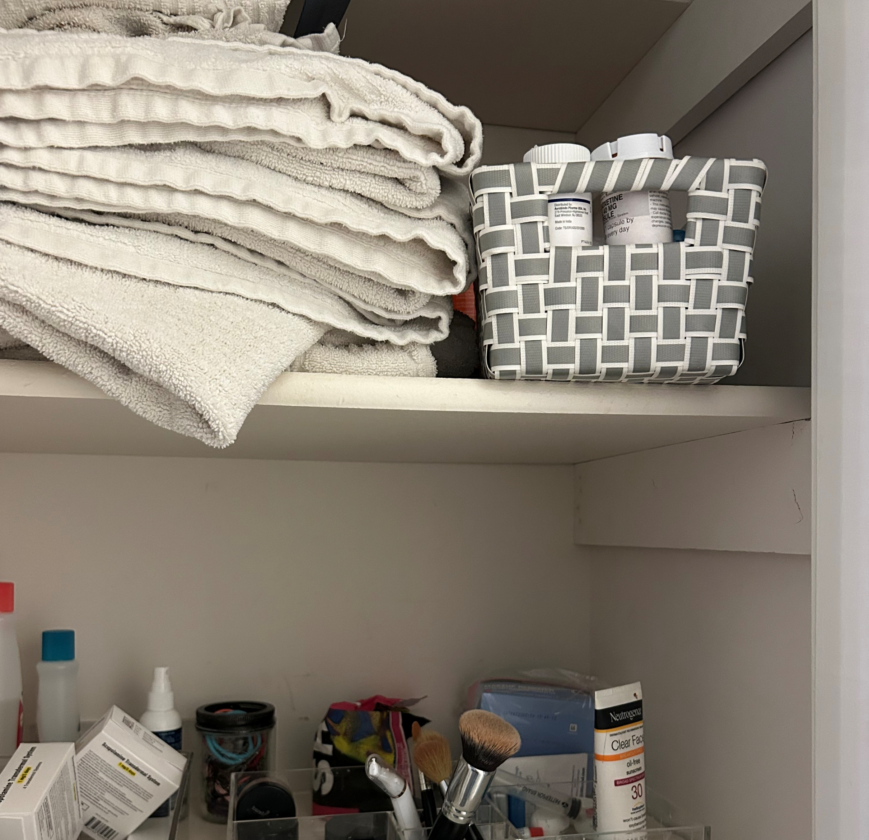
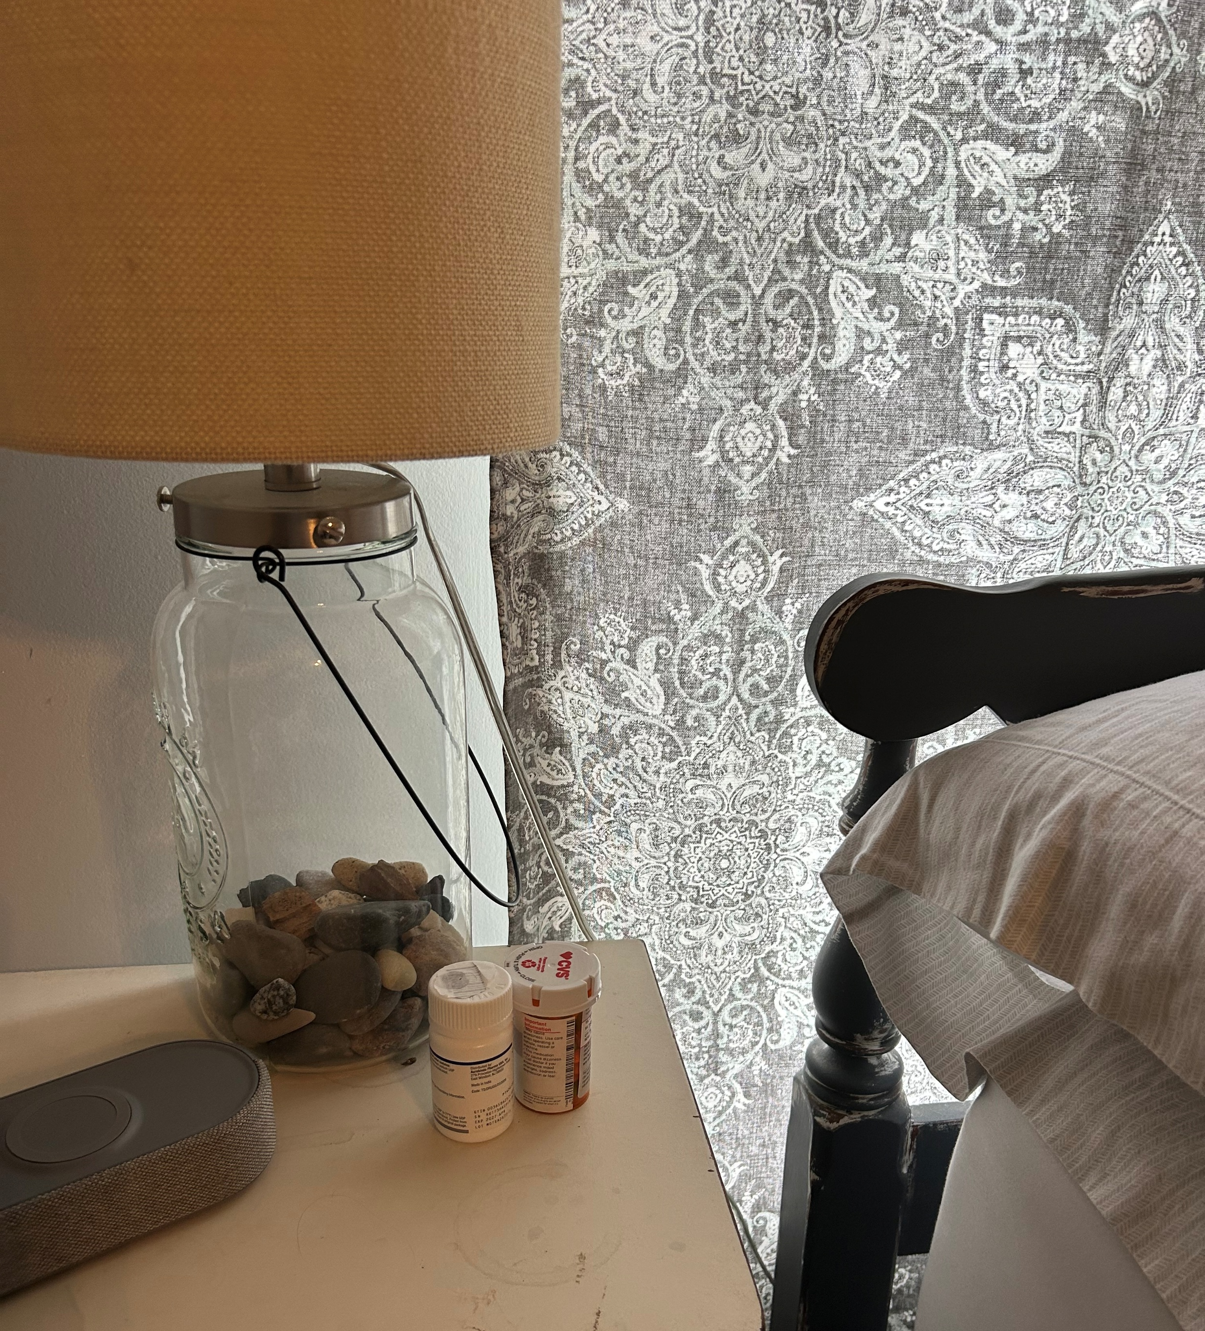
I spy a SAFE and an UNSAFE place to store medicine…
1
2
Answer
Notes:
Category: I Spy, 2 points

Slide 8
Answer slide 1
Unsafe
1
2
Safe
Game Board
Notes:
Category: I Spy, 2 points
The safe place is the high shelf in a cabinet, and the unsafe place is the nightstand. Medicine should always be stored in places where others cannot easily access it. We can encourage our family members to store medicine in safe places at home (high cabinets, high shelves, or locked spaces).

Slide 9
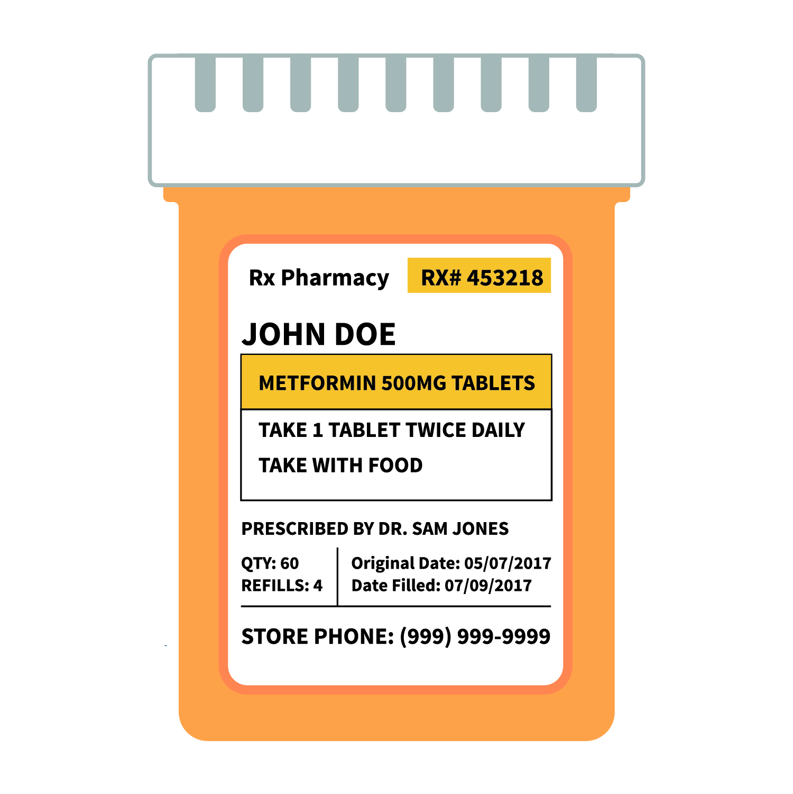
I spy information that tells Josie how to safely take their medicine…
JOSIE GRAY
Answer
Notes:
Category: I Spy, 3 points

Slide 10
All medicine comes with instructions
JOSIE GRAY
Game Board
Notes:
Category: I Spy, 3 points
A medication’s instructions provides the information that teaches us how to safely take the medicine. Medicine can have both helpful and possibly harmful actions in the body. To lower the chance the medicine hurts our bodies, we should only take medicine from a trusted adult. Trusted adults help us follow instructions and take the right medicine for the right reason.

Slide 11
I spy the medication that is safe for Derrick to take…
1
2
DERRICK GRAY
JOSIE GRAY
Answer
Notes:
Category: I Spy, 4 points

Slide 12
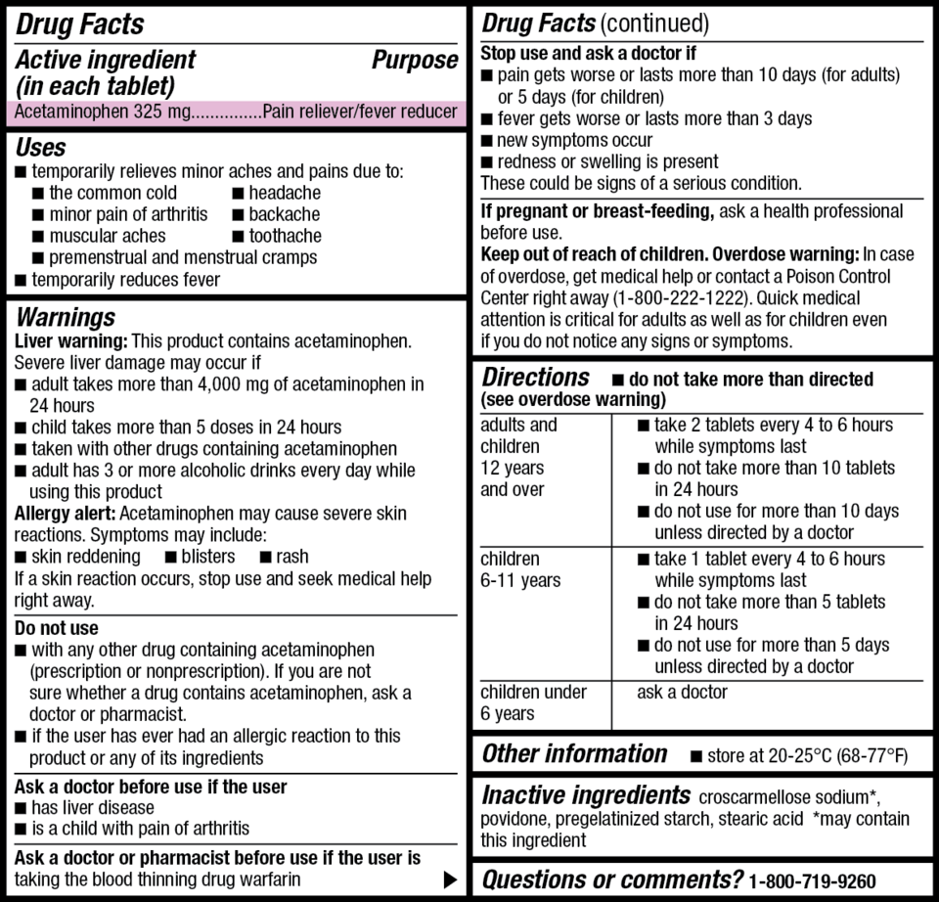
Answer slide 2
Prescription Medication
Over-the-Counter
Medication
1
DERRICK GRAY
Game Board
Notes:
Category: I Spy, 4 points
The medication with Derrick’s name on it is the medication safe for them to take. Medicine affects people differently. For example, medicine that helps you could make your friend sick. So, we should only take medicine with our name on it. To keep everyone safe, we should never share medicine or take somebody else’s medicine.
In addition, there are two types of medication – prescription and over-the-counter.
Prescription: Derrick’s medication is an example of a prescription medication. With prescription medications, you must receive permission from a doctor to take it. So, the medication is prescribed just for you. In this case, it is specifically prescribed for Derrick.
Over-the-counter: Some medicine is available without a doctor’s prescription, like over-the-counter medicine. So, the medicine will not have a specific name on it. However, even without a name, the same medication safety rule applies. We still should only take medicine from a trusted adult, never share medication, and follow the medication instructions (identified by the arrow).

Slide 13
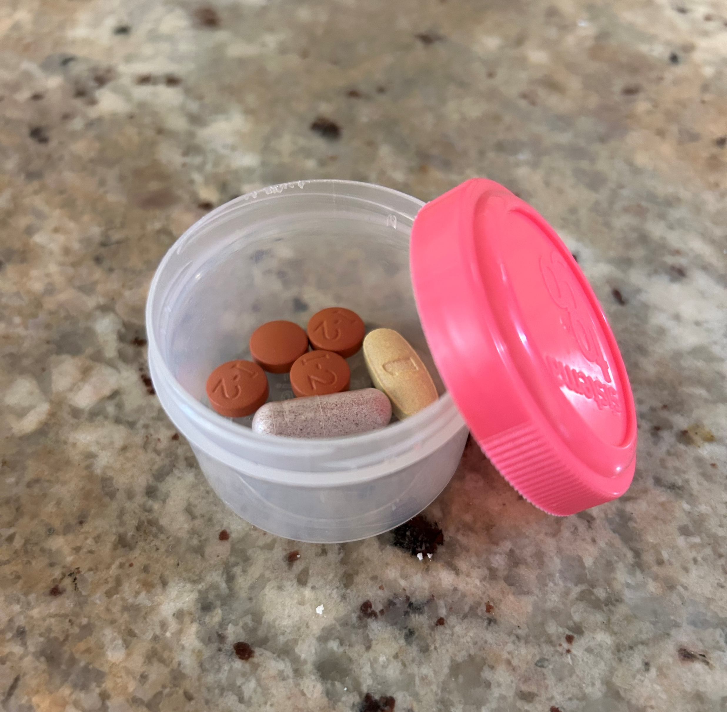
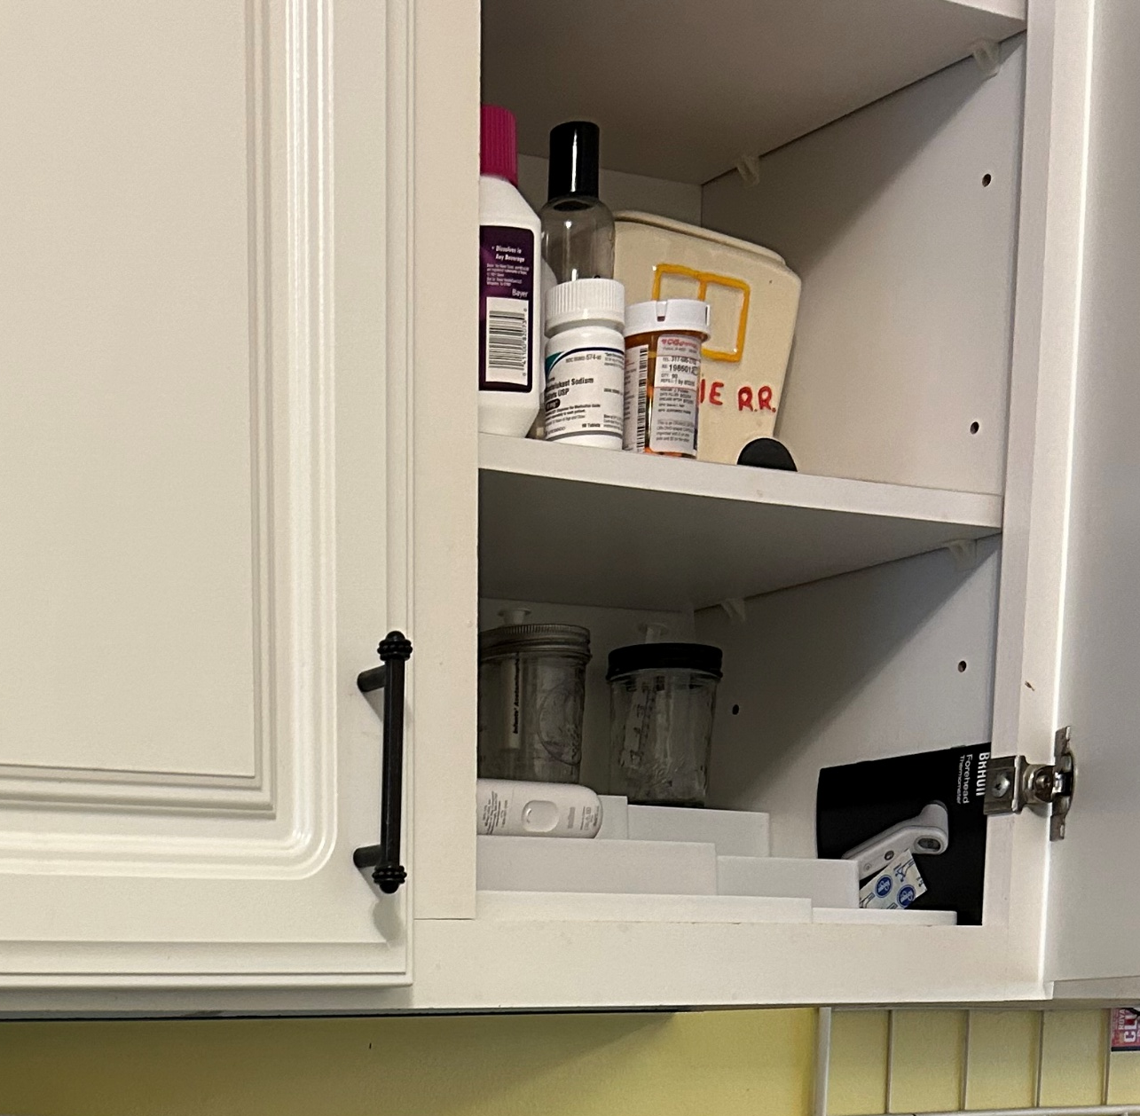
Which container is SAFELY storing medicine?
1
2
Answer
Notes:
Category: Safe Selections, 1 point

Slide 14
Answer slide 3
Unsafe
1
2
Safe
Game Board
Notes:
Category: Safe Selections, 1 point
One safe practice for storing medicine is keeping the medicine in its original container. In this example, the original container is the medicine bottle stored on a high shelf, not the medicine in the unlabeled container. Medicine and candy can look very similar but work very differently in our bodies. So, to keep everyone safe, medicine and candy should be stored in their original containers.

Slide 15
Select the items that are SAFE to share…
Answer
Notes:
Category: Safe Selections, 2 points

Slide 16
Answer slide 4
Game Board
Notes:
Category: Safe Selections, 2 points
Some things aren’t meant to be shared. We should not share items that may hurt others (like medicine or items that share our germs, like toothbrushes and underwear). Medicine affects people differently. For example, medicine that helps you could make your friend sick. To keep everyone safe, we should never share medicine or take somebody else’s medicine.

Slide 17
Is this a SAFE or UNSAFE person to help you make choices about medicine?
Answer
Notes:
Category: Safe Selections, 3 points

Slide 18

SAFE!
Game Board
Notes:
Category: Safe Selections, 3 points
Safe - only trusted adults should help us make choices about medicine, and pharmacists meet the definition of a trusted adult.
Pharmacists are community helpers that teach us how to safely use medicine and make choices that keep us healthy. Like doctors and other healthcare providers, pharmacists are excellent resources for answering your family’s questions about medicine.

Slide 19
Is it a SAFE or UNSAFE choice to take medicine from your friends?
Answer
Notes:
Category: Safe Selections, 4 points

Slide 20
UNSAFE!
Game Board
Notes:
Category: Safe Selections, 4 points
Taking medicine from your friends is not safe – only take medicine from trusted adults. Trusted adults ensure you are receiving the correct medicine for the right reason, as well as taking the medicine safely and following instructions. Always ask trusted adults for help with medicine.

Slide 21
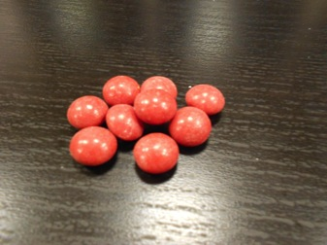
What Should I Do?
You find these red things on the counter. It looks like candy, should you eat it?
Answer
Notes:
Category: What should I do?, 1 point

Slide 22
No!
Ask a trusted adult for help.
Game Board
Notes:
Category: What should I do?, 1 point
If you do not know what it is, you should not eat it! Always ask a trusted adult before eating anything. Medicine and candy look similar, but they work very differently in our bodies. This is why we should ask our parents and guardians to keep medicine in its original container. Also, we should always ask trusted adults for help with medicine or if you find anything outside its original container.

Slide 23
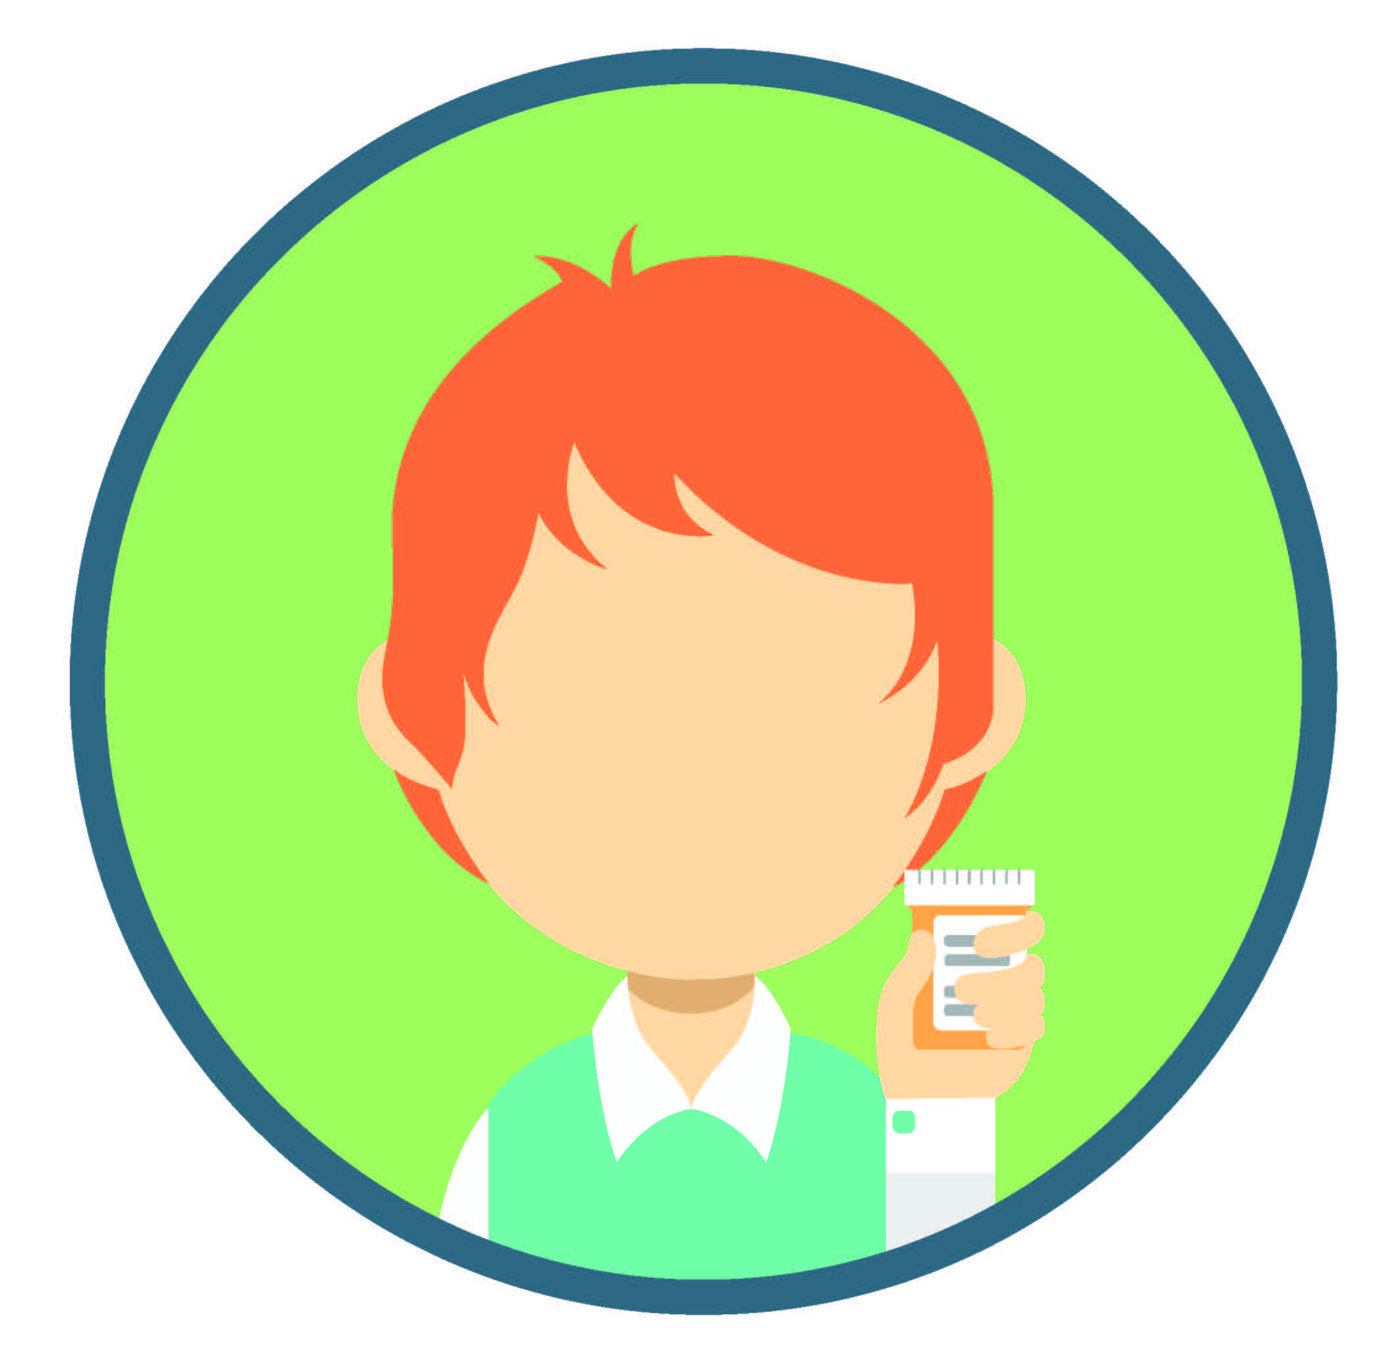
What Should I Do?
If you need to take medicine, should you take the medicine by yourself?
Answer
Notes:
Category: What should I do?, 2 points

Slide 24
No!
Only take medicine from trusted adults.
Game Board
Notes:
Category: What should I do?, 2 points
You should only take medicine from a trusted adult. Medicine can help us, but it may hurt us if we do not follow instructions, take the wrong medicine, or take someone else’s medicine. This is why it is important to only take medicine from a trusted adult in your life – they will help keep you safe when making choices about medicine.

Slide 25

What Should I Do?
Your friend is visiting your house and feels sick.
You want to help your friend – should you share medicine with them?
Answer
Notes:
Category: What should I do?, 3 points

Slide 26
No!
You should not share medicine with others. Ask a trusted adult for help.
Game Board
Notes:
Category: What should I do?, 3 points
Sharing medicine can be very dangerous. Medicine affects people differently, and medicine that helps you might actually hurt your friend. So, it is never safe to share medicine. Medicine should only be taken from a trusted adult – ask a trusted adult for help.

Slide 27

What Should I Do?
A friend invites you to take something that they say is medicine.
Answer
Notes:
Category: What should I do?, 4 points

Slide 28

Say “no”:
Explain why it is not a good idea
Explain what could happen by saying “yes”
Give a reason
Walk away
Ask a trusted adult for help
Game Board
Notes:
Category: What should I do?, 4 points
Encourage participants to say “no” using one of these approaches. If interested, consider asking participants to give an example of each approach or discuss the example given below.
Explain why you think it’s not a healthy or safe choice: “I don’t think that’s a good idea. We should only take medicine from a trusted adult. I don’t think it is safe to take anything without talking to a trusted adult first.”
Explain what could happen if you said “yes”: “If we do that, I think the medicine could hurt our bodies. I don’t want to feel any of those bad effects.”
Give a reason: “No thanks. I do a lot of different activities, and I don’t want to hurt my body or get in trouble.”
Simply say “no” and walk away: “No thanks. I need to get going, I’ll talk to you later!”
Ask a trusted adult for help.
Note to facilitator: facilitators are welcome to modify this slide to best meet the needs of the children. We would also encourage facilitators to remind children to always talk with a trusted adult if they indeed experience this situation.

Slide 29
Keep medicines safe by storing them on a _____ shelf in the bathroom or kitchen.
Answer
Notes:
Category: What’s the Word?, 1 point

Slide 30
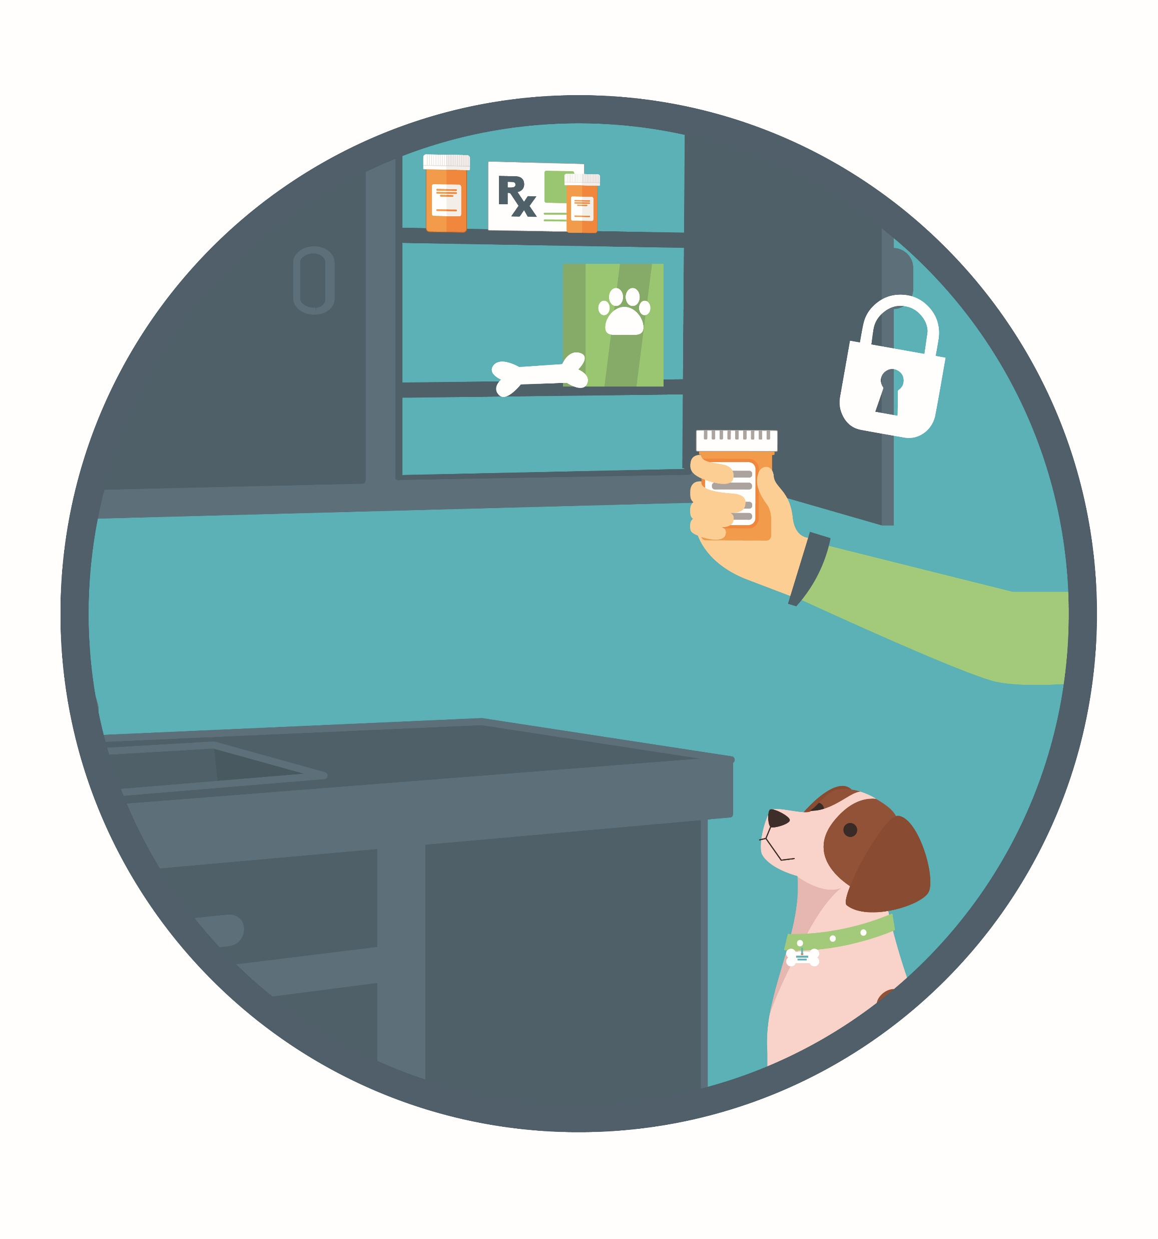
High Shelf
Game Board
Notes:
Category: Rhyme Time, 3 points
Medicine should always be stored in places where others cannot easily access it. We can encourage our family members to store medicine in safe places at home (high cabinets, high shelves, or locked spaces).

Slide 31
Follow ______! This makes it more likely that the medicine will help, not hurt, our bodies.
Answer
Notes:
Category: What’s the Word?, 2 points

Slide 32
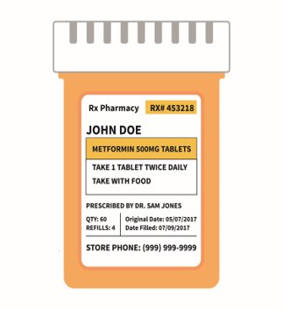
Instructions
DERRICK GRAY
Game Board
Notes:
Category: Rhyme Time, 2 points
Following instructions or rules keep us safe. We follow rules at school, when playing a sport, or when swimming in a pool. Medicine also comes with instructions that tell us how to safely take the medicine. Only take medicine from a trusted adult. Trusted adults help us follow the medicine’s instructions - this makes it more likely the medicine will help us and not hurt our bodies.

Slide 33
You should never ____ medicine with anyone.
Answer
Notes:
Category: What’s the Word?, 3 points

Slide 34
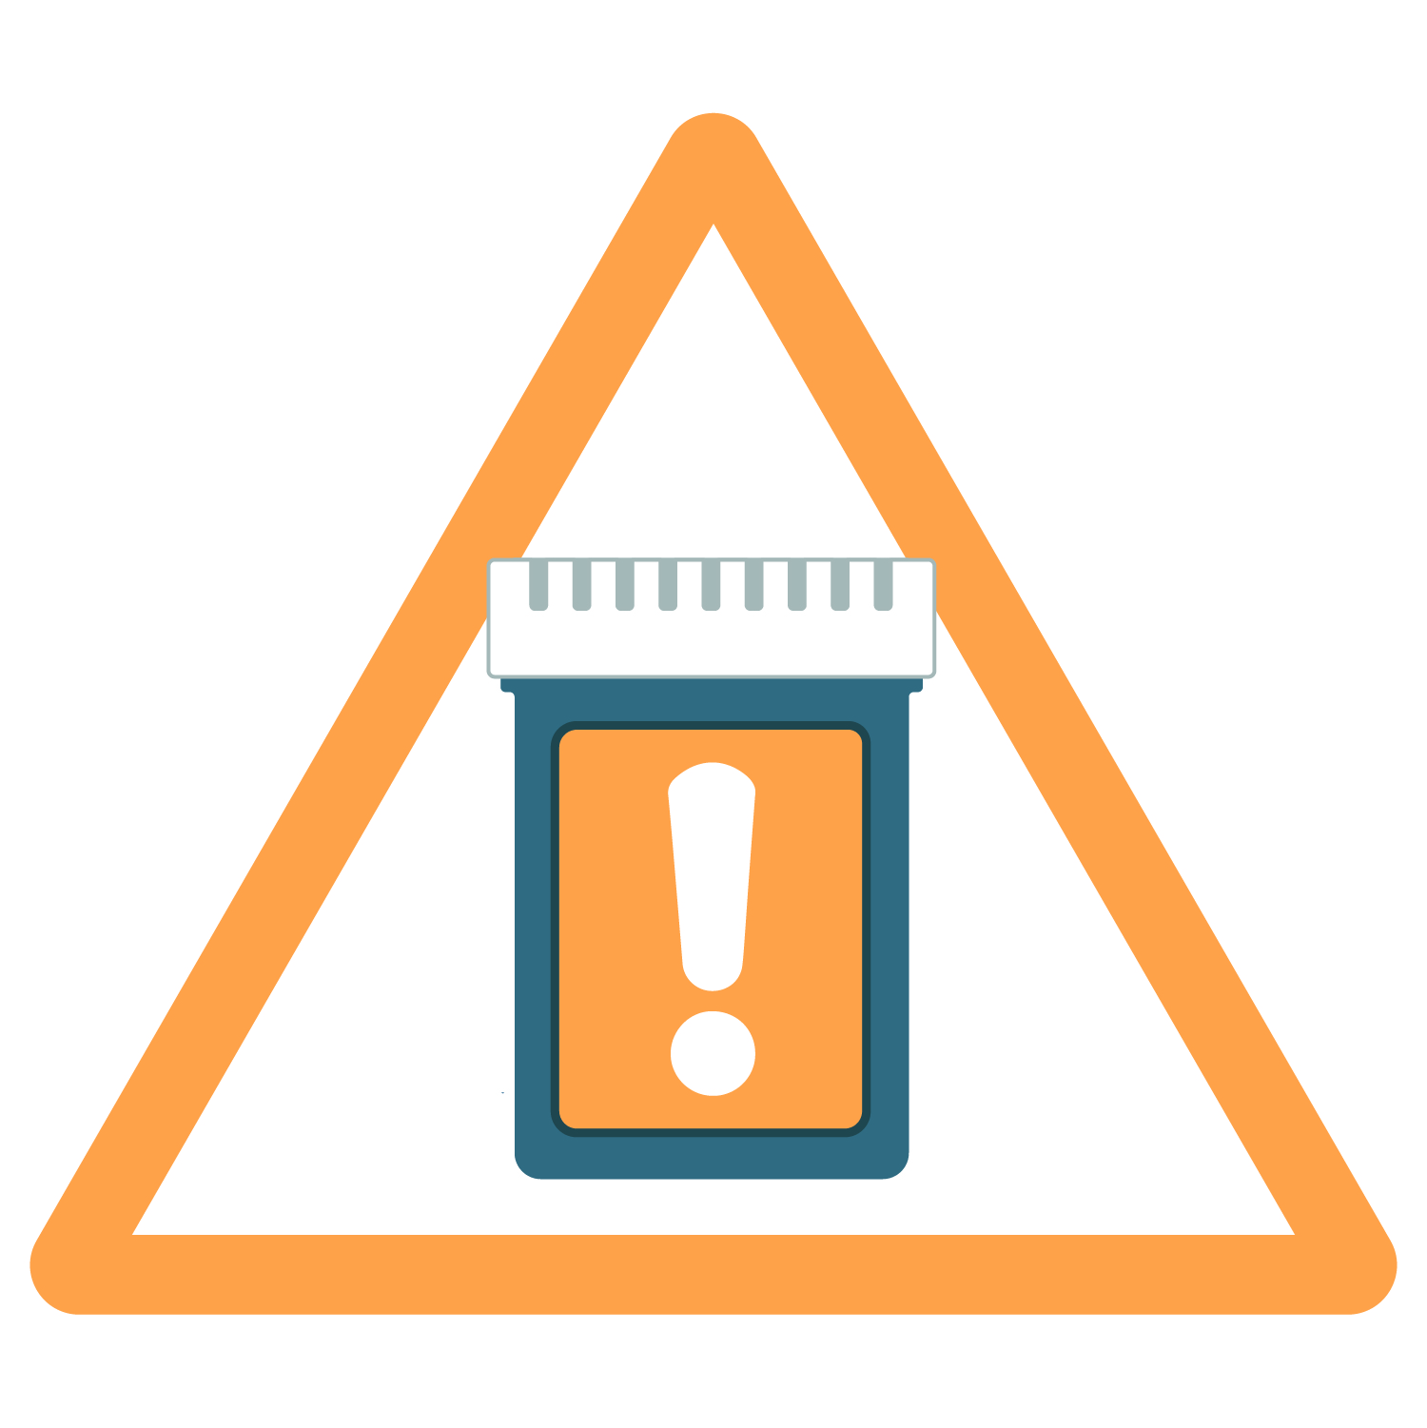
Never Share
Game Board
Notes:
Category: Rhyme Time, 3 points
Everyone is different and medicine could affect us in different ways. Medicine that may help you could hurt your family or friends. To keep everyone safe, you should never share your medication or take someone else’s medication.

Slide 35
A ______ adult makes you feel ____. You can ask them for help with medicine.
Answer
Notes:
Category: What’s the Word?, 4 points

Slide 36

Trusted Adult
+
Safe
Game Board
Notes:
Category: Rhyme Time, 4 points
Trusted adults make children feel safe and comfortable. They listen, answer their questions, and act in ways that demonstrate they care about the child’s health and safety. Trusted adults exist both in the home and in the community. Each of you may have different trusted adults in your life at home. In the community, examples of trusted adults include school nurses, pharmacists, and teachers.

Slide 37

Final Question!
Add 4 points for correct answers…
Next
Notes:
Note to facilitator:
If interested, encourage each team to add the number of points earned for each correct answer (the answers they circled on their answer sheet).
Click ‘Next’ when you are ready to ask the final question.

Slide 38
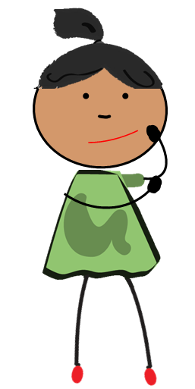
Final Question
List 2 of the 4 medication safety rules…
Answer
Notes:
Note to facilitator:
Depending on how you’re utilizing this game and the age of your participants, consider asking participants to name three or all four medication safety rules.
Advance the slide to reveal the answer(s).

Slide 39
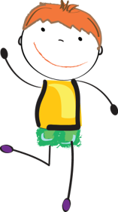
Medication Safety Rules
Ask trusted adults for help with medicine.
Only take medicine that is meant for you.
Keep medicine in safe places.
Share what you learn today with family and friends.
Thank you for playing!
Notes:
Note to facilitator:
Use this slide to conclude the game. If you kept score, calculate the final point totals for each team and announce a winner.

