Slide 1
Presenter Name
Presenter’s Organization
Date
Notes:
Welcome to today’s program, “Generation Rx: Safe Medication Practices for Life”. You may be asking yourself, “What is Generation Rx?”. Generation Rx has two primary connotations.
First, there is a historical connotation taken from Greg Critser’s book, Generation Rx: How Prescription Drugs are Altering American Lives, Minds, and Bodies. In this book, Greg describes how we have become a drug-taking society where we use prescription medications at unprecedented rates and their use has become normalized in our culture. Thus, we are “Generation Rx,” all of us from the very young to the very old.
The second connotation speaks to an educational initiative developed in a partnership between the Ohio State University College of Pharmacy and the Cardinal Health Foundation. This initiative educates the public or “Generation Rx” about how to safely use prescription medications, in an effort to prevent their misuse. “Generation Rx” focuses on teaching safe medication practices for life.

Slide 2
Program Outline
Discuss the scope, causes, and consequences of misusing prescription drugs.
Identify four “key messages” for safe medication practices.
Discuss how you can take action at home or in your community to educate others about safe medication practices.
Notes:
Transition: The agenda for today’s program includes three items.
To give context, we’ll begin by discussing the scope, causes and consequences of misusing prescription drugs. We then want to focus on how you as an individual can prevent the misuse of prescription drugs. We’ll do that by identifying four “key messages” for safe medication practices, and end with discussing how you can take action at home or in your community to educate others about the information you’ve learned today.

Slide 3
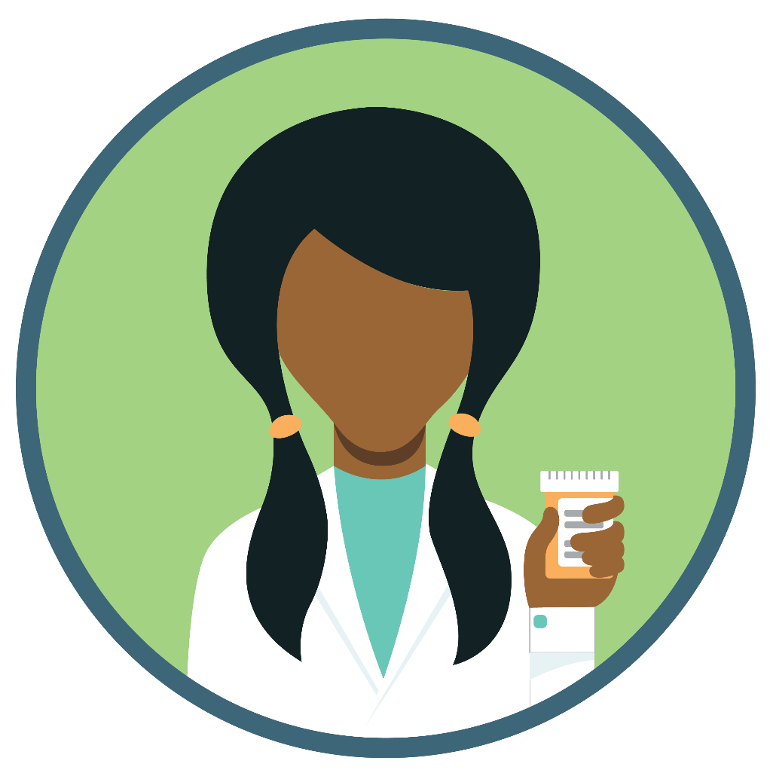
Medications can help us…
Notes:
Transition: Let’s begin by establishing the beneficial impact of prescription medications.
Prescription medications can help us lead longer and healthier lives when used under the supervision of a healthcare professional.
Our life expectancy is the longest in history, and people are now able to live with many diseases that were once fatal.
We are preventing or curing many illnesses and relieving troublesome symptoms, in part, because of prescription medications.

Slide 4
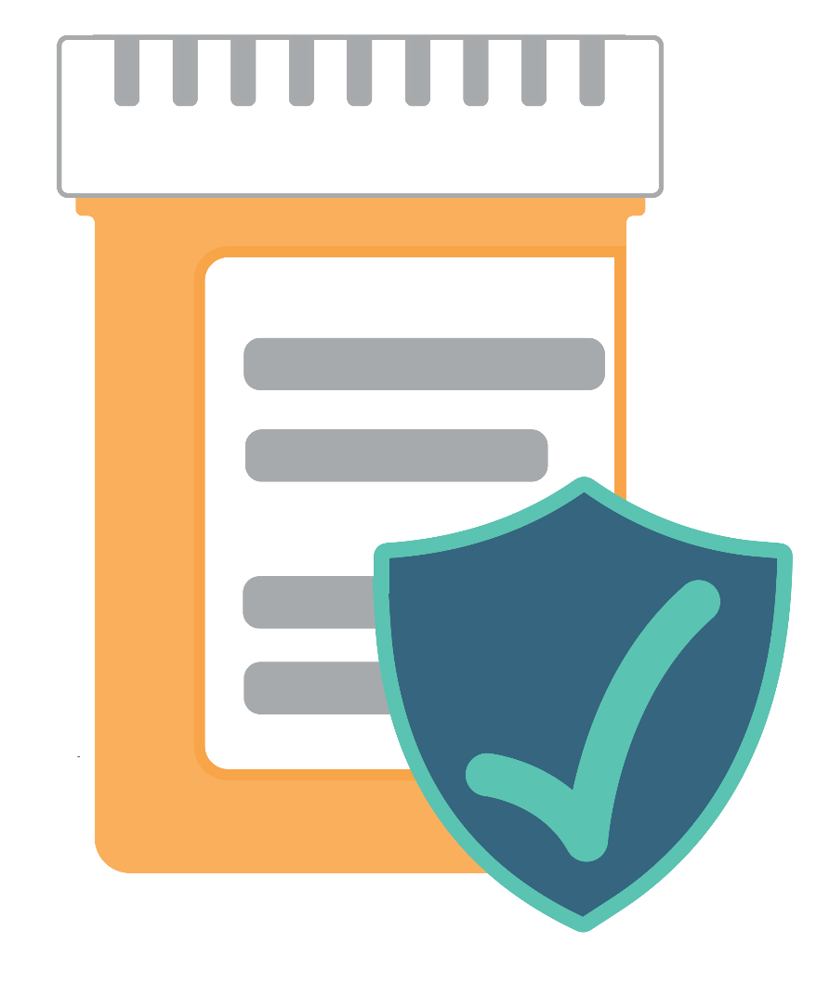
…when used as directed by a healthcare professional
Notes:
Transition: But these powerful, sometimes life-saving medications, helpful when used as directed by your healthcare professionals, can also be harmful – especially when misused.
This is one of our most important messages: it is very important to only use medications as directed by your healthcare professionals, who will monitor your care and help you avoid harmful effects.

Slide 5
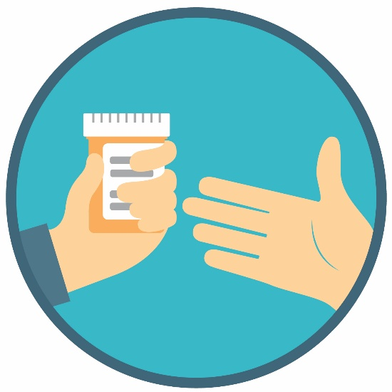
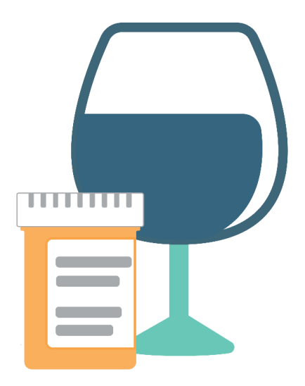
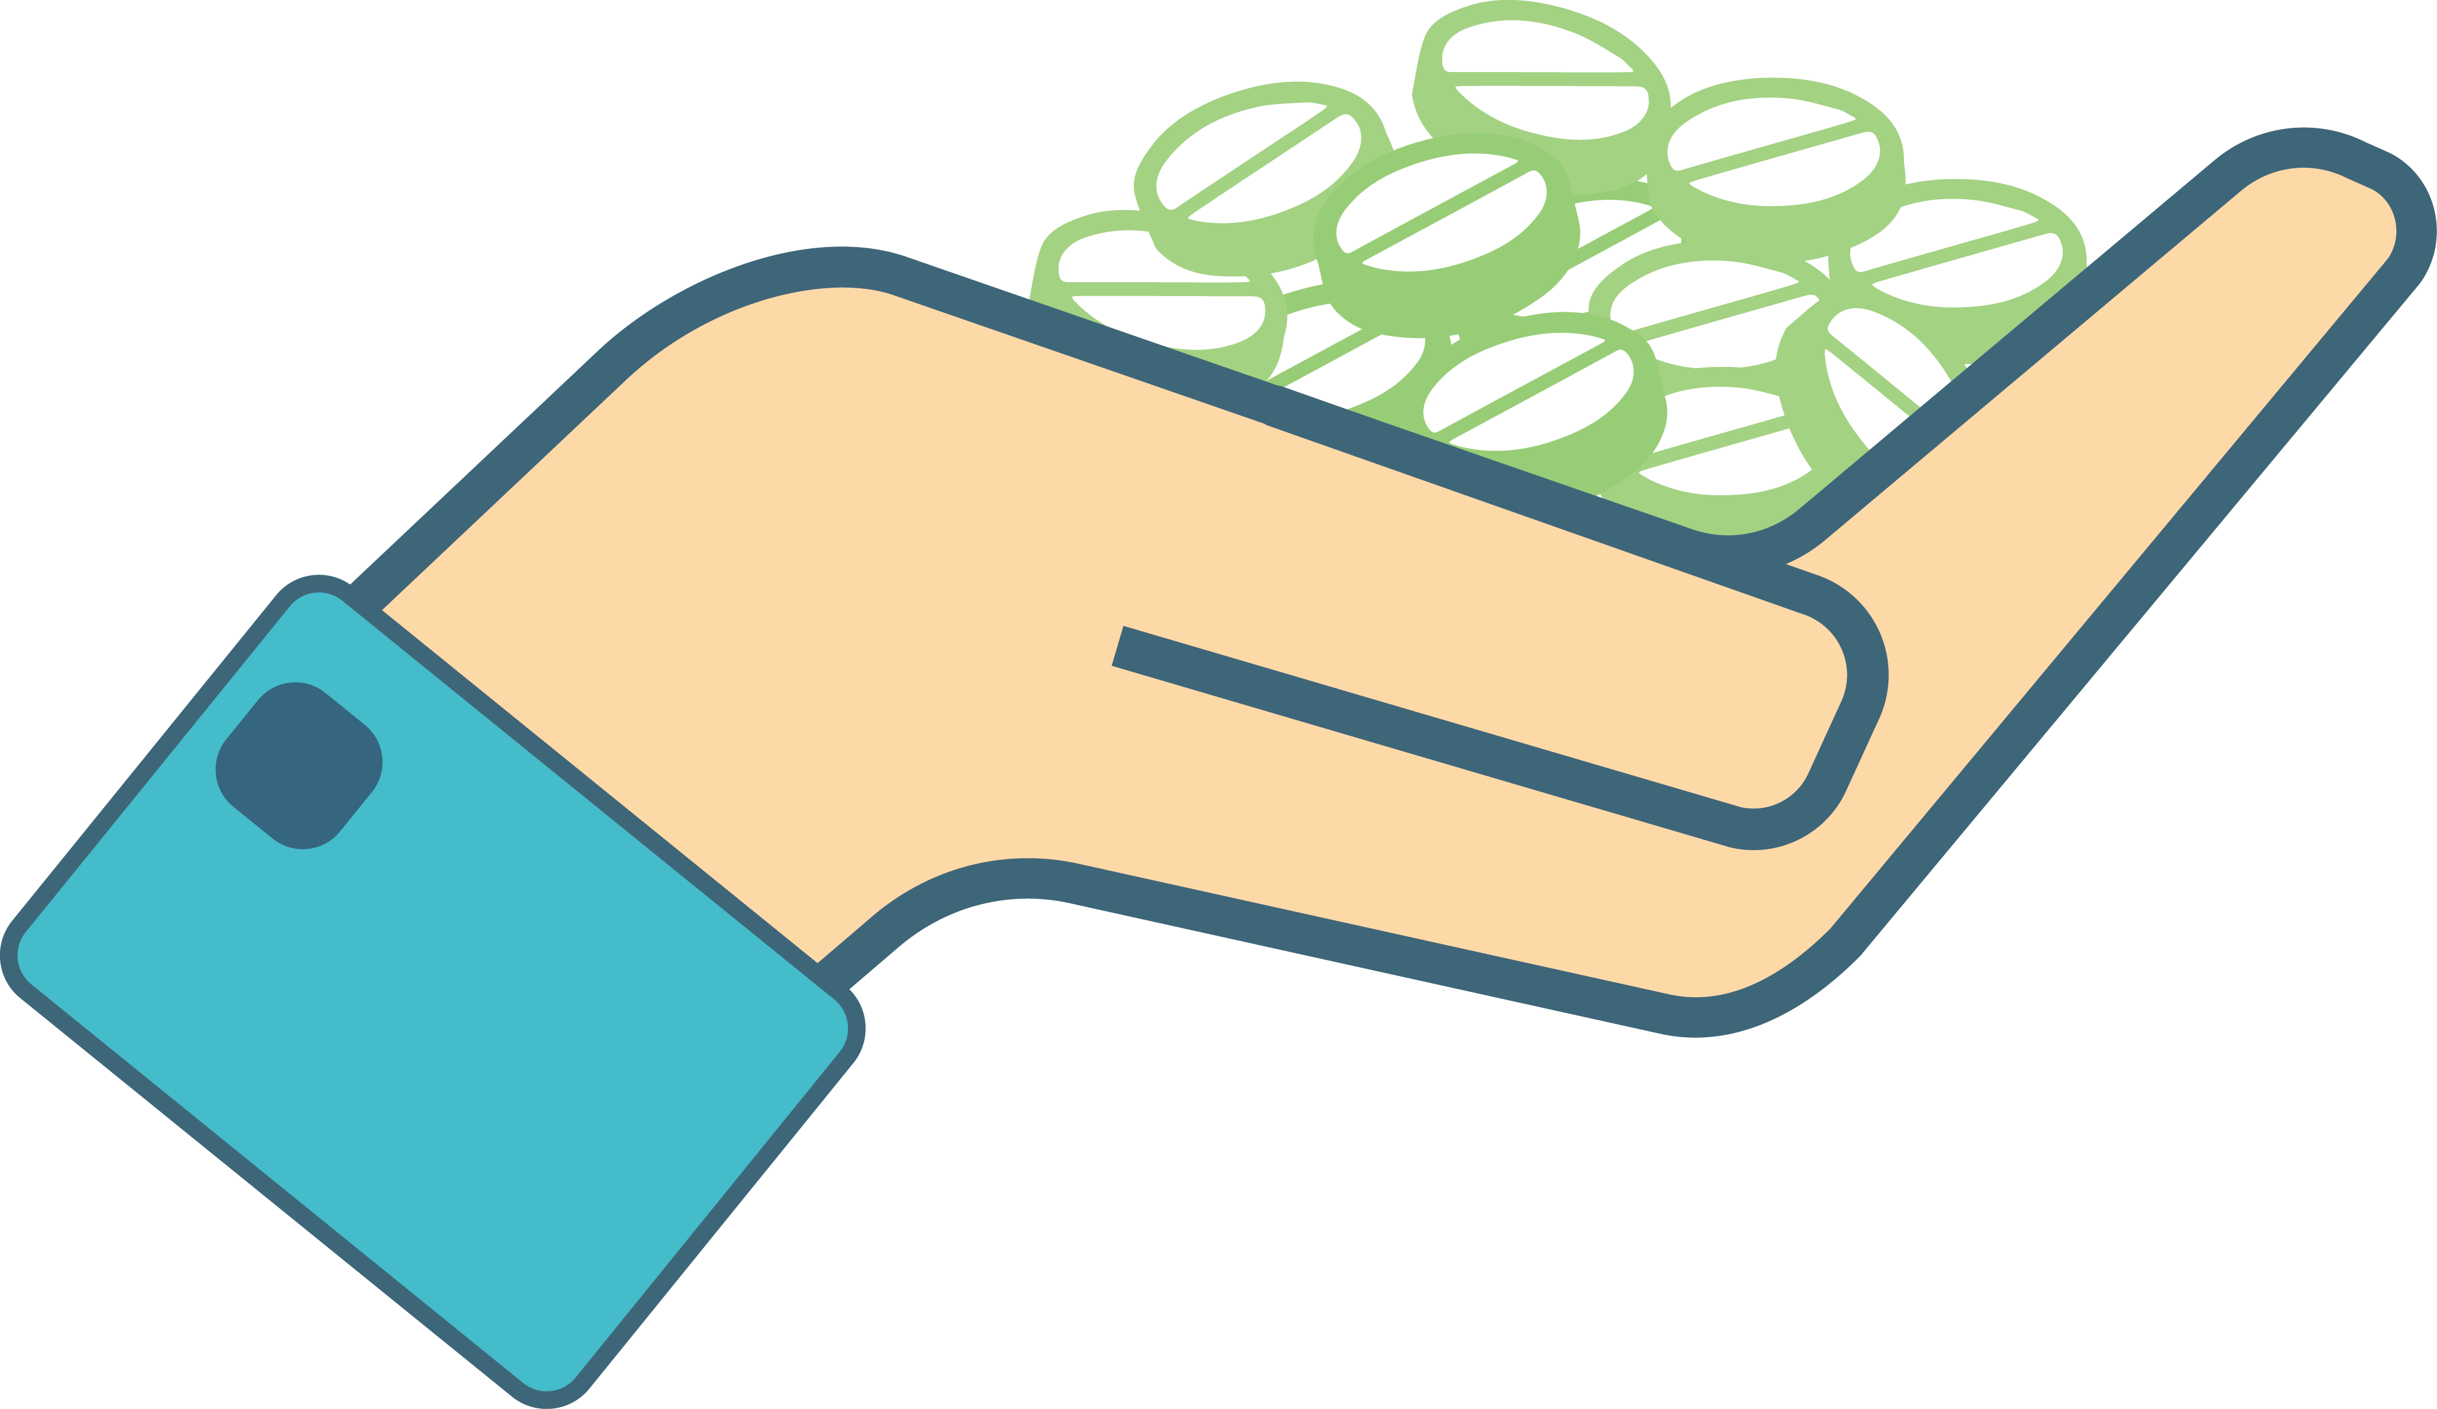
Which scenario depicts prescription drug misuse?
Notes:
Transition: Before we move forward, let’s consider this question—”How do we define prescription drug misuse?”
Here are three scenarios. Scenario 1: a patient prescribed an opioid pain medication is in severe pain—the patient takes more than instructed to manage their pain. Scenario 2: a patient shares their medication with a friend or family member. Scenario 3: a patient mixes their prescription medication with alcohol to elicit a pleasurable effect.
Which scenario do you think depicts prescription drug misuse? (Note for facilitator: encourage participants to discuss amongst themselves which scenario(s) depict prescription drug misuse. When ready, poll the audience).
Correct! Each scenario depicts prescription drug misuse. Many people may believe that ‘Scenario 3’ is the only situation depicting misuse, as the individual appears to be misusing the prescription medication by mixing it with alcohol, perhaps with the purpose to escape or to elicit a pleasurable effect.
However, the behaviors depicted in Scenarios 1 and 2 also define prescription drug misuse. It’s often the case that people misusing are not doing it on purpose. They might misuse to manage stress, or to manage an existing medical condition. Not taking your prescription as instructed by a healthcare professional or perhaps sharing your prescription medication with others, even if your intention is to help that individual, is just as dangerous.

Slide 6
Misusing medications is:
Taking more than prescribed
Taking medication for a reason different than prescribed
Sharing or taking someone else’s medication
Regardless of intentions…
Notes:
Transition: Therefore, we define prescription drug misuse as engaging in three key behaviors.
Taking more of a prescription medication than prescribed.
Taking a prescription medication for a reason different than prescribed.
Sharing or taking someone else’s prescription medication.
And as we noted on the previous slide, regardless of our intentions or reasons, engaging in any of these behaviors is misuse.
Note for facilitator: If asked, the National Institute of Health drafted and currently supports these definitions of prescription drug misuse.

Slide 7
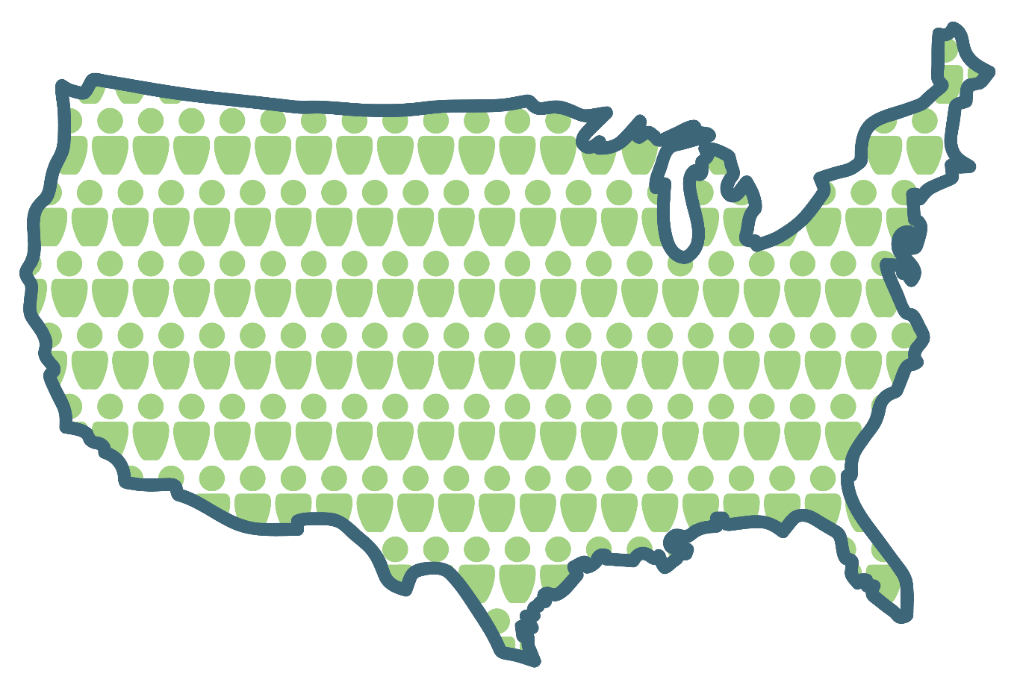
Prescription drug misuse
is a national epidemic
Notes:
Transition: And unfortunately, the Centers for Disease Control and Prevention (or CDC) now call this problem an “epidemic.”
Research indicates that millions of Americans misuse prescription drugs by taking them differently than the prescriber intended, and thousands do so for the first time every day.
Prescription drugs are among the most misused substances in the United States, more than all illicit “street” drugs combined except marijuana.
The most commonly misused prescription drugs include opioid pain medications (e.g. Vicodin, OxyContin), sedatives (e.g., Xanax, Valium) and stimulants (e.g., Adderall, Ritalin)

Slide 8

This epidemic affects all of us
Notes:
Transition: This epidemic affects all of us.
There is no stereotypical “type” of person susceptible to prescription drug misuse.
Prescription drug misuse occurs from the very young through the very old. It occurs in rural and suburban communities among those of all socioeconomic status. This is not a “youth” issue. These risks apply to everyone, including adults.
Note for facilitator: based on your audience, you may wish to share some of the statistics listed below.
General statistic:
6.2 million Americans aged 12 and older reported misusing a prescription medication in the past month [National Survey on Drug Use & Health (NSDUH), 2016]
Statistics to share with parents:
Two-thirds of teens that report misusing prescription opioid pain medications state they received this medication from friends or family members (Partnership for Drug Free Kids, accessed 08/2019).
27% of parents report they have taken a prescription medication without having a prescription for it themselves (Partnership for Drug Free Kids, accessed 08/2019). What example does this set for youth? We’ll discuss how we can model safe medication practices later in the talk.
The mean age for first misusing prescription drugs is 18-25 year olds [National Survey on Drug Use and Health (NSDUH), 2011].
27% of teens and 16% of parents believe using prescription drugs to get “high” is much safer than using illicit “street drugs” [Partnership Attitude Tracking Study (PATS), 2013, 2014].
31% of teens and 13% of parents believe it is okay to take a prescription drug without a legitimate prescription to deal with injury or pain [Partnership Attitude Tracking Study (PATS), 2013, 2014].
Statistics to share with working professionals:
Reports published in 2011 indicated that in 2007, prescription opioid misuse led to $42 billion in lost workplace productivity per year (www.generationrxworkplace.com, accessed 08/2015; 2007 was the latest report of this kind).
Research supports that substance misusers are more likely to be fired, frequently change jobs, and remain unemployed than those that do not misuse (Sansone 2012).
Statistics to share with senior citizens:
SAMHSA (Substance Abuse and Mental Health Services Administration) estimates the number of older adults with a substance use disorder in 2020 to be 5.7 million (increased from 2.8 million from 2002-2006). (SAMSHA 2017)
Current research estimates 17% of senior citizens struggle with a substance misuse problem (SAMHSA, 2012).
Emergency department visits involving misuse of prescription opioids by senior citizens increased 121% between 2004 – 2008 (SAMHSA, 2012).
Note for facilitator: the statistics in #1-2 for senior citizens reflect substance misuse in general—this is not a statistic specific for prescription drug misuse.

Slide 9
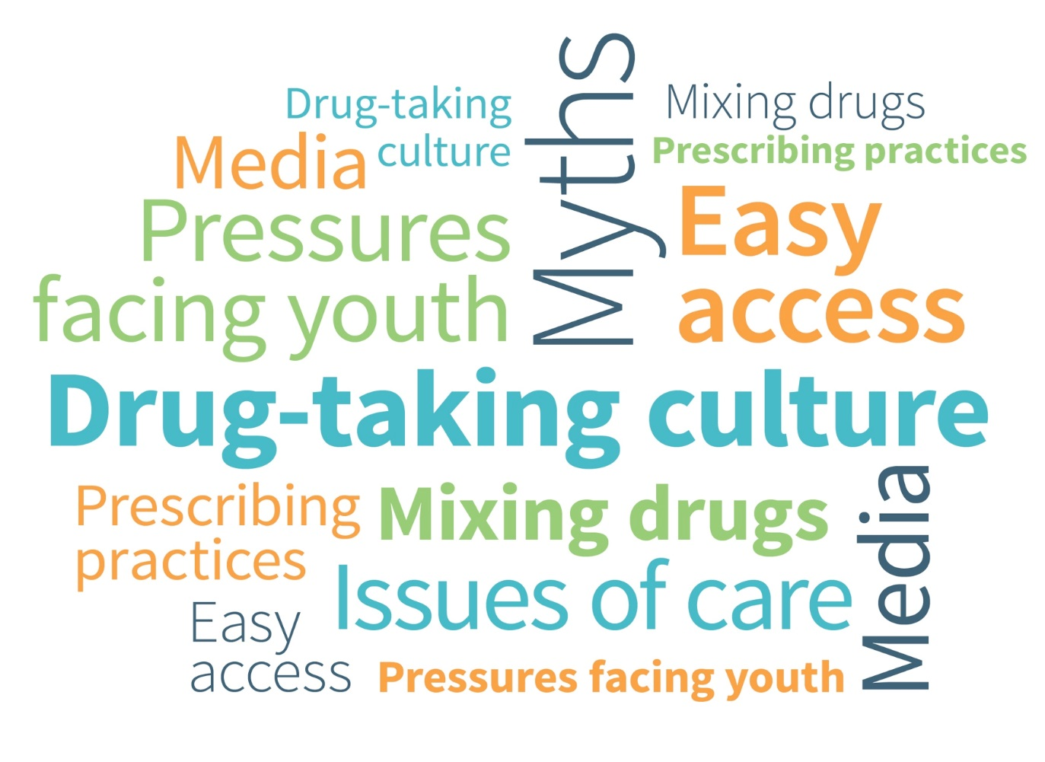
Several factors fuel the misuse of prescription drugs:
Notes:
Transition: Why is our community vulnerable to the misuse of prescription drugs? We believe several factors fuel the misuse of prescription drugs.
Note for facilitator: If time only allows for discussion of a few factors, we recommend discussing the factors listed in the first three talking points.
Drug-taking Culture: First, as we discussed earlier, we are “Generation Rx”, all of us from the very young to the very old. We are a drug-taking society, and the use of medications has become normalized in our culture.
Easy Access: Second, because we are using medications at unprecedented rates, they are relatively easy to obtain without a prescription. In fact, data from the National Survey on Drug Use and Health demonstrates that the majority of individuals that misuse a prescription drug get them from family members or friends.
Misperceptions: Third, there are many misperceptions surrounding the legality and safety of prescription drugs. For example, many of us don’t realize that it is illegal (and considered a felony offense for the types of medications which are most misused) to provide any prescription drug to another person without a legitimate prescription. Unfortunately, many individuals do not understand these dangers and thus don’t recognize that the misuse of many prescription drugs can be just as dangerous as using illicit “street” drugs.
Prescribing Practices: The number of prescriptions written by doctors has escalated, especially that for prescription opioids. In 2012, the Center for Disease Control and Prevention (CD) reported that physicians wrote over 250 million prescriptions for opioid medications (CDC, 2014).
Media: We are only one of two countries (other is New Zealand) that permit direct-to-consumer advertisements for prescription medications. These advertisements fuel our false beliefs that medications provide quick fixes to everyday problems.
Mixing Drugs: Referencing back to misperceptions—misperceptions also exist regarding the dangers of mixing prescription medications with alcohol. Many overdoses result from mixing prescription medications with alcohol or with other drugs.
Pressures facing youth: Like adults, many youth misuse prescription medications to deal with various pressures they experience. Pressures may include managing daily stress and anxiety or perhaps pressure to perform at a high level either in athletics or in academics.
Issues of care: In some situations, healthcare professionals may not be educating patients on the safe use of the medications prescribed to them following a surgery or treatment of a medical condition. This lack of education can lead to misuse.

Slide 10
Most commonly misused medication classes
Type | Opioids | Stimulants | Sedatives
Intended Use | Pain management | ADHD (alertness, impulse control) | Sleep and anxiety disorders, seizure disorders
Misuse Dangers | Dependence, addiction, slowed breathing, decreased mental alertness | Dependence, addiction, increased heart rate, increased blood pressure, increased anxiety | Dependence, addiction, slowed breathing, decreased mental alertness
Examples | Percocet®, Vicodin®, Oxycontin® | Adderall®, Ritalin®, Vyvanse®, Concerta® | Xanax®, Ativan®, Valium®
Notes:
We’ve talked on the causes and consequences of prescription drug misuse. We would like to provide a bit more detail on the three most commonly misused types of prescription medication.
When prescribed by a healthcare professional and used as intended, these medications can be very helpful for those that need them. Some of the reasons why these medicines might be prescribed can be seen here, and there are other medically necessary reasons.
When misused, however, these prescription medications can cause dangerous effects in the body and consequences can be very serious, even fatal. Any of these three classes of medication can lead to dependence and addiction. It is important to have regular contact with your prescriber or pharmacist to determine the best use of your medicines.
By misusing medications, like taking someone else’s medication, taking more than prescribed, or taking it for a reason other than prescribed, you are at an increased risk for misuse dangers seen on this slide for stimulants, sedatives, and opioids.
For more information on these specific medication classes, please see the videos and find additional information on GenerationRx.org.

Slide 11
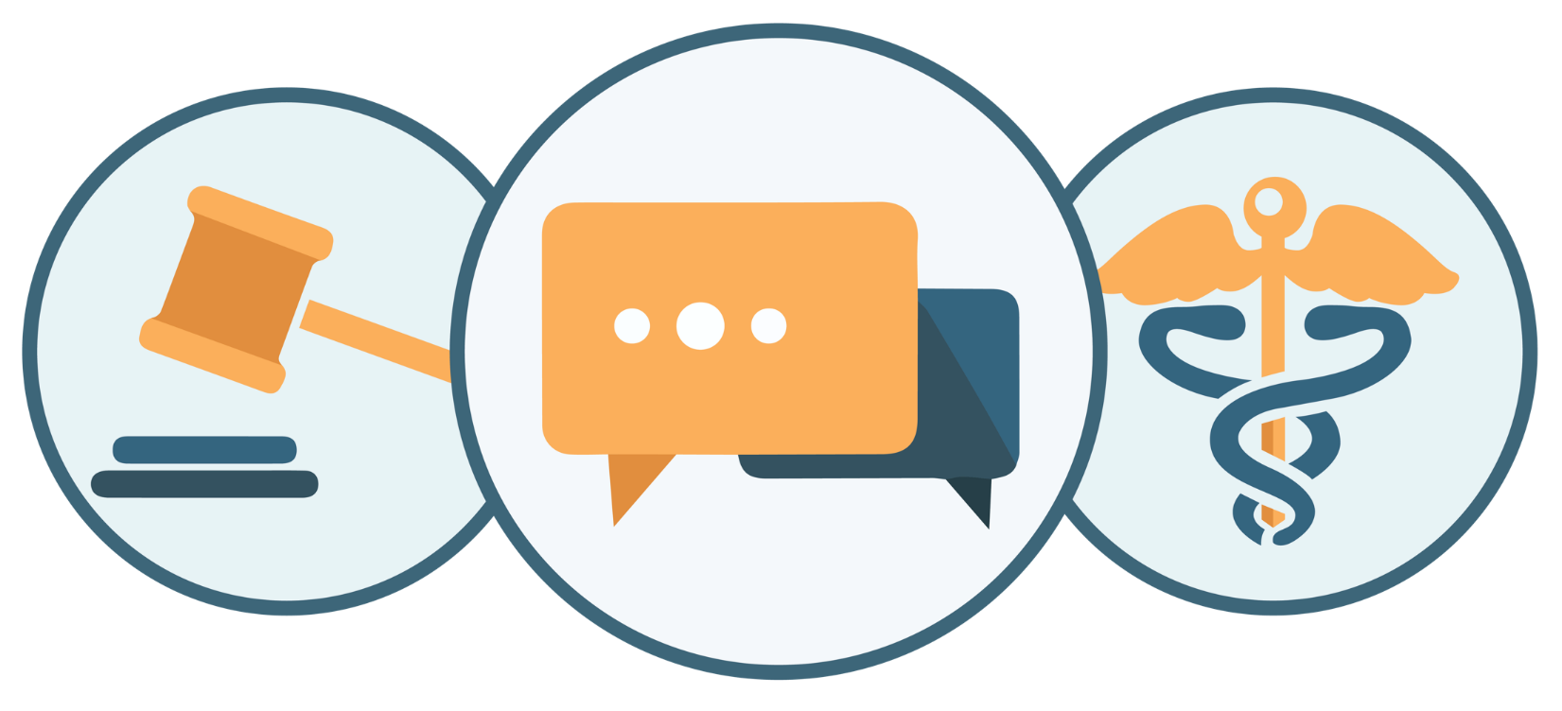
The misuse of prescription drugs
has serious consequences
Notes:
Transition: We’ve identified the factors that fuel this problem, but how does the misuse of prescription drugs impact our community? (Note for facilitator: consider asking the audience to contribute ideas)
We believe the misuse of prescription drugs has serious legal, social, and health consequences:
Legal impact:
In the previous slide, we discussed how federal law prohibits the possession of a prescription drug without a written prescription. Many of the prescription drugs which are most misused are called “controlled substances” (for example, Vicodin®, OxyContin®, Valium®, Xanax®, Adderall®, Ritalin®), indicating there are even stricter prescribing and dispensing regulations for their use.
Social impact:
The misuse of medications can affect our family and friends, our job, our education, our finances, and much more.
Reports published in 2011 indicated that in 2007, the annual cost of prescription opioid misuse to the U.S. economy was close to $53 billion/yr, with $42 billion in lost workplace productivity, $8.2 billion to criminal justice costs, $2.2 billion to drug abuse treatment, and $944 million to medical complications (Hansen et. al. 2011 and www.generationrxworkplace.com, accessed 08/2015; 2007 was the latest report of this kind)
Health impact:
The most tragic consequence of prescription drug misuse affect our health, including drug overdose deaths, which is the leading cause of accidental death in the U.S.
Death isn’t the only health-related consequence. Due to the high misuse and addiction potential of certain prescription drugs (e.g., opioid pain medications), emergency department visits and drug addiction treatment admissions relating to medication misuse have both escalated.
Drug addiction to prescription opioid pain medications account for over 15% of the approximate 1 million drug treatment admissions each year. This has increased from under 5% in 2002 (Office of National Drug Control Policy, 2014).
In 2011, approximately 2.5 million emergency department visits in the U.S. were due to drug misuse, including over 1.4 million visits related to the misuse of prescription drugs (Office of National Drug Control Policy, 2014).
Not taking your prescription as directed by a healthcare professional can result in immediate negative effects, including:
For prescription opioid pain medications: drowsiness, confusion, sedation, slowed breathing
For prescription sedatives: decreased heart rate and blood pressure, impaired coordination and judgement, confusion, sedation, slowed breathing
For prescription stimulants: increased heart rate and blood pressure, irregular heart beat, nervousness, insomnia
Lastly, many experts attribute the recent rise in deaths resulting from heroin overdoses to the misuse of prescription drugs. In fact, recent research indicates that 3 out of 4 heroin users first reported misusing prescription opioid pain medications (Cicero et al 2014), which exhibit identical effects to heroin in the body (and thus remain a cheaper, more accessible alternative).

Slide 12
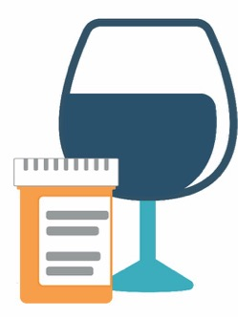
Mixing alcohol and prescription medications can have dangerous effects on the body
Notes:
Mixing alcohol with medications is potentially very dangerous because it sends the body mixed messages and increases your risk for dangerous levels of intoxication.
Note that alcohol reduces heart rate, as do sedatives and opioids. This can lead to a dangerously low heart and breathing rate, ultimately stopping breathing. In addition, alcohol slows messages between the body and brain, as do opioids and sedatives. This can lead to confusion, “passing out”, and coma. Combined with the effects on the heart and lungs, this can be very dangerous very quickly.
Stimulants increase heart rate, and the mixed messages with alcohol may cause an irregular heart beat and severe over intoxication. These mixed messages with alcohol slowing the brain response confuse the body and increase the risk for dangerous levels of alcohol intoxication, as well as other potential harms resulting from risky drinking.

Slide 13
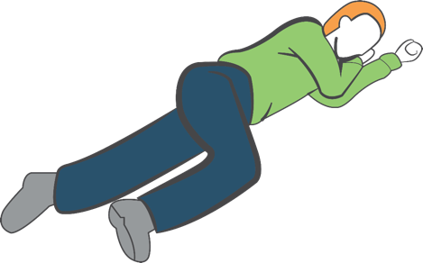
Take action in a suspected overdose situation:
Hand
supports
head
Call 9-1-1
Move individual to recovery position
If available, administer naloxone
  Reverses opioid overdose only
Stay with the person until help arrives
Knee stops
body from
rolling onto
stomach
Notes:
If you suspect someone has overdosed on any drug, how can you take action?
First, call 9-1-1.
Second, move the individual to the recovery position (place the individual on their left side—with their arms under their head, bending their right leg to prevent them from rolling onto their stomach). This position is designed to prevent suffocation if the individual vomits.
Third, if available, administer naloxone. Opioids cause death through modifying the brain’s respiratory center—essentially, you stop breathing. When naloxone is administered, the ability for the opioid drug to stop respiration is blocked or prevented, and the individual resumes breathing.
Naloxone is available as an auto injector or as an intranasal spray.
Accessing naloxone by the general public varies from state to state. To find a naloxone distribution program in your area, consult the search engine labeled, “Overdose Prevention Program” at the following site: http://harmreduction.org/overdose-prevention/overdose-news/prescribe-naloxone/
It is critical to remember two precautions regarding the use of naloxone:
Because of naloxone’s actions in the body, it will precipitate withdrawal symptoms (e.g., vomiting, combativeness or agitation) upon administration in an individual physically dependent on opioid drugs.
If the patient actually overdosed on a non-opioid drug (prescription sedatives, alcohol, etc.), administering naloxone will have no effect, and it will not rescue breathing, but will also not harm the person.
For more information on naloxone, visit “Learn/Helping Others” at GenerationRx.org.
Lastly, stay with the individual until help arrives.

Slide 14

YOU can make a difference!
Notes:
Transition: The good news is that you can make a difference! Prescription drug misuse can be prevented…and prevention starts with you.
How can you prevent prescription drug misuse at home or in your community? (Note to facilitator: Consider allowing participants to brainstorm and share ideas. You may wish to summarize these ideas on a whiteboard, if available).

Slide 15
Safe Medication Practices to Follow
1
Only use prescription medications
as directed by a health professional
Do not share or take someone else’s medication
Keep your medications safe
Model safe medication practices
2
3
4
Notes:
Transition: We can stop this epidemic by following four key safe medication practices, which we will discuss in more detail on the following slides.

Slide 16

1
Only use prescription medications as directed by a health professional
Notes:
Transition: First, only use prescription medications as directed by a health professional (Note for facilitator: consider connecting this message back to the factors that fuel this problem).
Many overdoses result from mixing prescription drugs with other medications or alcohol. Never mix medications with alcohol. If you are taking more than one prescription medication, consult your pharmacist first to ensure this combination is safe.
Follow the dosing instructions prescribed by your doctor. These instructions are intentional, and help to avoid negative effects.
Talk with your doctor or pharmacist if you feel your medication needs adjusted.

Slide 17

2
Do not share
or take
someone else’s medication
Notes:
Transition: Second, never share your prescription medications with others or use someone else’s prescription medication (Note for facilitator: consider connecting this message back to the factors that fuel this problem).
Many factors determine how we respond to medication—our genetics, weight, and pre-existing medical conditions, amongst others. Therefore, individuals can respond to the same medication differently.
Engaging in behaviors of self-diagnosis and self-prescribing is dangerous—always report any health concerns to a healthcare professional.
Regardless of intention, sharing or taking someone else’s medication is not safe. Only use medications under the guidance of a healthcare professional.

Slide 18
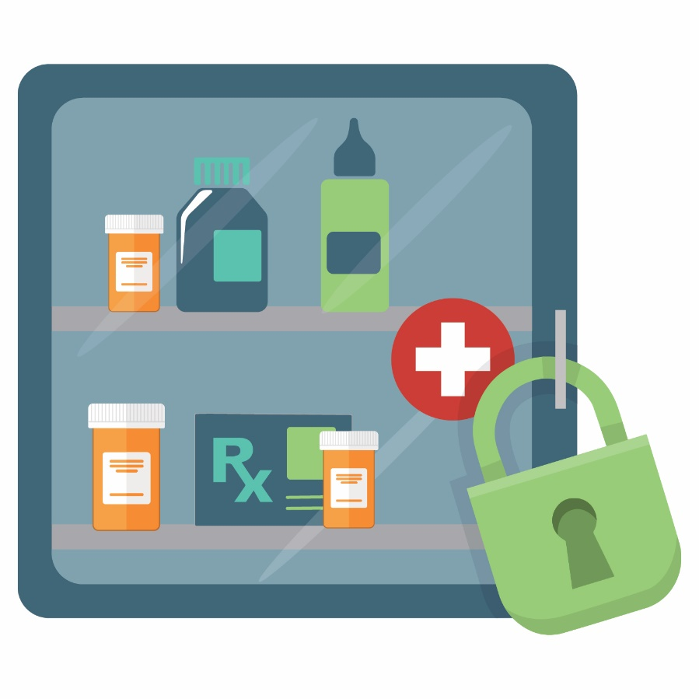
3
Keep your medications safe: storage
Notes:
Transition: Third, keep your medications secure through safe storage and disposal practices. First, we’ll discuss storage. How do you safely store medications? (Note to facilitator: encourage participants to suggest safe storage places)
When prescribed a prescription medication, store medications in secure locations such as lock-boxes, medication safes, or other lockable spaces.
Avoid storage places where children and others can easily access, such as drawers, nightstands, or kitchen counters/cabinets.
Recall that most people who misuse prescription drugs get them from family members or friends.

Slide 19
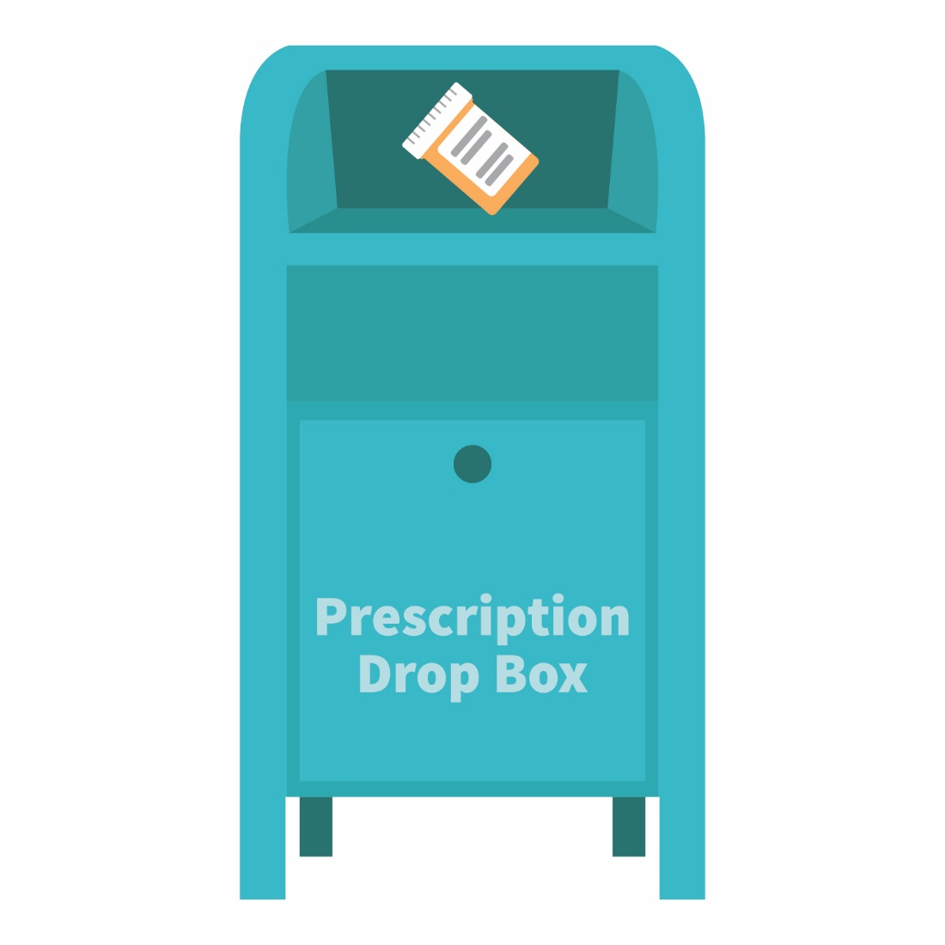
3
Keep your medications safe: disposal
Notes:
Transition: Next, we’ll discuss disposal. Once finished with a prescription medication, you have three options for safely disposing a medication:
Option #1: place the medication in a drug dropbox. To find a dropbox in your area, visit: rxdrugdropbox.org
Option #2: you can take advantage of community drug take-back programs that allow the public to bring unused drugs to a central location for proper disposal. Call your local law enforcement agency or ask your pharmacist to see if a take-back program is available in your community.
Option #3: progress to next slide

Slide 20
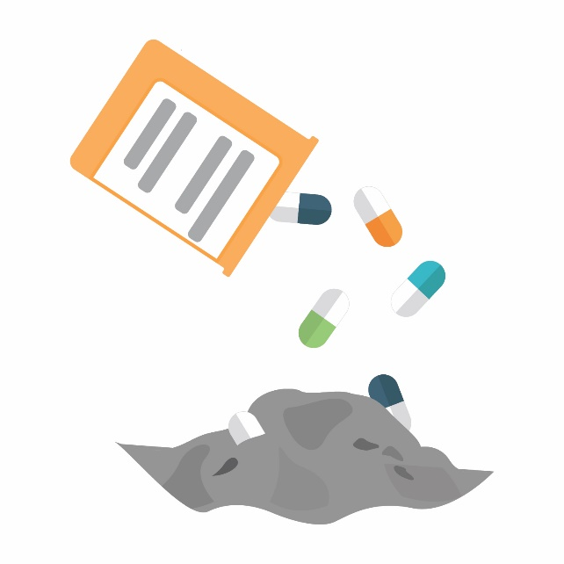
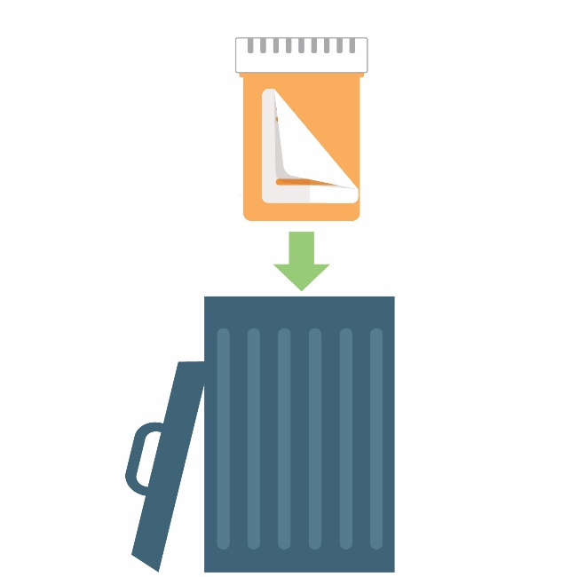
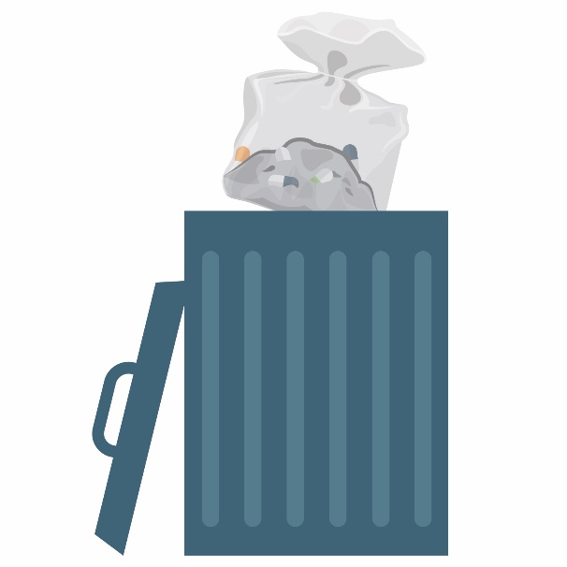
No drug dropbox or
take-back near you?
STEP 1: STEP 2: STEP 3:
Notes:
Transition: If there is not a drug dropbox or take-back program near you, there is a third option that allows for safe disposal at home.
Before completing these steps, we encourage you to follow any disposal instructions on the drug’s label or patient information sheet.
If disposal instructions are not given, complete these three steps:
Step 1: Remove the pills from the original container and mix them with an undesirable substance such as used coffee grounds or kitty litter
Step 2: Throw away the sealed mixture into the trash.
Step 3: Remove the prescription label and dispose of the empty bottle.
In general, you should not flush medications down the toilet; however, the FDA still recommends that certain drugs should be disposed by flushing (for a list, visit: www.fda.gov).

Slide 21
4
Model safe medication practices
Notes:
Transition: Lastly, be a good example to those around you by modeling these safe medication-taking practices.
Remember to:
Be your own health advocate:
Learn about your medications
Keep a Complete Medication Record
Use your pharmacist as a trusted resource
When appropriate, discuss the dangers of misusing prescription drugs with your family, friends, colleagues, students, or patients.

Slide 22
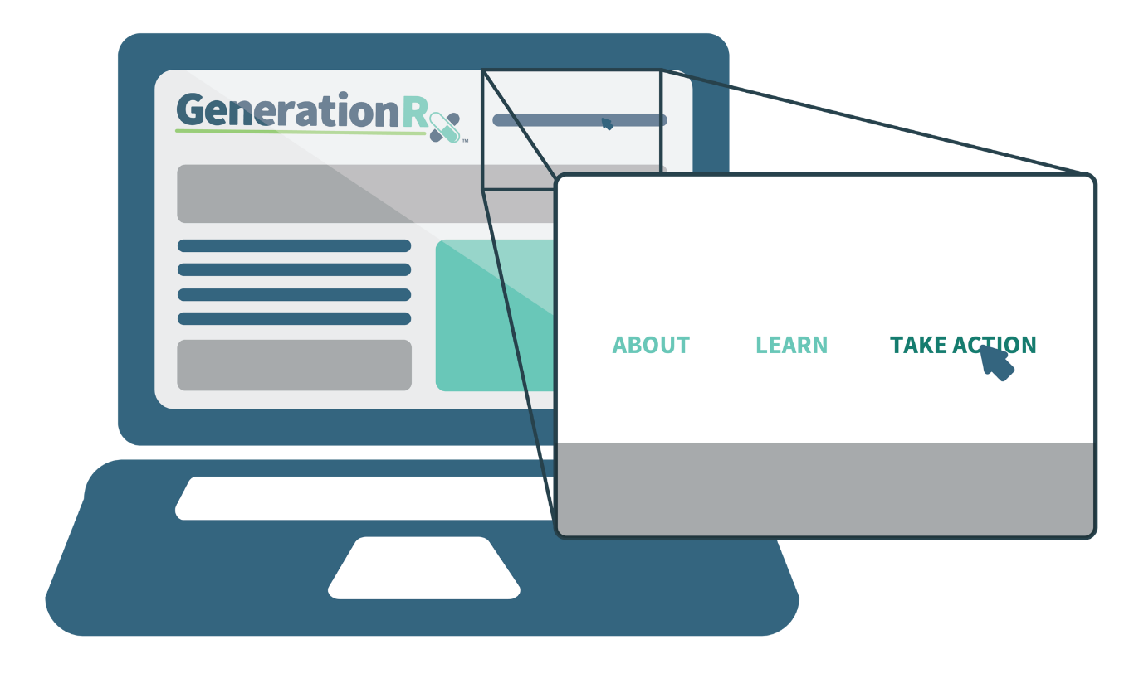
Take action: educate others
Free educational resources
at GenerationRx.org
Notes:
Transition: We also encourage you to take action and share these messages with your family and community. How can you do this?
You can take action at home, by discussing these safe medication practices with your family as well as modeling these safe behaviors. We have a handout (Note for facilitator: distribute the “Take Action” handout or reference where they can pick it up) that summarizes the four key messages we just discussed, including safe places for medication storage as well as safe methods for medication disposal. We encourage you to post this handout in your home, perhaps on a bulletin board or on the refrigerator.
You can take action in your community, by educating others about this issue as well as safe medication practices. Visit our website, GenerationRx.org, to access free, ready-to-use resources designed to educate people of all ages in your community. These resources provide an opportunity for you to present this program to other adults, or present similar educational programs to other audiences using age-appropriate resources.
Lastly, share your experiences. Consider submitting your tips and personal experiences about how you advocate safe medication practices at home or in your community. To do this, visit the ‘Contact’ section of GenerationRx.org. In this same section, you can also submit any questions you may have regarding how to use these educational resources.
Note for facilitator: if technology allows, you may wish to visit GenerationRx.org and showcase the appropriate sections as you talk through this slide.

Slide 23
Questions?
Notes:
Transition: Does anyone have any questions or comments?
Before we end, we do encourage you to take a survey evaluating today’s program on GenerationRx.org. You can find a link to this survey at the bottom of the home page. We value your feedback to help us assess the impact of this work and continually improve Generation Rx materials.
Note to facilitator: we encourage you, as the presenter, to also complete this survey. Thank you for advocating safe medication practices in your community!

